Slide 1
Urban Firewood Co
Proposed Special Use Project

Slide 2
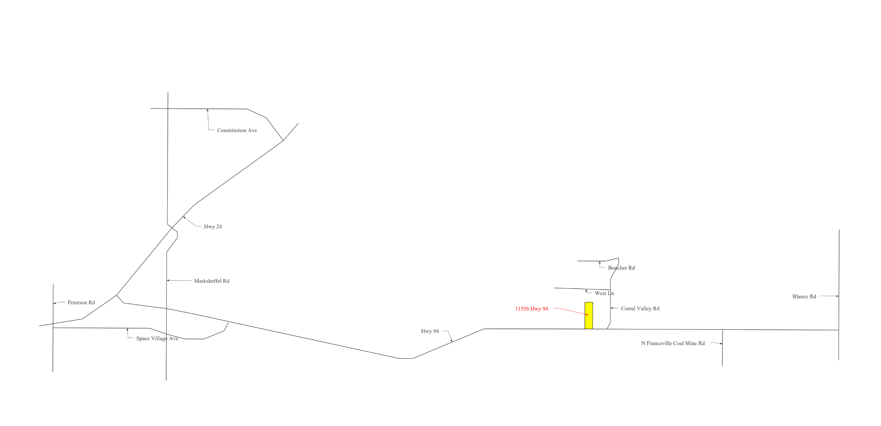
Vicinity Map

Slide 3
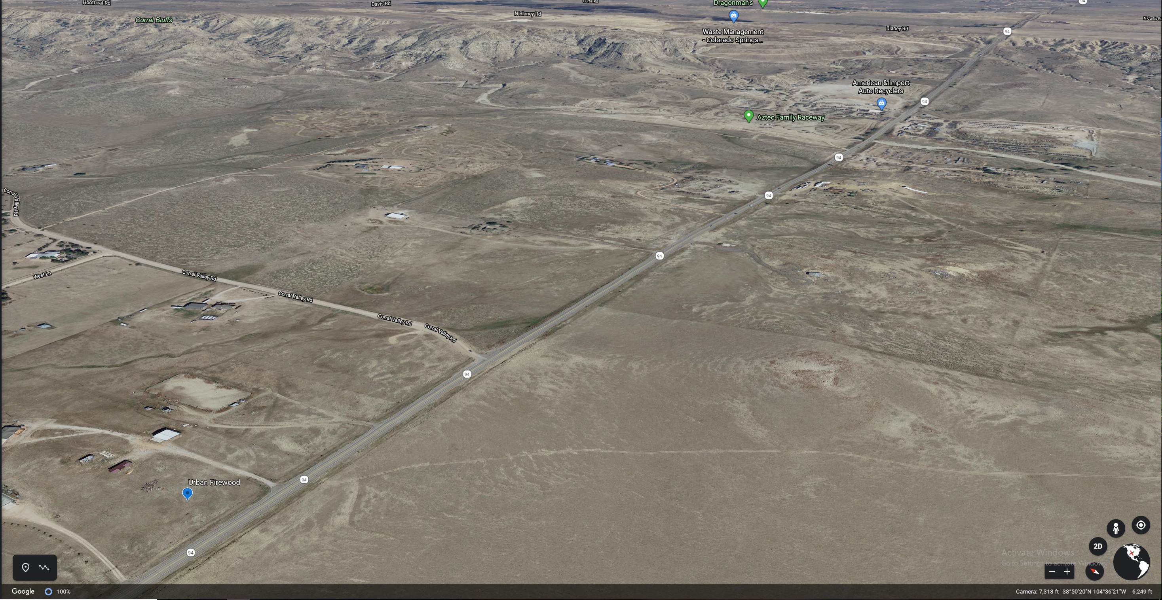

Slide 4
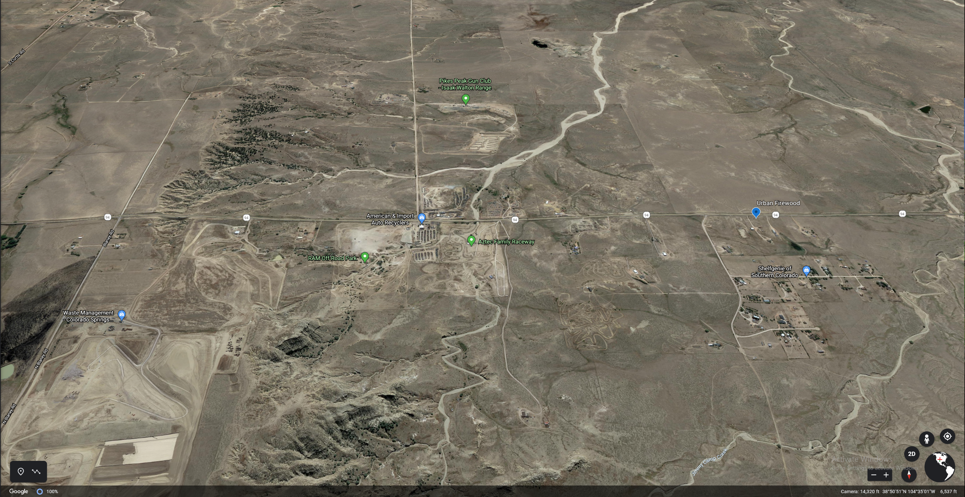

Slide 5
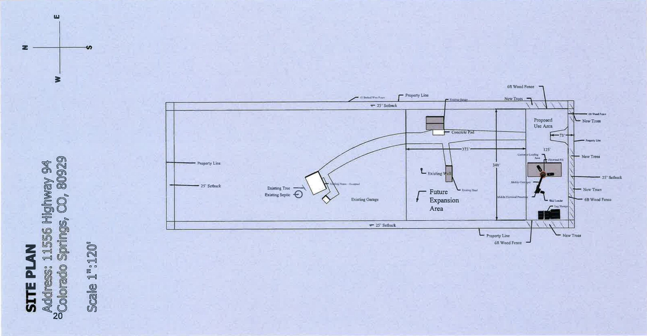
Site Plan

Slide 6
Concerns
Noise
Our firewood processor puts out 75Db of noise. (Commercial Lawnmowers run 100-120DB)
Traffic
Our CDOT permit grants us up to 100 round trips, however we anticipate only 10 to 15.
Curb Appeal
Adding 6ft privacy fence / roadside trees with landscaping
Air Pollution
All of our equipment (3 years or newer) is compliant with California's pollution standards.
Fire Danger
We comply with all county/state fire laws and hold a burn permit (#365067) for mobile fireplaces.

Slide 7
Urban Firewood Demonstration Video

Slide 8
Q&A

