Slide 1
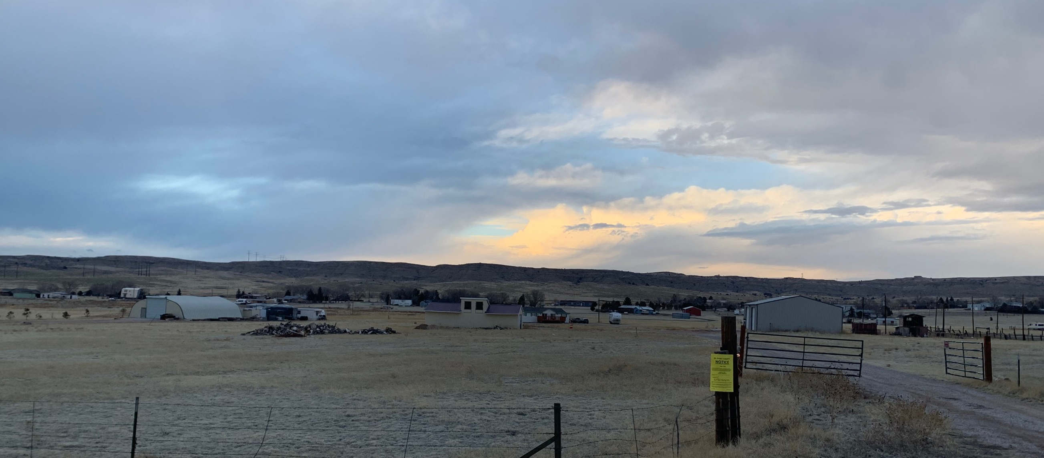
AL-19-019 Urban Firewood
Lindsay Darden, PLANNER ii
Elizabeth Nijkamp, P.E. Engineer Manager

Slide 2
Public input
If you wish to participate remotely and have not already provided a name and a reliable phone number, please email that information to Tracey Garcia at traceygarcia@elpasoco.com at this time.

Slide 3
Overview of Process
Review criteria
Applicant presentation
Staff presentation
Break to call in members of public
Public testimony (allow time between each person to call in the next person)
Break to ensure all members of the public have had an opportunity to speak.
Applicant rebuttal
Discussion and decision
If you wish to participate remotely and have not already provided a name and a reliable phone number, please email that information to Tracey Garcia at traceygarcia@elpasoco.com at this time.

Slide 4
Approval Criteria
5.3.2 Special Use
In approving a special use, the following criteria may be considered:
The special use is generally consistent with the applicable Master Plan;
The special use will generally be in harmony with the character of the neighborhood, and will generally be compatible with the existing and allowable land uses in the surrounding area;
The impact of the special use does not overburden or exceed the capacity of public facilities and services, or, in the alternative, the special use application demonstrates that it will provide adequate public facilities in a timely and efficient manner;
The special use will not create unmitigated traffic congestion or traffic hazards in the surrounding area, and has adequate, legal access;
The special use will comply with all applicable local, state, and federal laws and regulations regarding air, water, light, or noise pollution;
The special use will not otherwise be detrimental to the public health, safety, and welfare of the present or future residents of El Paso County; and/or
The special use conforms or will conform to all other applicable County rules, regulations or ordinances.

Slide 5
Public input
If you wish to participate remotely and have not already provided a name and a reliable phone number, please email that information to Tracey Garcia at traceygarcia@elpasoco.com at this time.

Slide 6
Property Owner
Property Owner: Joseph Yost, Urban Firewood

Slide 7
Overview of Process
Review criteria
Applicant presentation
Staff presentation
Break to call in members of public
Public testimony (allow time between each person to call in the next person)
Break to ensure all members of the public have had an opportunity to speak.
Applicant rebuttal
Discussion and decision
If you wish to participate remotely and have not already provided a name and a reliable phone number, please email that information to Tracey Garcia at traceygarcia@elpasoco.com at this time.

Slide 8
Public input
If you wish to participate remotely and have not already provided a name and a reliable phone number, please email that information to Tracey Garcia at traceygarcia@elpasoco.com at this time.

Slide 9
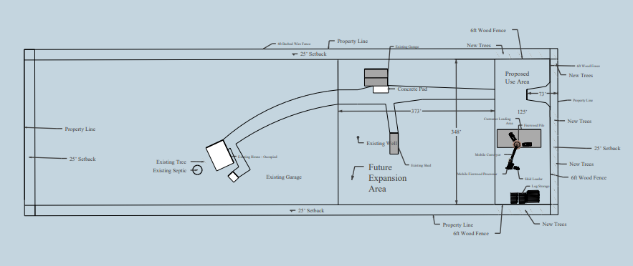
Request
A request by Joseph Yost for approval of a special use for firewood sales in the A-5 (Agricultural) zoning district.
Special uses can be approved administratively; however the PCD Director elevated this request to public hearing due to the opposition received from nearby property owners.
On August 20, 2020, the El Paso County Planning Commission recommended approval with a vote of 7-2.
N

Slide 10
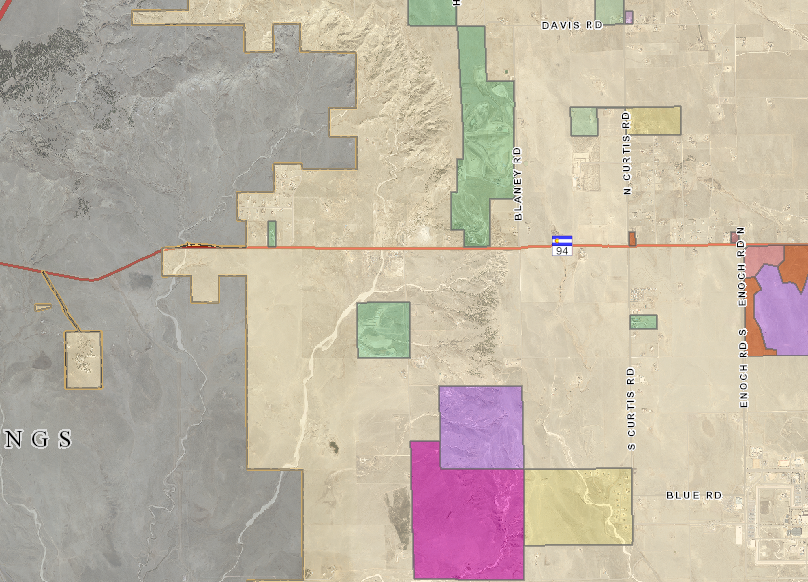
Zoning
The 10.57-acre property is zoned A-5 (Agricultural) and is located on the north side of Highway 94, approximately 0.15 miles west of the Highway 94 and Corral Valley Road Intersection.
The parcel was initially zoned A-4 (Farming) in 1965 when that portion of El Paso County was initially zoned.
In 1978, the parcel was rezoned to A-2 (Agricultural).
A-2 is now known as A-5 (Agricultural) due to nomenclature changes.
SITE

Slide 11
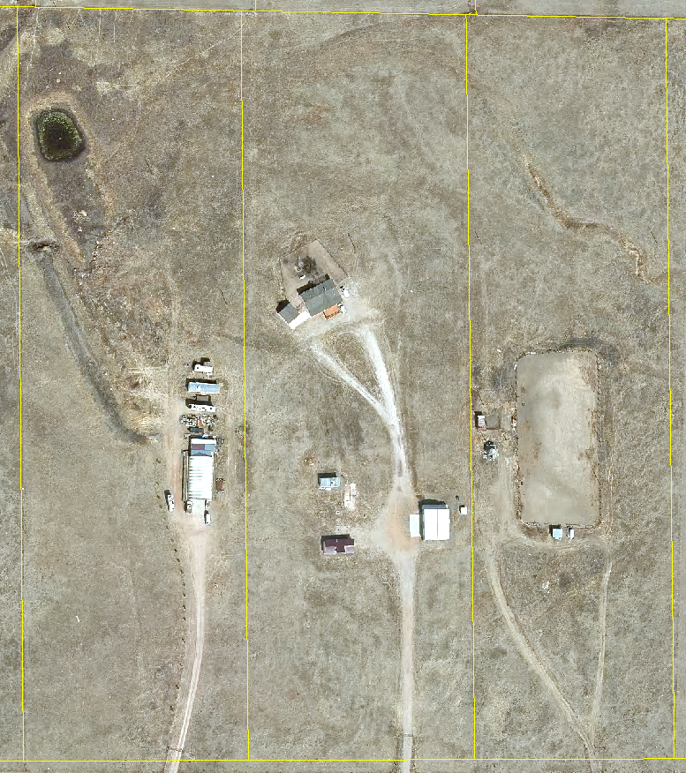
Background
In 1978 a special use for firewood sales was approved.
In 1988 a variance of use to permit retail sales and outside storage was approved for the parcel with an expiration of one year.
In 1989, the applicant requested an extension for the variance of use which was denied by the BoCC.
The property currently has a modular home, detached garage and some sheds and has been used for residential purposes.

Slide 12
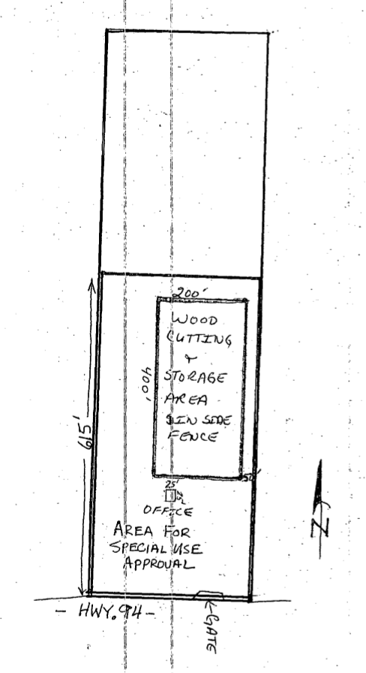
Background
The Code in effect at the time the special use was approved for firewood sales did not require that the approved special use be established within a specific time period or, if abandoned, specify that the special use was no longer valid.
Two Conditions of Approval:
That the eight-foot solid fence be installed per the letter of intent.
That all work and storage be contained within the fenced area.
An Administrative Determination would be required to determine if the previously approved special use could be re-established as depicted in the 1978 special use approval.

Slide 13
Proposed Development
N

Slide 14
Zoning Compliance
Minimum lot size – 5 acres
Setbacks – 25 feet on all sides
Maximum building height – 30 feet
Maximum lot coverage – none
The applicant is not proposing to construct any new structures as part of the current special use request.
N

Slide 15
Land Development Code Analysis
The Code (2019) defines firewood sales as “a freestanding facility for the storage, display and sale of cut wood that is used for fuel. A firewood sales facility may also include wood splitting”.
Firewood sales is permitted in A-5 (Agricultural) zoning district with approval of a special use on parcels with a minimum of 10 acres.
Firewood sales at the front of the site, residential would be maintained at rear of site.
N

Slide 16
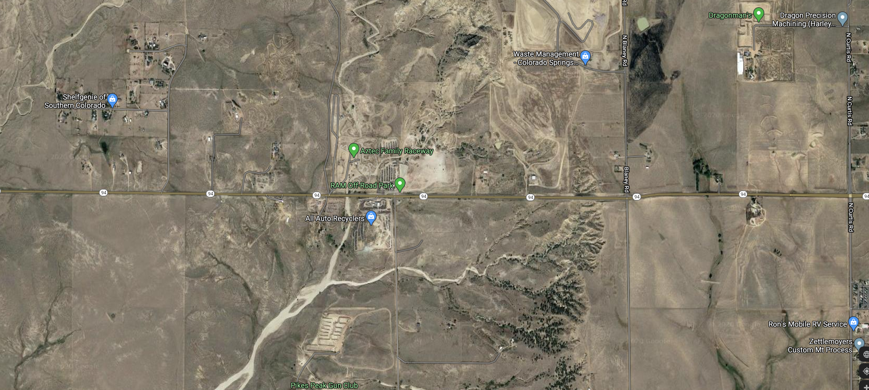
Land Development Code Analysis
Nearby Non-Residential Uses

Slide 17
Land Development Code Analysis
The applicant has indicated the proposed machinery will emit 75 decibels of noise. For reference, the average commercial riding lawn mower emits 100-120 decibels.
The site is not located within a fire protection district; however Ellicott Fire Protection District has an existing memorandum of understanding with the El Paso County Sheriff’s department to provide emergency response to fires, accidents, and medical events.

Slide 18
El Paso County Policy Plan (1998)
Policy 6.4.6 - Allow for the accommodation of necessary supporting commercial uses within or in proximity to rural residential areas in a manner that preserves the rural character of these areas.
Policy 6.3.8 - Recognize the need and allow for the reasonable accommodation of adequate amounts of land with sufficient infrastructure for land uses of a heavy industrial nature and/or considered to be "locally undesirable" within all subareas of the County provided that adequate facilities and services will be available. Consider the environmental, visual and land use compatibility impacts and incorporate, where possible, buffering and screening techniques to address compatibility with surrounding uses.
Policy 6.1.11 - Plan and implement land development so that it will be functionally and aesthetically integrated within the context of adjoining properties and uses.
Policy 7.1.1 - Accommodate unique combinations of land uses (such as employment and residential uses) on the same property if it can be demonstrated that aggregate impacts will be limited, adequate facilities and services will be available, and the use will be compatible with the character of the surrounding area.
Policy 7.1.2 - Consider the future combined impact of potential additional land use requests when considering individual applications for special or unique land uses.
Policy 12.1.6 - Support efforts to provide structural fire protection for those areas where such protection currently does not exist.

Slide 19
El Paso County Policy Plan (1998)
Firewood sales could support the nearby rural residential neighborhoods.
Existing modular home on-site will be occupied by an employee of the business.
Less intense residential use near the rear of the property and firewood sales at the front of the parcel.
Applicant is proposing a 6-foot tall opaque wood fence and new trees to screen the proposed use and mitigate visual impacts to surrounding parcels.
Proposed firewood sales is not anticipated to conflict with the rural character of the surrounding area.
More intense non-residential uses in the vicinity of the parcel.

Slide 20
El Paso County Water Master Plan (2018)
The El Paso County Water Master Plan (2018) has three main purposes; better understand present conditions of water supply and demand; identify efficiencies that can be achieved; and encourage best practices for water demand management through the comprehensive planning and development review processes.
The site is located in Region 8 and there are currently no central water suppliers.

Slide 21
El Paso County Water Master Plan (2018)
The existing residential use is served by a private residential well that does not permit water withdrawal for commercial use.
The only water proposed to be used is to establish and sustain the required landscaping proposed to help screen the use.
The applicant has indicated that water will be purchased and brought to the site to irrigate the landscaping.
Because there is no structure proposed for the firewood sales use, the EPC health dept. has authorized use of portable toilet for employee use.

Slide 22
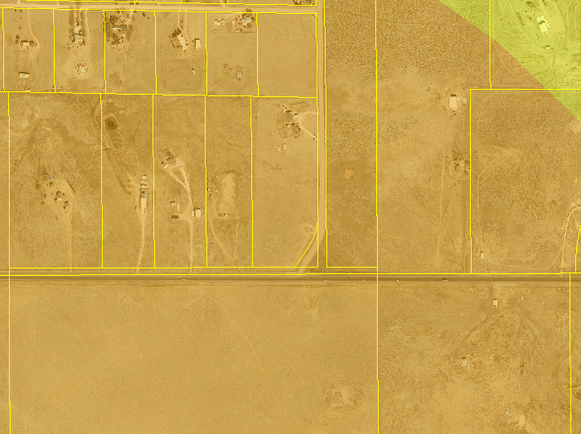
Wildlife
The El Paso County Wildlife Habitat Descriptors (1996) identifies the parcel as having a high wildlife impact potential due to potential habitat for swift fox, a species of concern.

Slide 23
Drainage and Erosion Control
The property is located in the Jimmy Camp Creek drainage basin (FOFO2000), which is included in the Drainage Basin Fee Program; however, drainage and bridge fees are not assessed with special use requests.
No land disturbance is anticipated; therefore, no grading/erosion control plan will be required.

Slide 24
Transportation
The property is accessed via State Highway 94.
A traffic impact study is not required, and the County Road Impact Fee does not apply to this request because the special use is not expected to generate 100 more daily vehicle trips than the property would be expected to generate without the special use request being approved.
A CDOT access permit is required and has been obtained (access permit No. 219085).

Slide 25
Posting
The Planning and Community Development Department notified 7 adjacent property owners on July 29, 2020 for the Planning Commission Meeting.
15 letters of opposition were received.
1 retraction of letter of opposition was received.
Neighborhood Meeting on May 20, 2020. One attendee.

Slide 26
Conditions and Notations
Conditions
Approval is limited to the firewood sales use as discussed and depicted in the applicant’s letter of intent and the attached site plan exhibit.
Approval of a site plan shall be required prior to initiating the use.
Notations
The special use approval includes conditions of approval and the accompanying site plan. No substantial expansion, enlargement, intensification or modification shall be allowed except upon reevaluation and public hearing as specified in the El Paso County Land Development Code.
The Board of County Commissioners may consider revocation and/or suspension if zoning regulations and/or special use conditions/standards are being violated, preceded by notice and public hearing.
If the special use is discontinued or abandoned for two (2) years or longer, the special use shall be deemed abandoned and of no further force and effect.

Slide 27
Overview of Process
Review criteria
Applicant presentation
Staff presentation
Break to call in members of public
Public testimony (allow time between each person to call in the next person)
Break to ensure all members of the public have had an opportunity to speak.
Applicant rebuttal
Discussion and decision
If you wish to participate remotely and have not already provided a name and a reliable phone number, please email that information to Tracey Garcia at traceygarcia@elpasoco.com at this time.

Slide 28
Public input
If you wish to participate remotely and have not already provided a name and a reliable phone number, please email that information to Tracey Garcia at traceygarcia@elpasoco.com at this time.

Slide 29
Questions?
N

