Slide 1
Updates and Opportunities
June 8, 2020

Slide 2
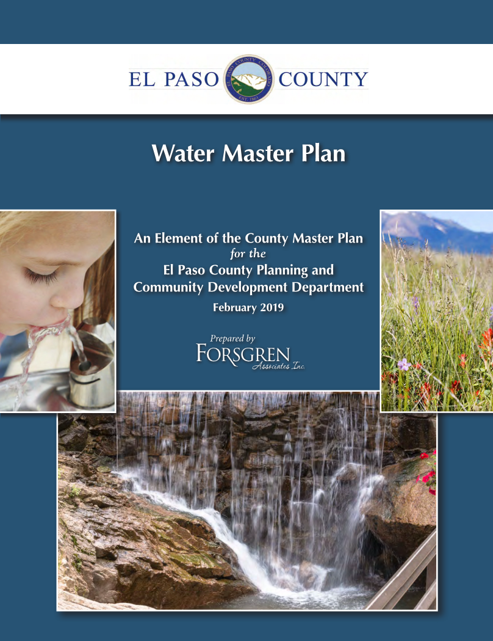
Continuation of Award Winning Planning Efforts
The Master Plan process is intended to build upon the
successful completion and ongoing implementation of
the Water Master Plan.
Adopted in 2018
2019 Merit Award – Colorado Chapter of the American Planning
Association (APA)
2020 Achievement Award – National Association of Counties (NACo)

Slide 3
Master Planning Process To Date
4 Fundamental Steps
Where are we now? – Created a profile of the current status of El Paso County (good, bad and ugly)
Completed early 2019
Where are we going? – Analyzed data specific to the County and identified trends (industries, growth, demographics, etc.)
Completed late 2019
3. Where do we want to go? – Creating the vision for the future of El Paso County
Completed early 2020
How do we get there?
Underway currently - https://elpaso-hlplanning.hub.arcgis.com/
Anticipated completion of the full Master Plan document in late 2020 or early 2021

Slide 4
Planning for the Future of El Paso County
Three Components to Help Us “Get There”:
Placetypes – currently seeking public input (released June 1st)
Key Areas
Areas of Change
https://elpaso.hlplanning.com/pages/placetypes-outreach--el-paso

Slide 5
Planning for the Future of El Paso County
What are Placetypes?
Rural Areas
Residential Areas (Large-Lot, Suburban, and Urban)
Centers (Rural, Regional, and Employment)
Sensitive Areas (Regional Open Space and Mountain Interface)
Military Installations and Incorporated Areas
Utility areas
Benefits:
Based on the unique character of certain areas at a neighborhood scale
Tend to be more easily translated into zoning
Accounts for both primary and secondary land uses based on compatibility and function

Slide 6
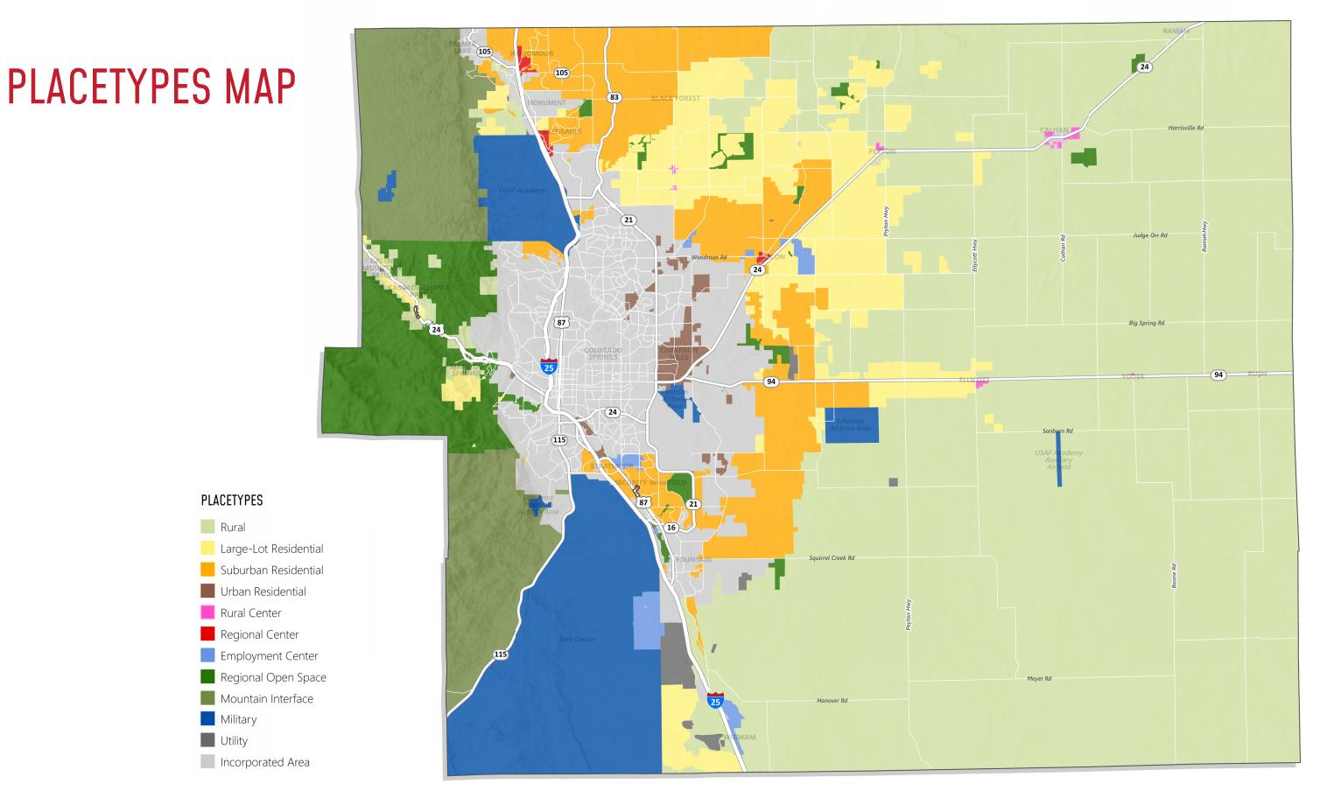

Slide 7
Planning for the Future of El Paso County
Up Next?
Key Areas (June 15th release)
Areas likely to be annexed
Small Towns and Rural Communities
Forested Areas
Pikes Peak Influence Area
Etc.
Areas of Change (June 29th release)
Protected/Conservation
No Change or Minimal Change
Infill and Redevelopment
New Development
Etc.

