Slide 1
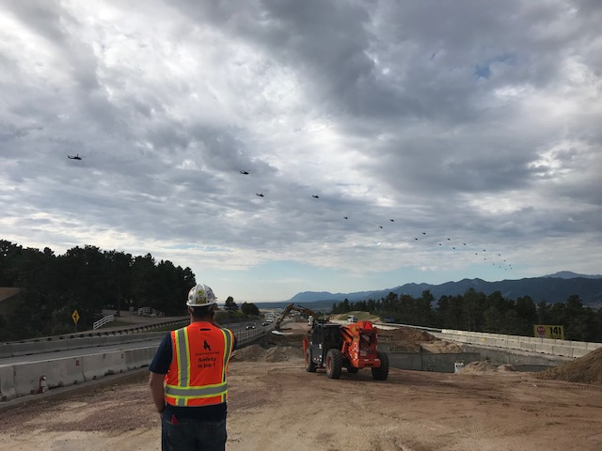

El Paso Board of County Commissioners
Paul Neiman, South Gap Project Director
June 30, 2020

Slide 2

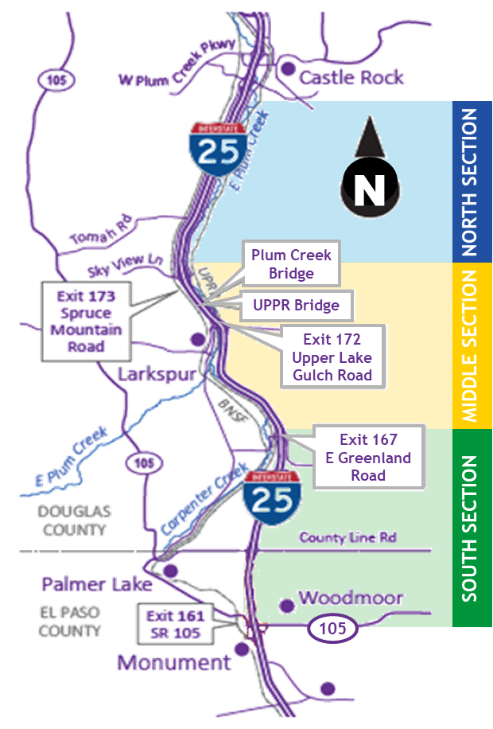
Project Overview
18 miles of I-25 reconstruction to improve safety and trip reliability
South of Castle Rock to Sky View Lane (5 miles)
Express Lanes
New pavement
Wider, safer shoulders
Package 1
Package 3
Sky View Lane to Greenland Road (6 miles)
New Express Lanes, pavement, and full safety shoulders
Interchange bridge replacements at Upper Lake Gulch Road, Spruce Mountain Road
Replacement of bridge over Plum Creek
One new wildlife crossing bridge
Continuous auxiliary lane between Skyview and Spruce Mtn Road
Package 2
Greenland Road to Monument (7 miles)
New Express Lanes, pavement, and full safety shoulders
Three new wildlife crossings bridge
Interchange bridge replacement at Greenland
New truck climbing lane on SB I-25 (Greenland to the Port of Entry, 5 Miles)
Package 4
County Line Road / Palmer Divide Bridge
Interchange bridge replacement
Added shoulders and left turn pockets
Overall safety improvements to all packages include: wildlife fencing, wildlife crossings, ITS cameras, drainage, 6-inch striping, guardrail, impact devices, and lighting

Slide 3
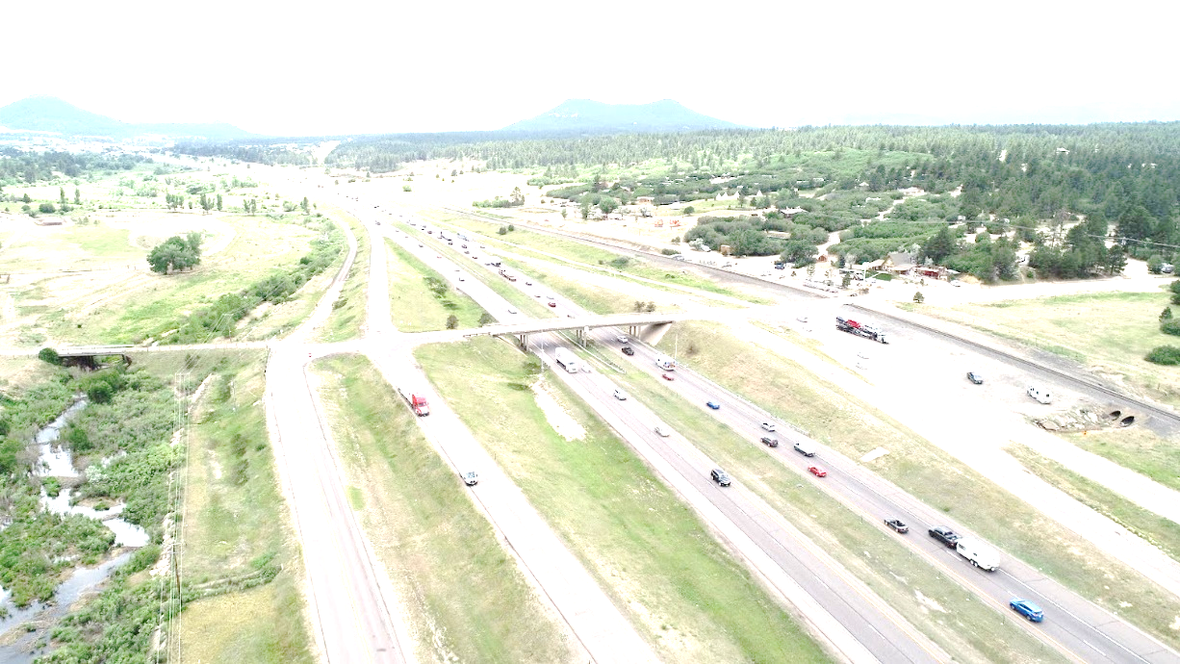
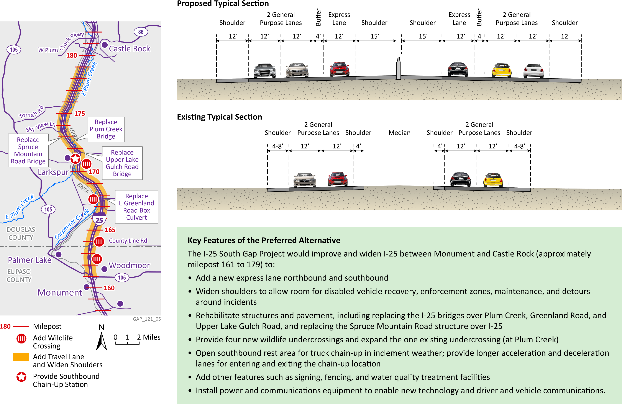
Typical Cross Section

Slide 4
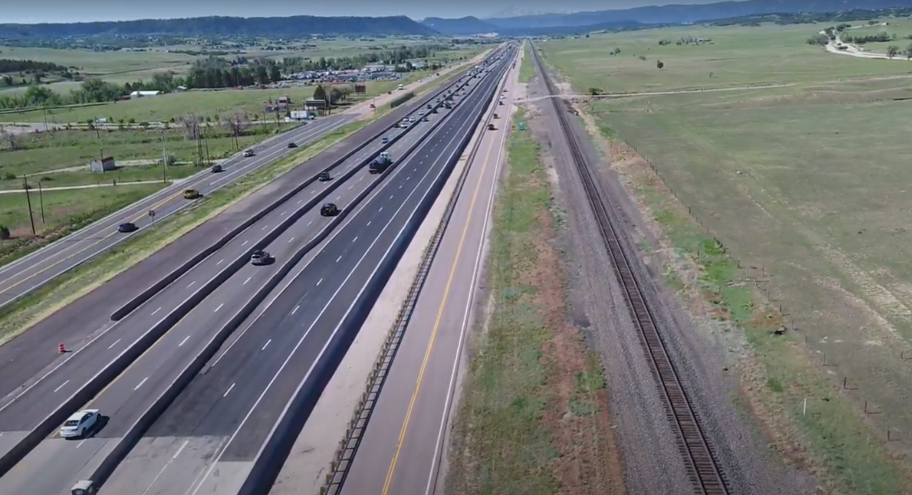
Construction Update – North Section
North Section (Pkg 1)
South of Castle Rock to Sky View Lane (5 miles)
Construction began September 4, 2018
Estimated 81% complete
Work completed to date:
Frontage Road drainage work
Median barrier walls
Paving
SB I-25 shifted to final alignment on new pavement
Removed 4 miles of temporary concrete barrier
Upcoming work:
NB I-25 traffic shifts to outside of roadway
Continue temporary barrier removal
Frontage road barrier work in August (10-day closure)
Tomah Rd. Signal Project to begin June 15th, coordinating with Douglas County
More Paving
Issues:
No major issues at this time

Slide 5
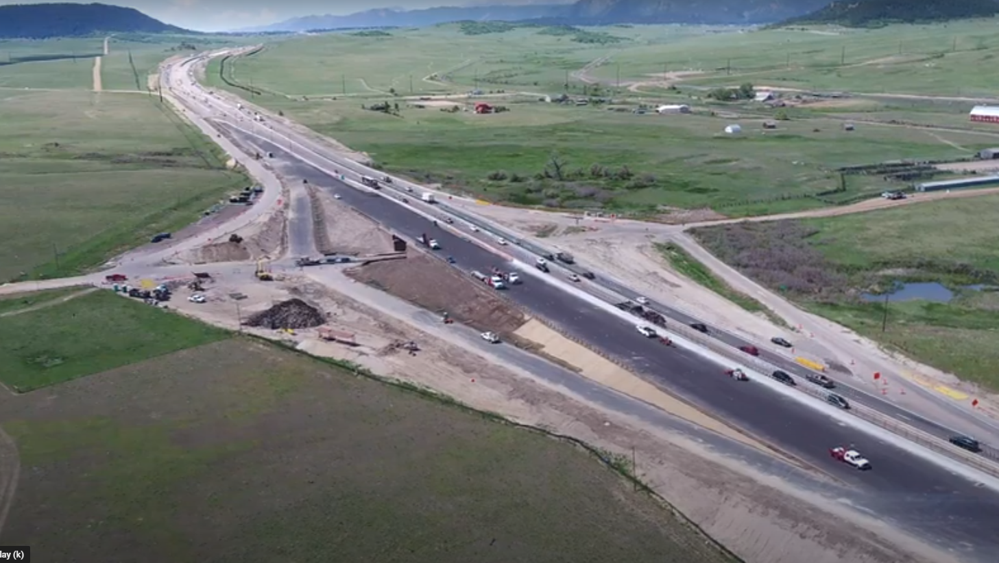
Construction Update – South Section
South Section (Pkg 2)
Greenland Road to Monument (7 miles)
Construction began December 1, 2018
Estimated 53% complete
Work completed to date:
Drainage and bridge work
East portion of Greenland bridge complete
All traffic shifted onto new East portion of the Greenland bridge
Work has begun on West portion of the bridges
SB I-25 on- and off-ramps at Greenland closed for 45 days starting June 25th
Upcoming work:
Monument Hill Frontage Road, 7-month closure starting in July for wildlife crossing
Three wildlife crossing bridge structures under construction
SB I-25 Monument Hill truck climbing lane construction
And more paving!
Issues:
Unsuitable materials/subgrades

Slide 6
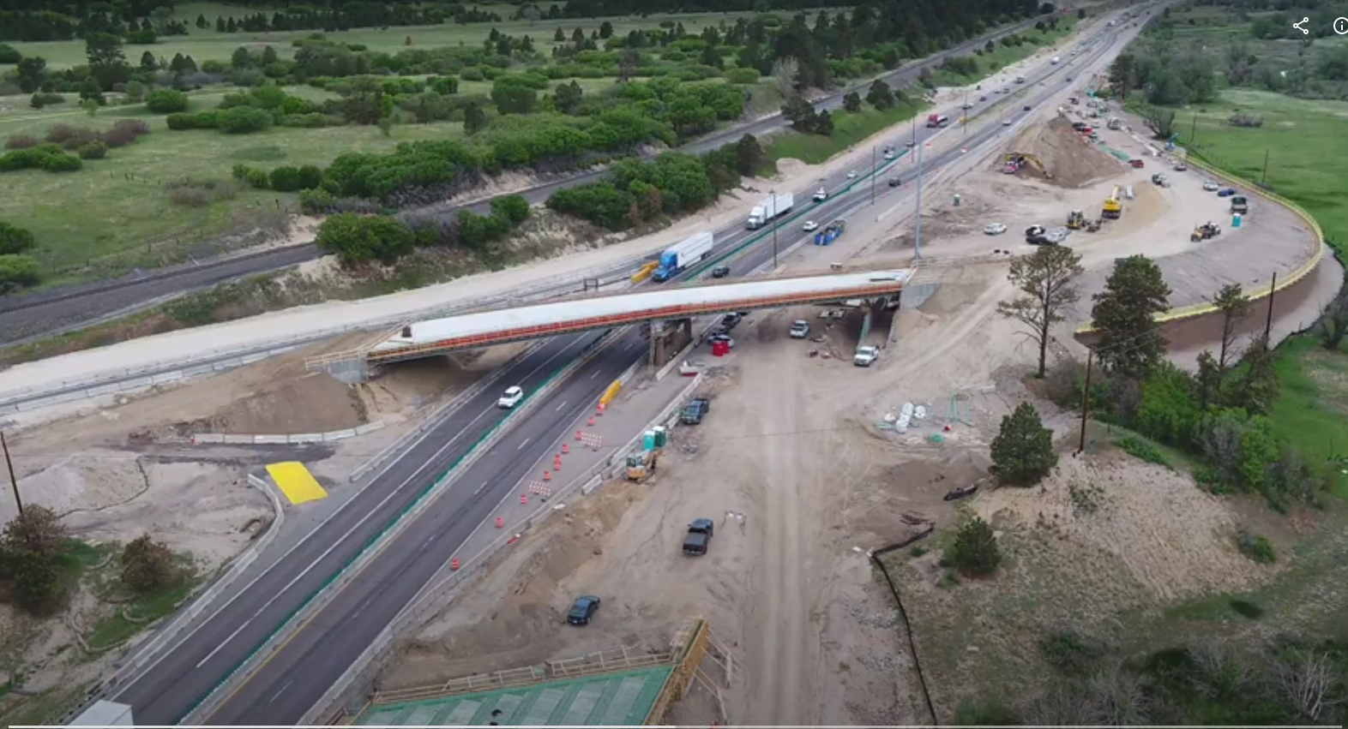
Construction Update – Middle Section
Middle Section (Pkg 3)
Sky View Lane to Greenland Road (6 miles)
Construction began August 7, 2019
Estimated 31% Complete
Work completed to date:
Spruce Mountain, Plum Creek, Upper Lake Gulch, and RR bridge under construction
Upcoming work:
Continued bridge construction
Traffic switches and overnight short detours at Upper Lake Gulch
Complete drainage at Spruce Mountain bridge (Fall re-open)
Drainage and earth work
More paving!
Issues:
Spruce Mountain bridge has some delays due to drainage issues
Unsuitable materials/subgrades

Slide 7
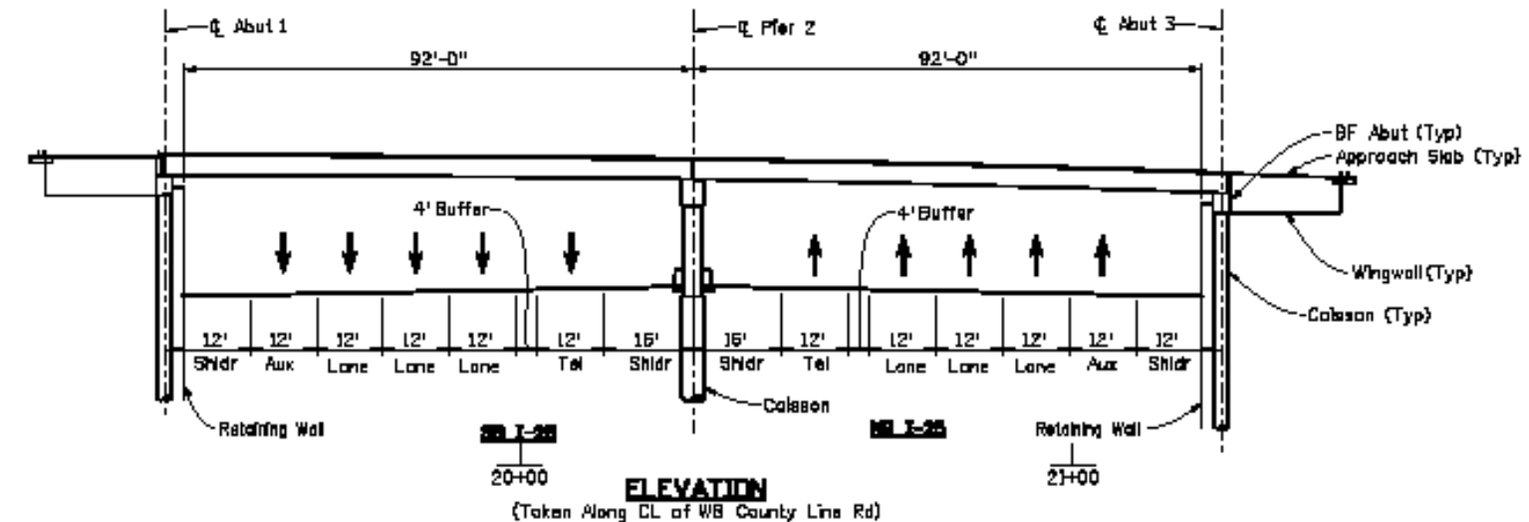
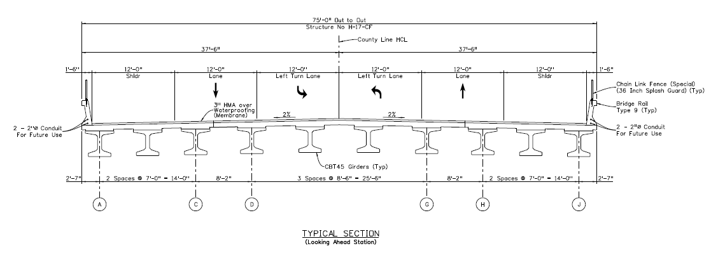
Construction Update – Package 4 (County Line Road Bridge)
County Line Road Bridge Replacement
Begin construction by the end of 2020/early 2021
30% design plans available for comment and review
General Requirements:
Two lanes open on County Line Road during all phases of construction
Two 12’ through lanes
Minimum 10’ shoulders on County Line Road between the ramps
Two continuous 12’ left turn lanes on County Line Road between the ramps
New bridge will accommodate the PEL’s recommended I-25 typical section

Slide 8
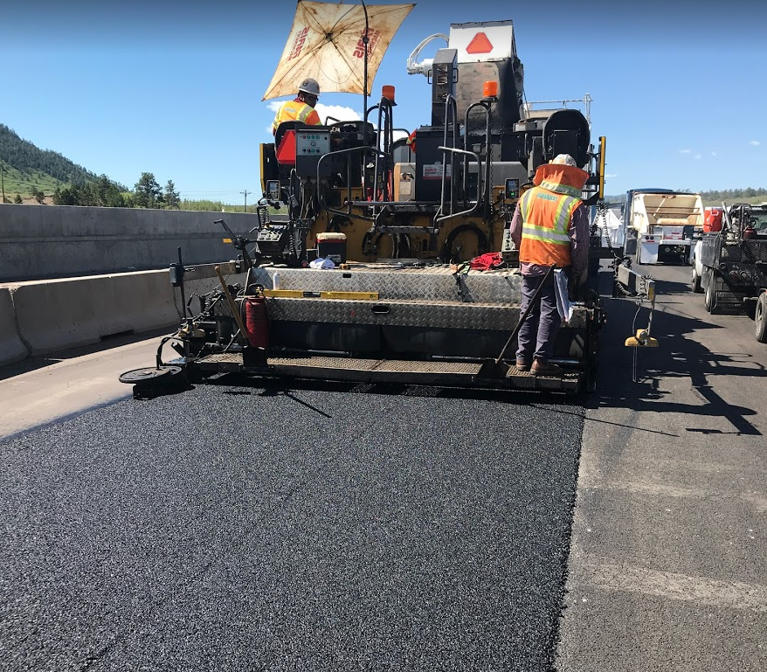
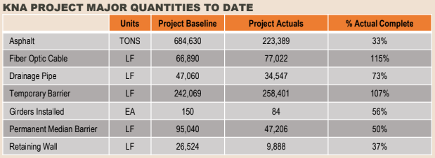
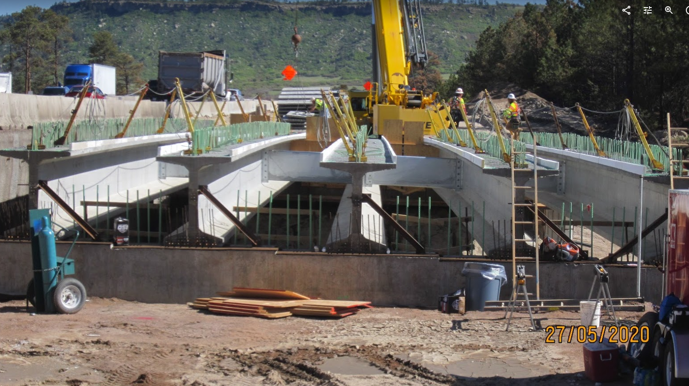
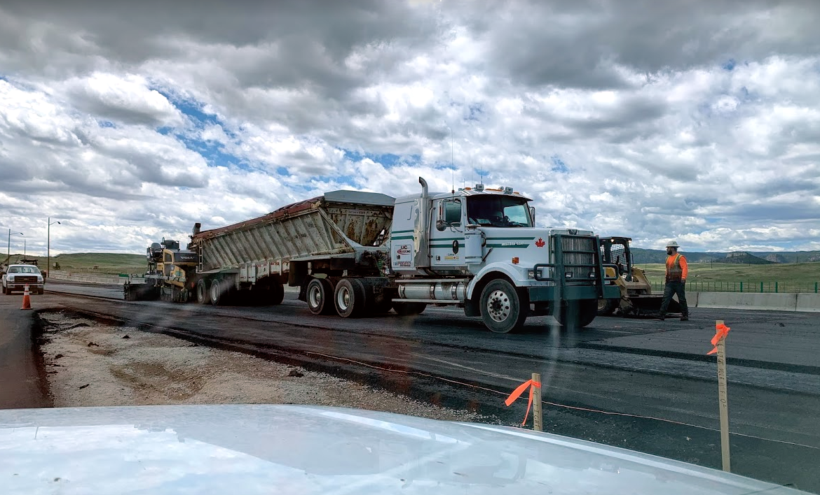
Construction Update – Summary
COVID-19 impacts
Project is tracking for possible issues and delays due to COVID-19.
Productivity is slower, but schedule has been maintained through added daytime lane closures and resequencing of work
Project has not advanced due to lighter traffic volumes
Project continues to monitor for possible impacts to schedule
Construction Schedule Summary…Summer 2020 will be HUGE!
North section substantial completion in November 2020
Overall project is on schedule for fall 2022 completion
Summer 2020…
350,000 tons of asphalt to be placed this year
Temporary asphalt plant operating in gravel pit onsite
13,000 LF of cast in place retaining wall structures
7 miles of concrete median barrier
2,500 LF sound wall
Deer fence, deer guards, drainage pipe, ITS features, permanent signing, etc.
Work continues day and night, weekdays and weekends
Lane closures occurring overnight
Overnight ramp closures will continue through summer at Upper Lake Gulch, Greenland, Spruce Mountain, and Sky View, alternating
Budget Summary
As of May 25, 2020, $153 million of work completed
629 days in construction as of May 25, 2020

Slide 9
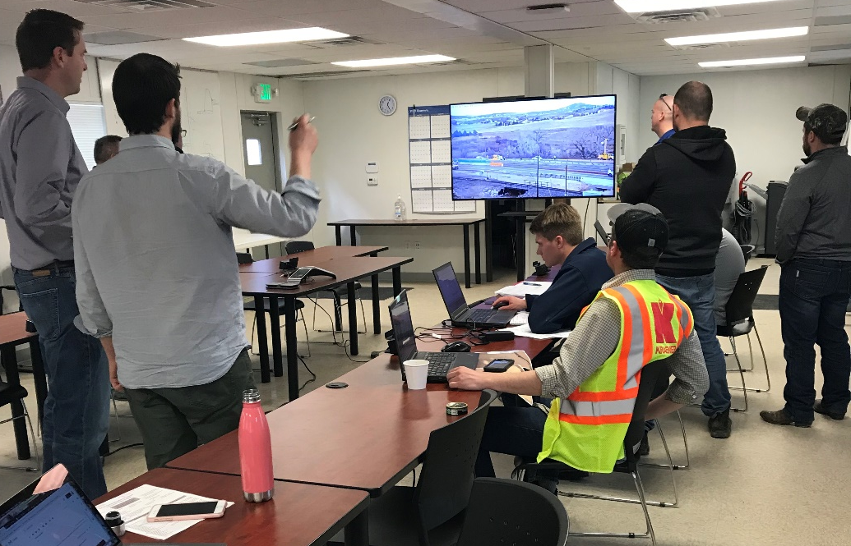
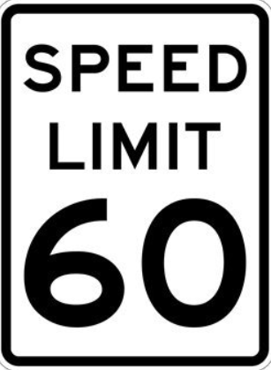
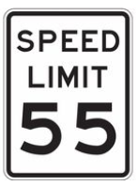
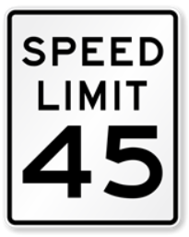
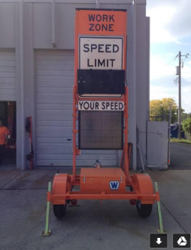
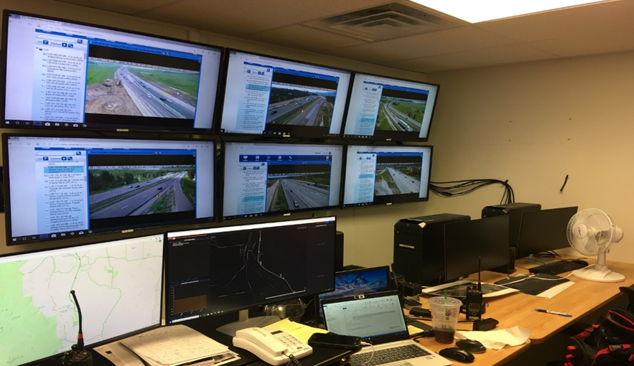
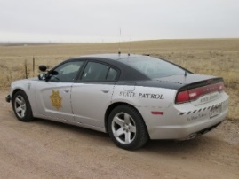
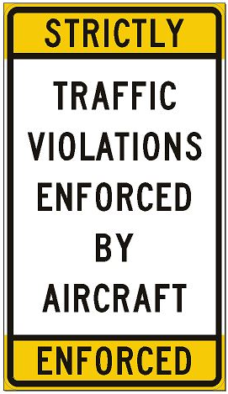
CDOT Safety Efforts
Reduced speed limits (by time of day)
Smart Work Zone System devices:
  Portable Variable Speed Limit (PVSL) signs
  Queue detection and truck entering/exiting warning systems
  Portable message boards (Remote)
Implemented a Project Operations Center
Courtesy Patrol (Tow trucks)
Added Traffic Control Vehicles (TMA’s, UTC’s)
Frequent restriping to help with delineation, including solid striping at curves and 6-inch temporary striping
Increased law enforcement, CSP (by ground and by air)
Hold biweekly meetings with first responders to discuss and improve incident response
Provide accurate and timely information to motorists through texts, e-blasts and Facebook

Slide 10
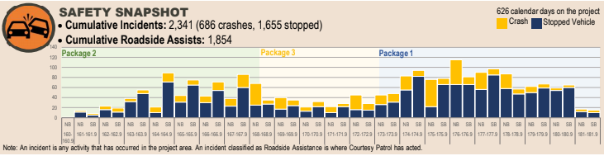
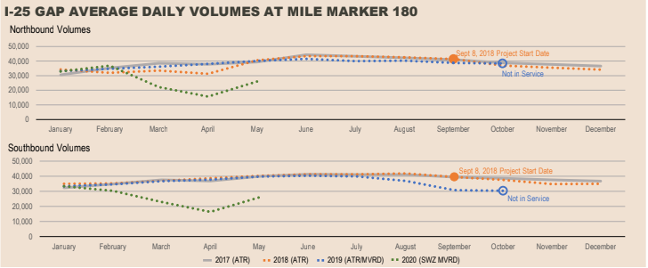
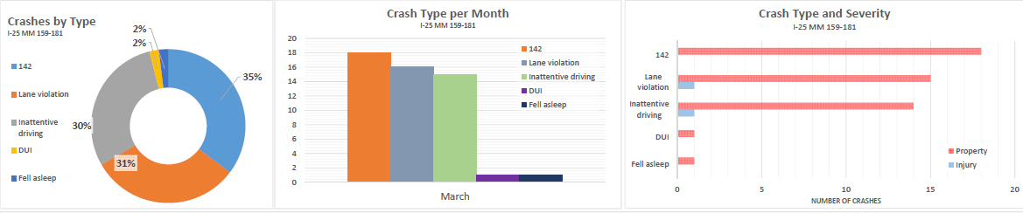
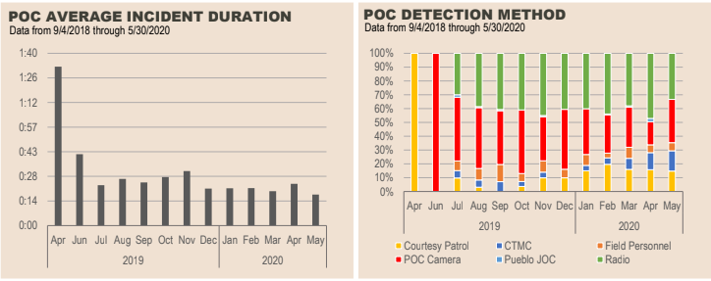
CDOT Safety Efforts – Incident Tracking
Project Courtesy Patrol Data only
CSP Data
Since COVID-19, the Gap has seen the same amount of tickets issued as the previous year during the same time
250 tickets in 9 days, mostly for speeding
Even though there was about a 50% decrease in traffic volumes, crashes did decrease, but not by 50%
66% of crashes in the Gap are rear-ends which cause 80% of injury crashes
Impaired driving is on the rise… anecdotally citations up 200% in the Gap
Project Operation Center has helped reduce incident response rates from 40 to 20 minutes
Project is evaluating weekly “Hot Spot” data for issues

Slide 11
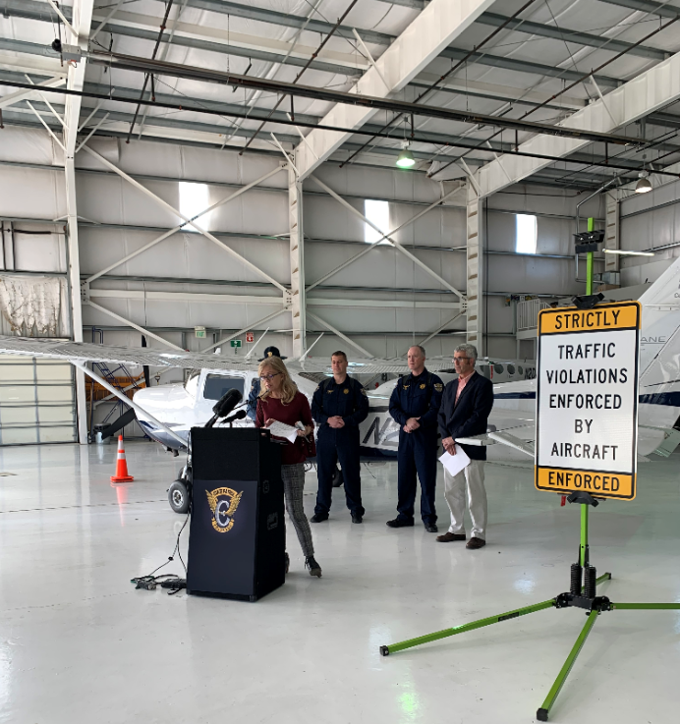
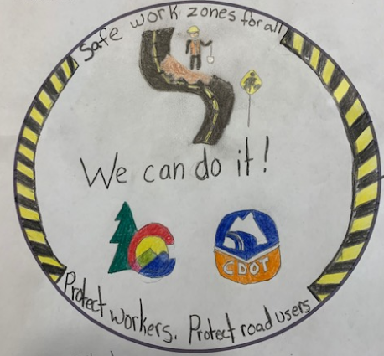
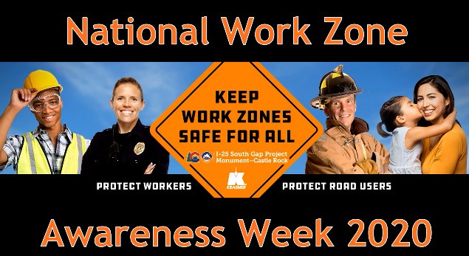
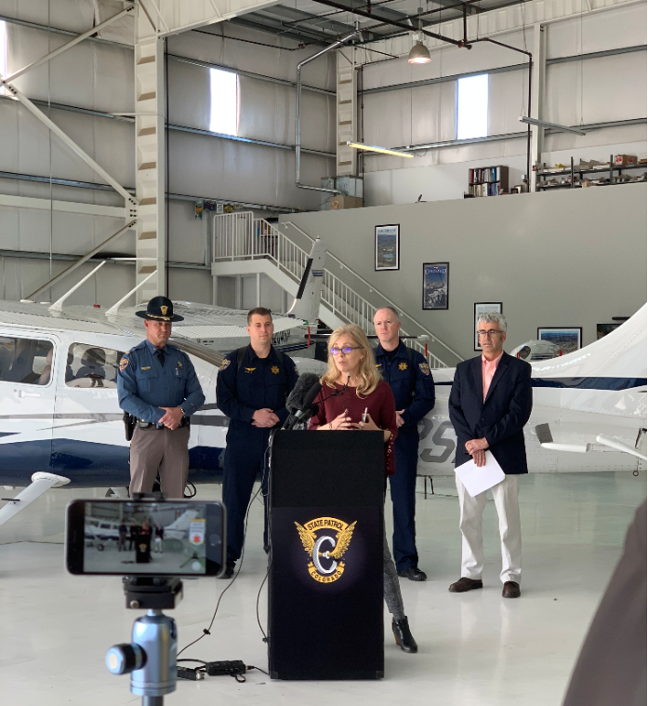
Public Information Update
Project Outreach to date:
Text Subscribers: 3,275
Facebook Followers: 2,675
E-blast Subscribers: 2,543
News Releases: 31 (Work Zone Awareness, logo contest, traffic impacts, project updates)
Hotline Calls/Emails: 1,196/859
March 11, 2020 - CSP Aircraft Enforcement Media Event
March 25, 2020 – PPACG project update
June 10, 2020 – Denver South Economic Development Forum
June 12, 2020 – Project Stakeholders Quarterly Meeting

Slide 12






Stay Informed
REACH OUT TO US
Paul Neiman: (303) 907-8931 or paul.neiman@state.co.us
CALL OUR HOTLINE
(720)745-5434
REGISTER FOR ALERTS
Text I25Gap to 21000
VISIT OUR WEBSITE
i25gap.codot.gov
FOLLOW US ON FACEBOOK
@I25SouthGapProject
EMAIL US
i25gap@codot.us

