Slide 1
El Paso County Board of County Commissioners Road Map Forward for El Paso County
Presented by: Susan Wheelan, El Paso County Public Health Director, Dr. Robin Johnson, El Paso County Public Health Medical Director, and Dr. Leon Kelly, El Paso County Coroner/El Paso County Public Health Deputy Medical Director
Supported by Public Health Leadership, Office of Data and Analytics, and Communicable Disease and Epidemiology
To: El Paso County Board of County Commissioners
Date: June 9, 2020

Slide 2
Factors to Consider Moving Forward
Objective: Broadly open more sectors of our economy in a safe manner
Strategies: Monitoring, mitigation, education, engagement
Social determinants of health
Public Health 3.0
Infection – viral exposure over period of time
Education and outreach to help people make the most informed decisions
Disease prevention measures
Special guidelines for high-risk populations
Prevent • Promote • Protect
www.elpasocountyhealth.org

Slide 3
The Social Determinants of Health
Public Health and the Social Determinants of Health
Social determinants of health include the conditions in which people are born, live, learn, work, play, and worship
Examples:
Availability of resources to meet daily needs (e.g., access to healthy foods)
Access to health care
Access to educational, economic and job opportunities
Availability of community-based resources
Transportation
Public safety
Social support
Socioeconomic conditions
Prevent • Promote • Protect
www.elpasocountyhealth.org

Slide 4
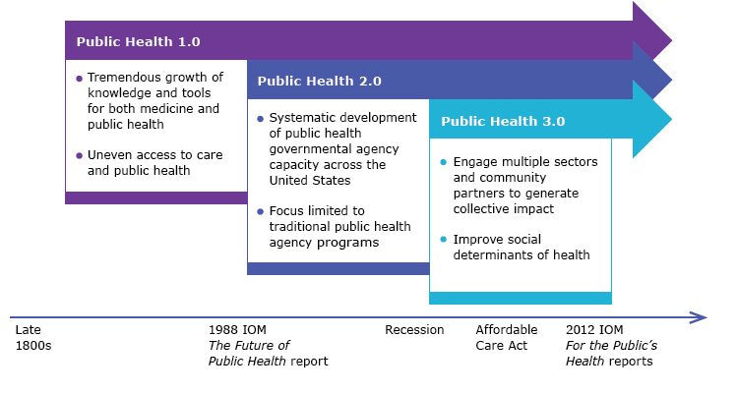
Public Health 3.0
Prevent • Promote • Protect
www.elpasocountyhealth.org

Slide 5
Public Health 3.0 - Modernizing Public Health
Public Health 3.0 model – local public health agencies serve as Chief Health Strategists, driving upstream initiatives in their community to enhance collective impact
Address social, environmental, and economic conditions that affect health and health equity
Key components:
Multi-sector partnerships
Data, analytics and metrics
Leadership and workforce
Essential infrastructure
Sustainable funding
Prevent • Promote • Protect
www.elpasocountyhealth.org

Slide 6
Infection – Viral Exposure Over Period of Time
Infection = exposure to virus x time
For COVID-19, estimated that approximately 10-15 minutes of exposure with less than six feet of physical distance is enough to obtain infection
A cough releases about 3,000 droplets at 50 mph (large droplets)
A sneeze releases about 30,000 droplets at 200 mph (small droplets)
During this phase, social distancing is still critical
Wearing a face covering in public is equally as important, particularly if social distancing is not possible
Prevent • Promote • Protect
www.elpasocountyhealth.org

Slide 7
Education and Outreach
Providing education to empower people to make the most informed decisions
Public Health provides the current data and local trends and shares with our community, so our residents have the knowledge they need to safely begin to engage in more activities
Interpretation of the data in the larger context
Understanding the data, risk, and how the virus is circulating in our community
Continue to share messaging on the importance of preventive hygiene and steps people can take to protect themselves as our economy continues to reopen
Prevent • Promote • Protect
www.elpasocountyhealth.org

Slide 8
Disease Prevention Measures
Frequently wash hands with soap and water for at least 20 seconds
If soap and water isn't available, use hand sanitizer after interactions with people or objects
Cough or sneeze into inner elbow, not hands
Frequently clean high-touch surfaces
Avoid touching your face
Maintain six feet of physical distance
Wear face coverings when in public and in close proximity to others
Get tested if you are experiencing symptoms
Stay home if you are sick
Prevent • Promote • Protect
www.elpasocountyhealth.org

Slide 9
What is Contact Tracing
Core disease control measure that has been used for decades
Used by health departments to prevent disease outbreaks
Key strategy to mitigate the spread of COVID-19 in our community
Tool we use to help track disease – it is not about invading privacy or tracking individuals
Usually involves a quick phone call with skilled and highly-trained Public Health staff, and the main goal is to protect you and the ones you love
Critical component as we continue to re-open our economy – it will make it easier for Public Health to help track cases, prevent outbreaks, and contain any outbreaks to small areas/groups of people
Prevent • Promote • Protect
www.elpasocountyhealth.org

Slide 10
How Does Contact Tracing Work?
Prevent • Promote • Protect
www.elpasocountyhealth.org

Slide 11
Special Guidelines for High-Risk Populations
High-risk populations include:
Individuals who are 65 years and older
Individuals with chronic lung disease or moderate to severe asthma
Individuals who have serious heart conditions
Individuals who are immunocompromised
Pregnant women
Individuals determined to be high risk by a licensed health care provider
People in these categories are still encouraged to remain at home as much as possible and avoid unnecessary social interactions
Practice social distancing
Gather in small groups, no more than 10
Prevent • Promote • Protect
www.elpasocountyhealth.org

Slide 12
Metrics
Incidence
Age demographics
Hospitalizations
Fatalities
Outbreaks
Community coordination for mitigation
Testing
Treatment
Vaccine/herd immunity
Prevent • Promote • Protect
www.elpasocountyhealth.org

Slide 13
Next Steps Forward
Proposing a further re-opening of the economy
Strategic, comprehensive and streamlined re-opening plan
Continuing to work with partners across multiple sectors so we can create a dialed approach
Flexibility to adapt our approach based on the trends we are seeing
Prevent • Promote • Protect
www.elpasocountyhealth.org

Slide 14
QUESTIONS
Prevent • Promote • Protect
www.elpasocountyhealth.org

