Slide 1
2020 Budget Report May 2020
Nikki Simmons, CPA, CPFO
County Controller
Financial Services Department
June 30, 2020

Slide 2
Presentation Overview
May 2020 Activity – General Fund Unrestricted (within BoCC Discretion)
May 2020 Activity - Partially Restricted
- Road & Bridge Fund
- Human Services Fund
- Capital Improvement Fund
- Self-Insurance Fund (Risk/Workers’ Compensation & Benefits)
May 2020 Activity - Restricted
- General Fund (Restricted)
- Conservation Trust Fund
- Schools’ Trust Fund
- Household Hazardous Waste Fund
- Local Improvement Districts

Slide 3
Unrestricted Funds May 2020

Slide 4
May 2020 – General Fund (Unrestricted)

Slide 5
May 2020 – General Fund (Unrestricted)

Slide 6
May 2020 – Fire/Flood Projects
Ongoing Projects
Riverside Construction- $ 3,103,055
Hanson Trail Head- $ 1,328,318
Willow Springs- $ 949,932
Total $ 5,381,305

Slide 7
Partially Restricted Funds May 2020

Slide 8
May 2020 – Road & Bridge

Slide 9
May 2020 – Road & Bridge Projects

Slide 10
May 2020 – Human Services

Slide 11
May 2020 – Capital Improvement

Slide 12
May 2020 – Self Insurance – Risk, Workers’ Compensation & Unemployment

Slide 13
May 2020 – Self Insurance – Health Trust Benefits

Slide 14
Restricted Funds May 2020

Slide 15
May 2020 – General Fund (Restricted)

Slide 16
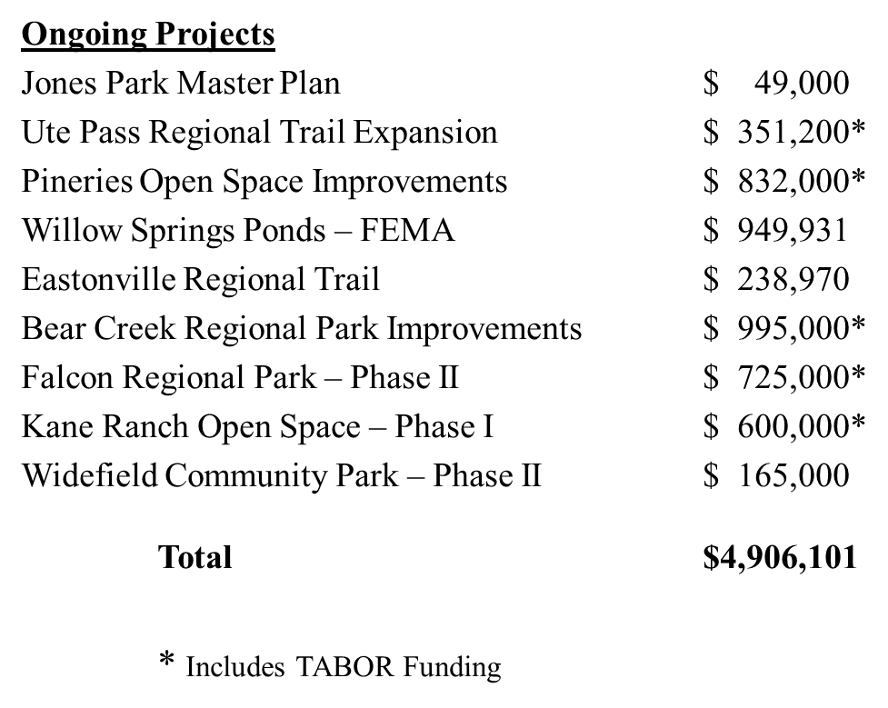
General Fund (Restricted) Community Services/County Parks Projects

Slide 17
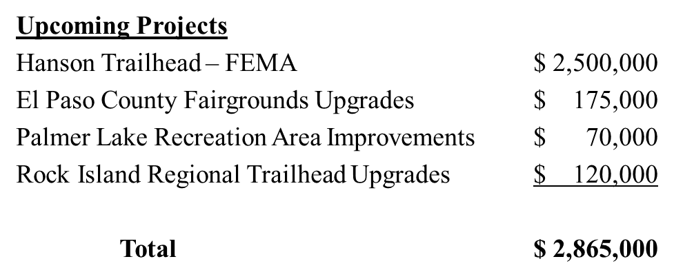
General Fund (Restricted) Community Services/County Parks Projects

Slide 18
May 2020 – Conservation Trust Fund

Slide 19
May 2020 – Schools’ Trust Fund

Slide 20
May 2020 – Household Hazardous Waste Fund

Slide 21
May 2020 – Local Improvement Districts (LIDs*)

Slide 22
Questions?

