Slide 1
2020 Primary Election Update
Chuck Broerman
El Paso County Clerk and Recorder
June 30, 2020

Slide 2
Election Safety of Staff and Judges
Worked closely with Dr. Kelly
Created written procedures - Health and Safety Manual
Compliance Judge
Work stations separation at least 6 feet
Plexiglass barriers
Personal Protection Equipment
Health and Temperature Screening
Masks
Gloves
Hand Sanitizer
Compliance Judge

Slide 3
Important Information
Unaffiliated voters
Received two ballots
Can only return one
17-year-olds can vote if they will be 18 by November General Election
Ballot due by 7:00 pm, postmarks will not count
Those in line by 7:00 pm will be allowed to vote

Slide 4
Ballot Update
408,000 Ballots Sent
Democratic Voters 83,055 20%
Republican Voters 152,979 38%
Unaffiliated Voters 157,302 39%
Other minor parties ~3%
5,400 UOCAVA ballots mailed
532 Returned
Expected Turnout
40% Turnout
Mail Ballot – 174,471
In Person – 1%

Slide 5
Ballots returns to date-Statewide (As of 6:30 AM 6-30-2020)

Slide 6
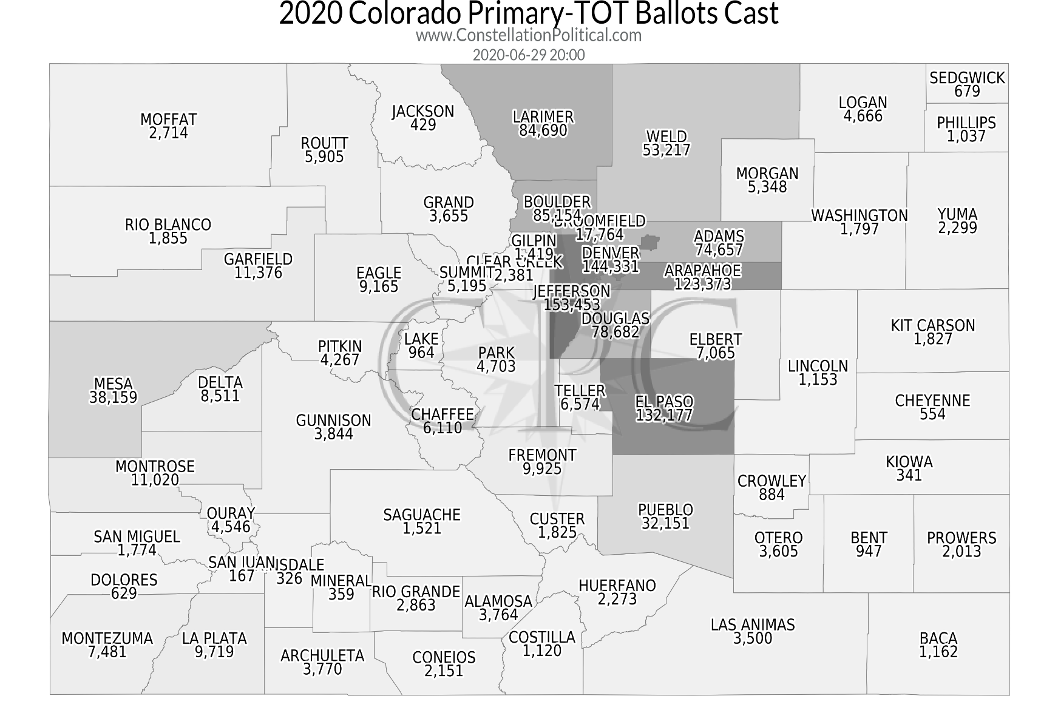
Returns Statewide By County (As of 6:30 AM 6-30-2020)

Slide 7
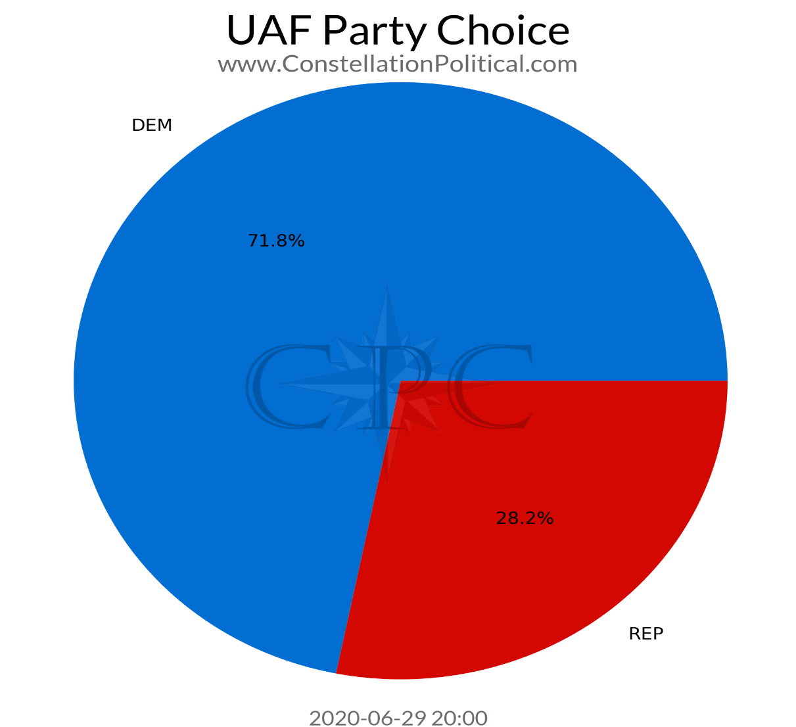
Statewide Unaffiliated Voters-Party Choice

Slide 8
Returns To Date- El Paso County Jurisdiction (As of 4:00 PM 6-29-2020)
Jurisdiction | DEM | REP | UAF | LBR | TOTAL
El Paso County | 33,414 | 57,136 | 38,259 | 712 | 129,521
Commissioner Dist 2 | 5,583 | 12,696 | 7,470 | N/A | 25,749
Commissioner Dist 3 | 9,944 | 12,224 | 9,718 | N/A | 31,886
Commissioner Dist 4 | 4,788 | 6,763 | 4,717 | N/A | 16,268
State House 14 | 4,028 | 9,468 | 5,822 | N/A | 19,318
State House 15 | 3,814 | 7,302 | 4,654 | N/A | 15,770
State House 16 | 4,436 | 7,283 | 4,883 | N/A | 16,602
State House 17 | 3,129 | 2,709 | 2,471 | N/A | 8,309
State House 18 | 6,619 | 4,672 | 5,275 | N/A | 16,566
State House 19 | 3,739 | 13,146 | 6,731 | N/A | 23,616
State House 20 | 4,771 | 8,235 | 5,399 | N/A | 18,405
State House 21 | 2,878 | 4,321 | 3,024 | N/A | 10,223
State Senate 10 | 7,759 | 13,426 | 8,851 | N/A | 30,036
State Senate 12 | 7,117 | 12,102 | 7,716 | N/A | 26,935

Slide 9
El Paso County-Unaffiliated Ballot Choice

Slide 10
Voter Service and Polling Centers
State Statute requires 5 VSPCs, we have 8
Centennial Hall
Citizens Service Center
Union Town Center
Powers Branch office
Citadel Mall-Food Court entrance
Chapel Hills Mall-North side
Vista Grande Baptist Church
Fountain Library

Slide 11
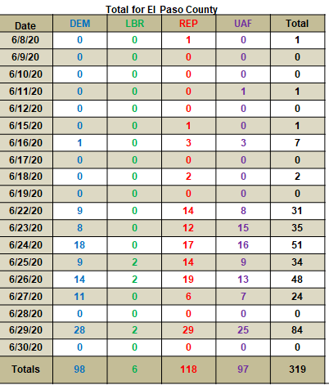
VSPC In-Person Voting June 8 -June 29, 4:00 PM

Slide 12
35 24-Hour Ballot Drop Boxes
First and Main-new
Falcon Fire Dept-Station 3 to Station 1
Boot Barn Hall at Bourbon Brothers
Colorado Springs Senior Center
Cottonwood Creek Recreational Center
Leon Young Sports Complex
Rocky Mountain Calvary
Vista Grande Baptist Church
Wilson Ranch Pool
Citadel Mall
School District 3 Federal Credit Union

Slide 13
Common Mistakes This Election
You must sign your own ballot envelope
Verify your name and address before signing on the back of your ballot envelope.
If you sign the incorrect envelope (such as your spouse’s), please draw a line through your signature and have the correct voter sign above.
I.D. Required
If your ballot instructions state you must return an I.D., you have to include a copy of an acceptable form of I.D. (acceptable forms listed in your voter instructions) to ensure your ballot is counted in a timely manner.
Change your mind on a candidate?
Clearly state your intentions by drawing a line through the incorrect selection and darken the oval of the correct one and circle your choice.
Identifying Marks
Please do not sign or initial your voted ballot, even when making a correction. This ensures voter anonymity. Your signature should only be on the outside of your ballot envelope.

Slide 14
Questions?
Call 719-575-VOTE (8683)
Epcvotes.com
Results will be available shortly after 7:00 PM
Unofficial results will be released approximately following the schedule below:
1) 7:15 p.m. - The results will reflect what has been counted through 5 p.m., on Election Day
2) 8:00 p.m.
3) 8:45 p.m.
4) 9:45 p.m.
5) 10:45 p.m.

