Slide 1
Clerk and Recorder Update
Return to Confidence
Chuck Broerman
El Paso County Clerk and Recorder
May 12, 2020

Slide 2
Public Services
Recording Services
Mortgage Liens
Deeds
Plat maps
Marriage license
Elections Services
Liquor and Marijuana Licenses
Motor Vehicle
Renewals
Titling
Handicap placards
Driver’s License renewals

Slide 3
Motor Vehicle
Over 30,000 transactions not conducted in the past 6-7 weeks
Online, mail, email, drop-box and Kiosks
Phone bank services 520-6240
Cannot do all transactions by phone, mail and e-mail
Kiosk transactions-6,529

Slide 4
Mitigation
Opened just three of our five offices
Increased the positive air flow
Plexiglas panels
50% staff
Screening
Scheduling customers
Face Masks
Hand Sanitizer stations
Expansion of Saturday hours and locations

Slide 8
Appointment capacity
Three offices (Monday-Friday)
UTC and Powers Locations open Monday-Saturday
Phone bank-2,257 calls
2,596 In-person transactions last week
864 Appointment slots per day next week (5,184)
702 Motor Vehicle Services appointments
162 Driver’s License renewals and transfers

Slide 9
Ways to increase capacity
Add service counters
Add hours of service per day
Add Saturday Office locations
Add office

Slide 10
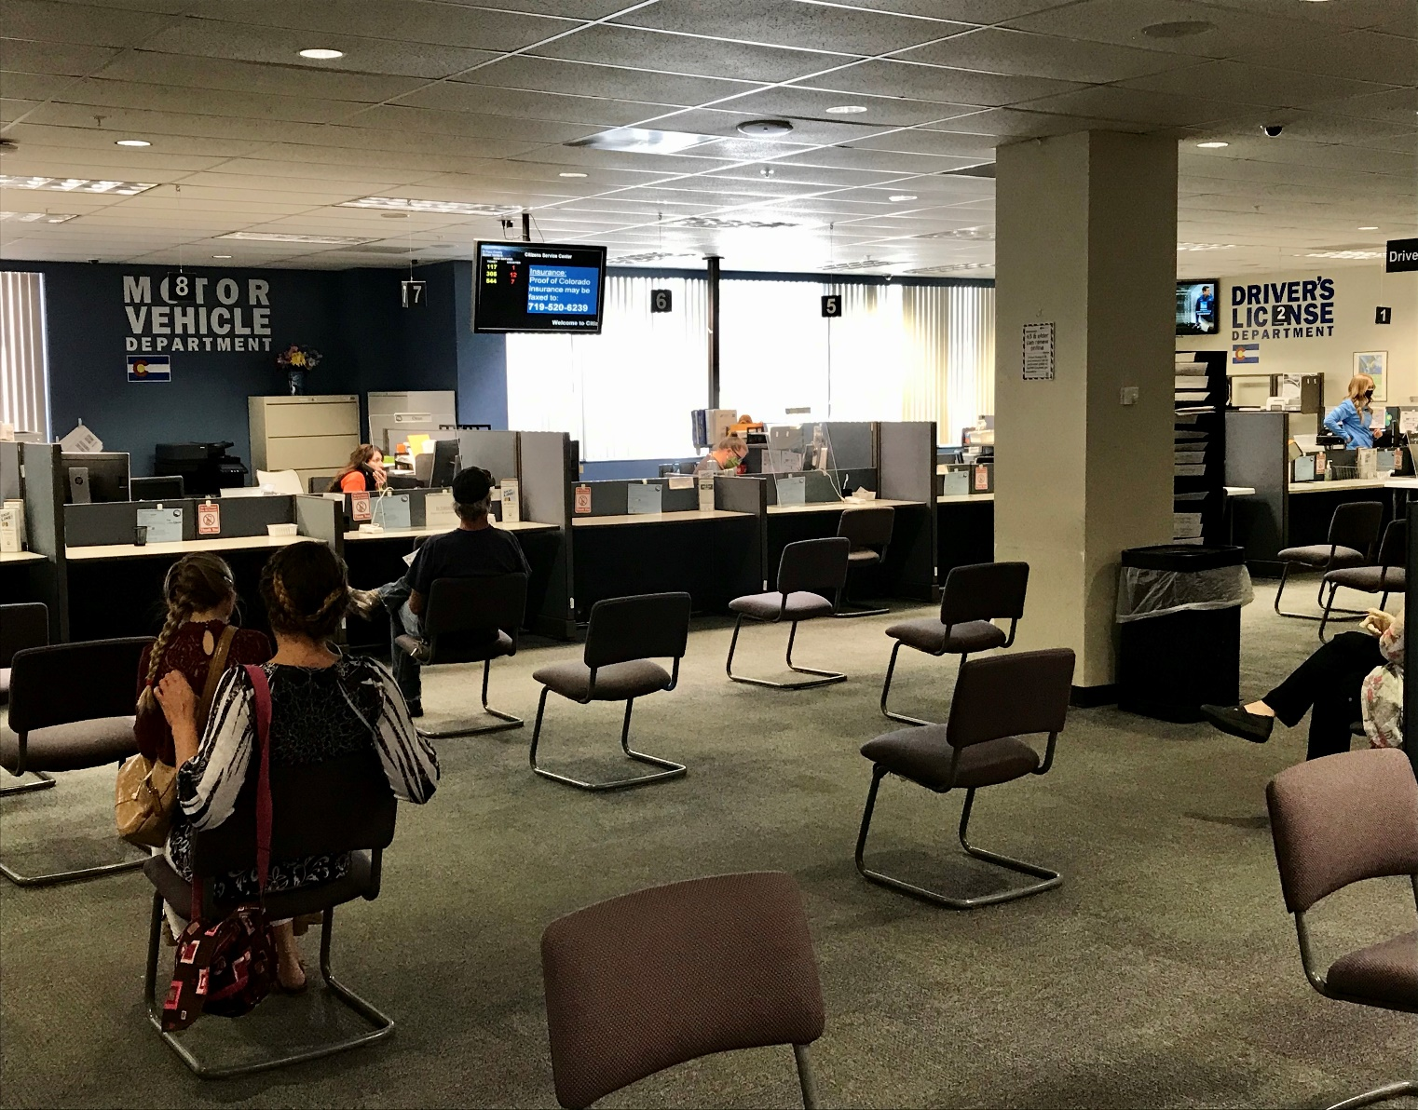
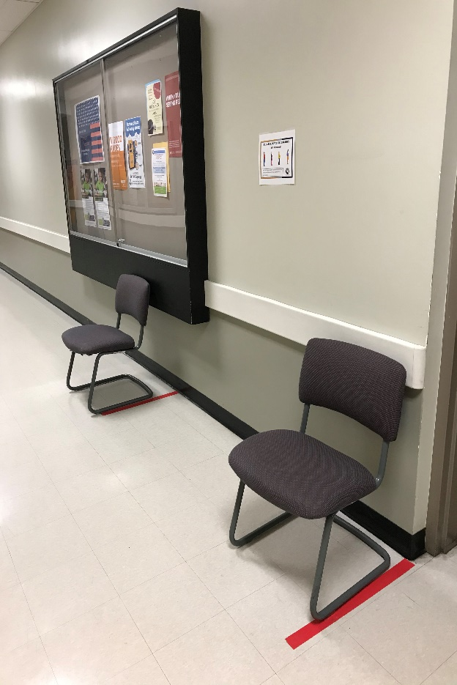
Physical Distancing Examples

Slide 11
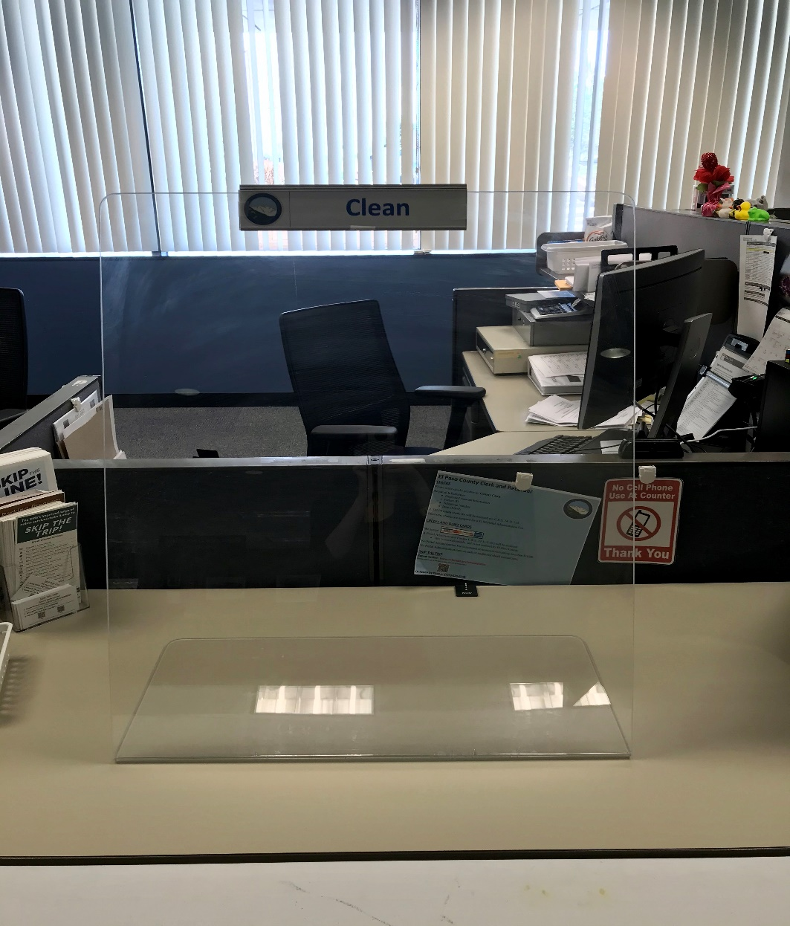
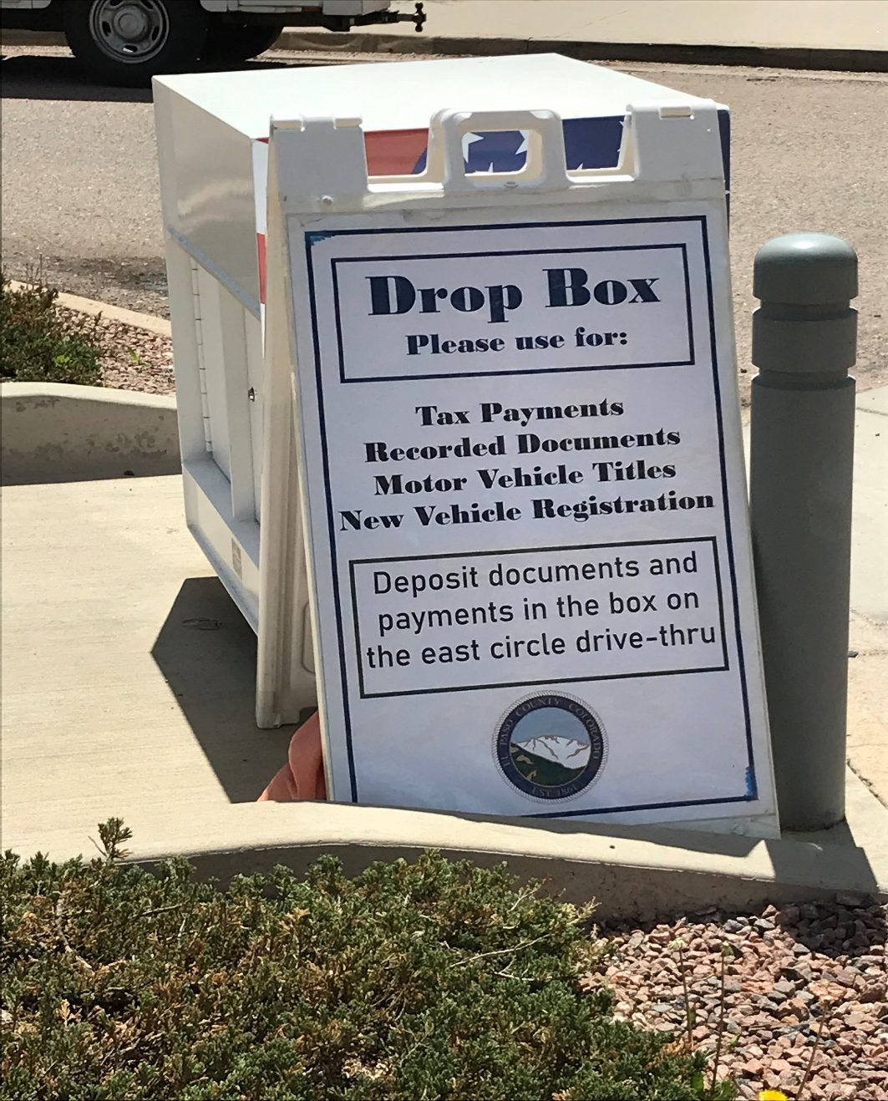
Physical Distancing Examples

Slide 12
Physical Distancing Examples

Slide 13
Past six weeks
Elections-skeleton shift
A/B/C shift
54 days until Election Day June 30, 2020
Full Strength – Everyone is separated in excess of 6 feet (10-12-15 feet)
Everyone wearing masks

Slide 14
Election Challenges
Election Judge recruitment
VSPC
Tight deadlines
Ballot Access legal challenges
List of critical milestones
Ballot certification-Completed
Proofing of ballot-Completed
UOCAVA-printing ballots today
HCF-ballot drops only
Media education program

Slide 15
Recording
Extremely busy
Home sales
Refinancing
Marriage license permissible remotely-Executive Order extended to May 27, 2020
By appointment other Recording transactions-only at Citizens Service Center
520-6200

Slide 16
Questions?

