Slide 1
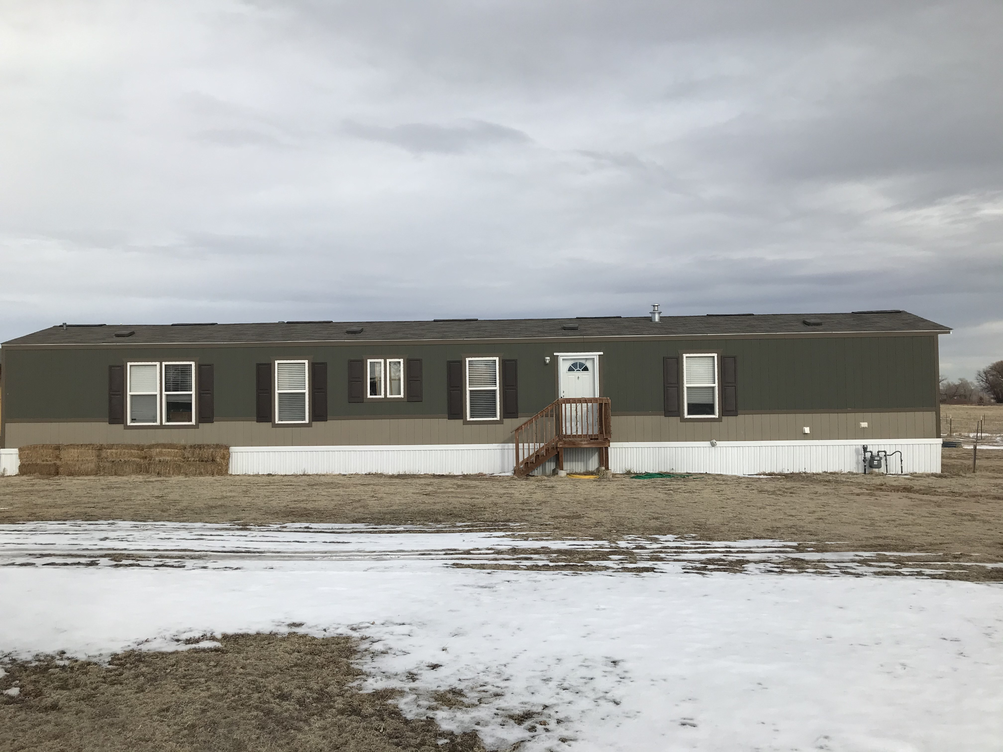
AL-19-026 Hyatt Accessory Living Quarters
Lindsay Darden, Planner II
Elizabeth Nijkamp, Engineer Review Manager

Slide 2
Review Criteria
There is a family hardship or need that justifies the request for the extended family housing.
The proposed use is compliant with the special use approval criteria of Chapter 5 of the Land Development Code.

Slide 3
Special Use Review Criteria
The special use is generally consistent with the applicable Master Plan;
The special use will generally be in harmony with the character of the neighborhood, and will generally be compatible with the existing and allowable land uses in the surrounding area;
The impact of the special use does not overburden or exceed the capacity of public facilities and services, or, in the alternative, the special use application demonstrates that it will provide adequate public facilities in a timely and efficient manner;
The special use will not create unmitigated traffic congestion or traffic hazards in the surrounding area, and has adequate, legal access;

Slide 4
Special Use Review Criteria
The special use will comply with all applicable local, state, and federal laws and regulations regarding air, water, light, or noise pollution;
The special use will not otherwise be detrimental to the public health, safety, and welfare of the present or future residents of El Paso County; and/or
The special use will not otherwise be detrimental to the public health, safety, and welfare of the present or future residents of El Paso County; and/or

Slide 5
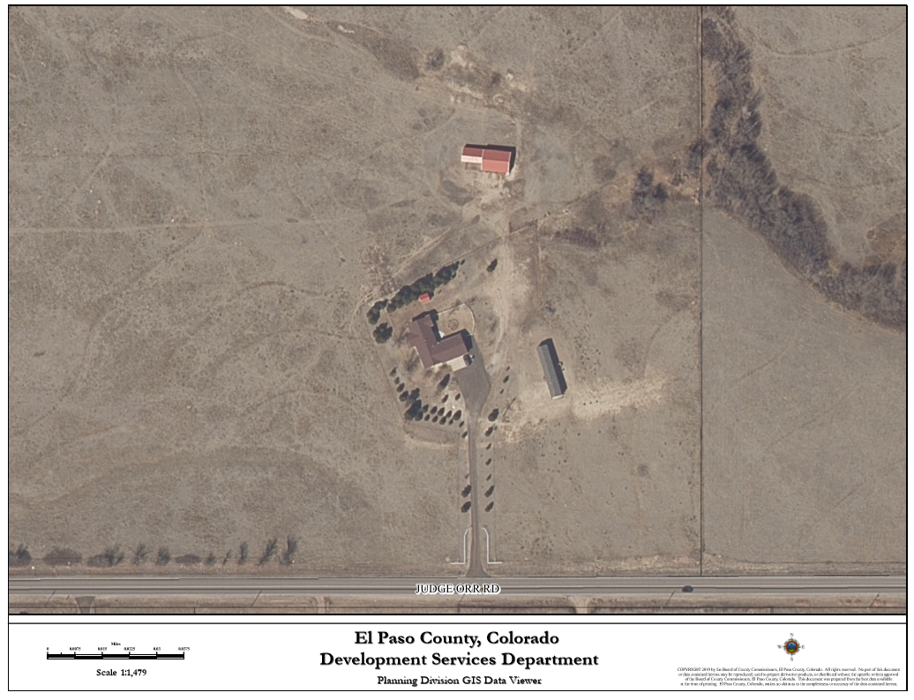
Request
Mark and Angelita Hyatt seek approval to designate the existing 1,216 square foot mobile home as accessory living quarters and request approval of a special use to allow for continuous occupancy by their son.
Planning Commission recommended approval of the project 7-0 on February 18, 2020.
Existing Mobile Home

Slide 6
Property Owner
Property Owners: Mark and Angelita Hyatt

Slide 7
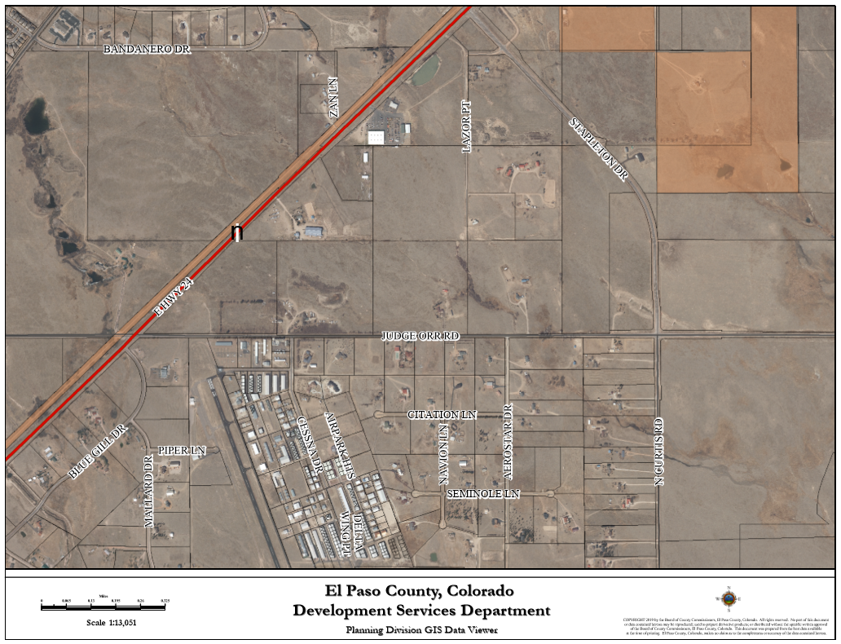
Vicinity Map
The 39.4-acre parcel was legally created in June 15, 2004. Subdivision was not required because the division of land comprised 35 acres or more.
The parcel is located on the north side of Judge Orr Road approximately 0.62 miles east of the Judge Orr Road and US Highway 24 Intersection.
Site

Slide 8
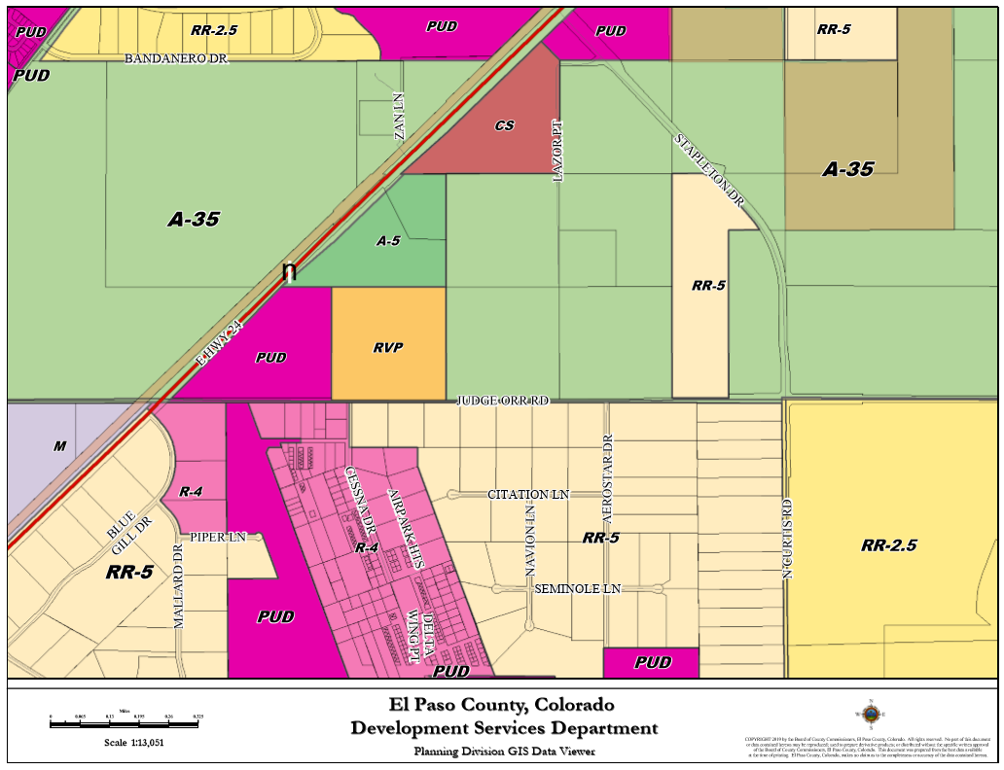
Zoning
The parcel was zoned A-35 (Agricultural) on March 25, 1999.

Slide 9
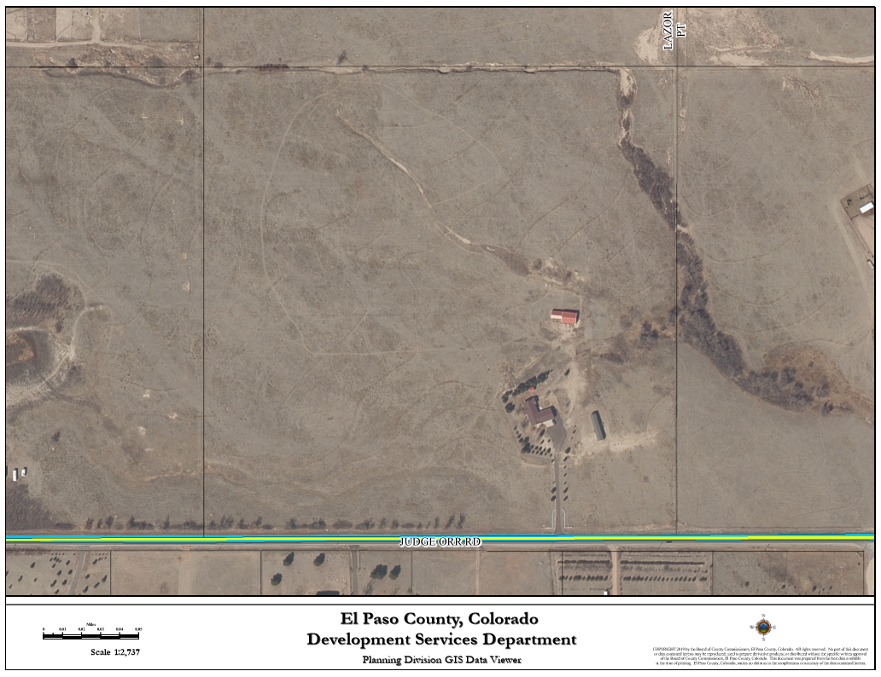
Existing Conditions
The primary use is single family residence that was constructed in 1994 per the assessor’s records. There is also a stable, a cattle shed, the mobile home proposed as accessory living quarters and a detached garage/utility building.

Slide 10
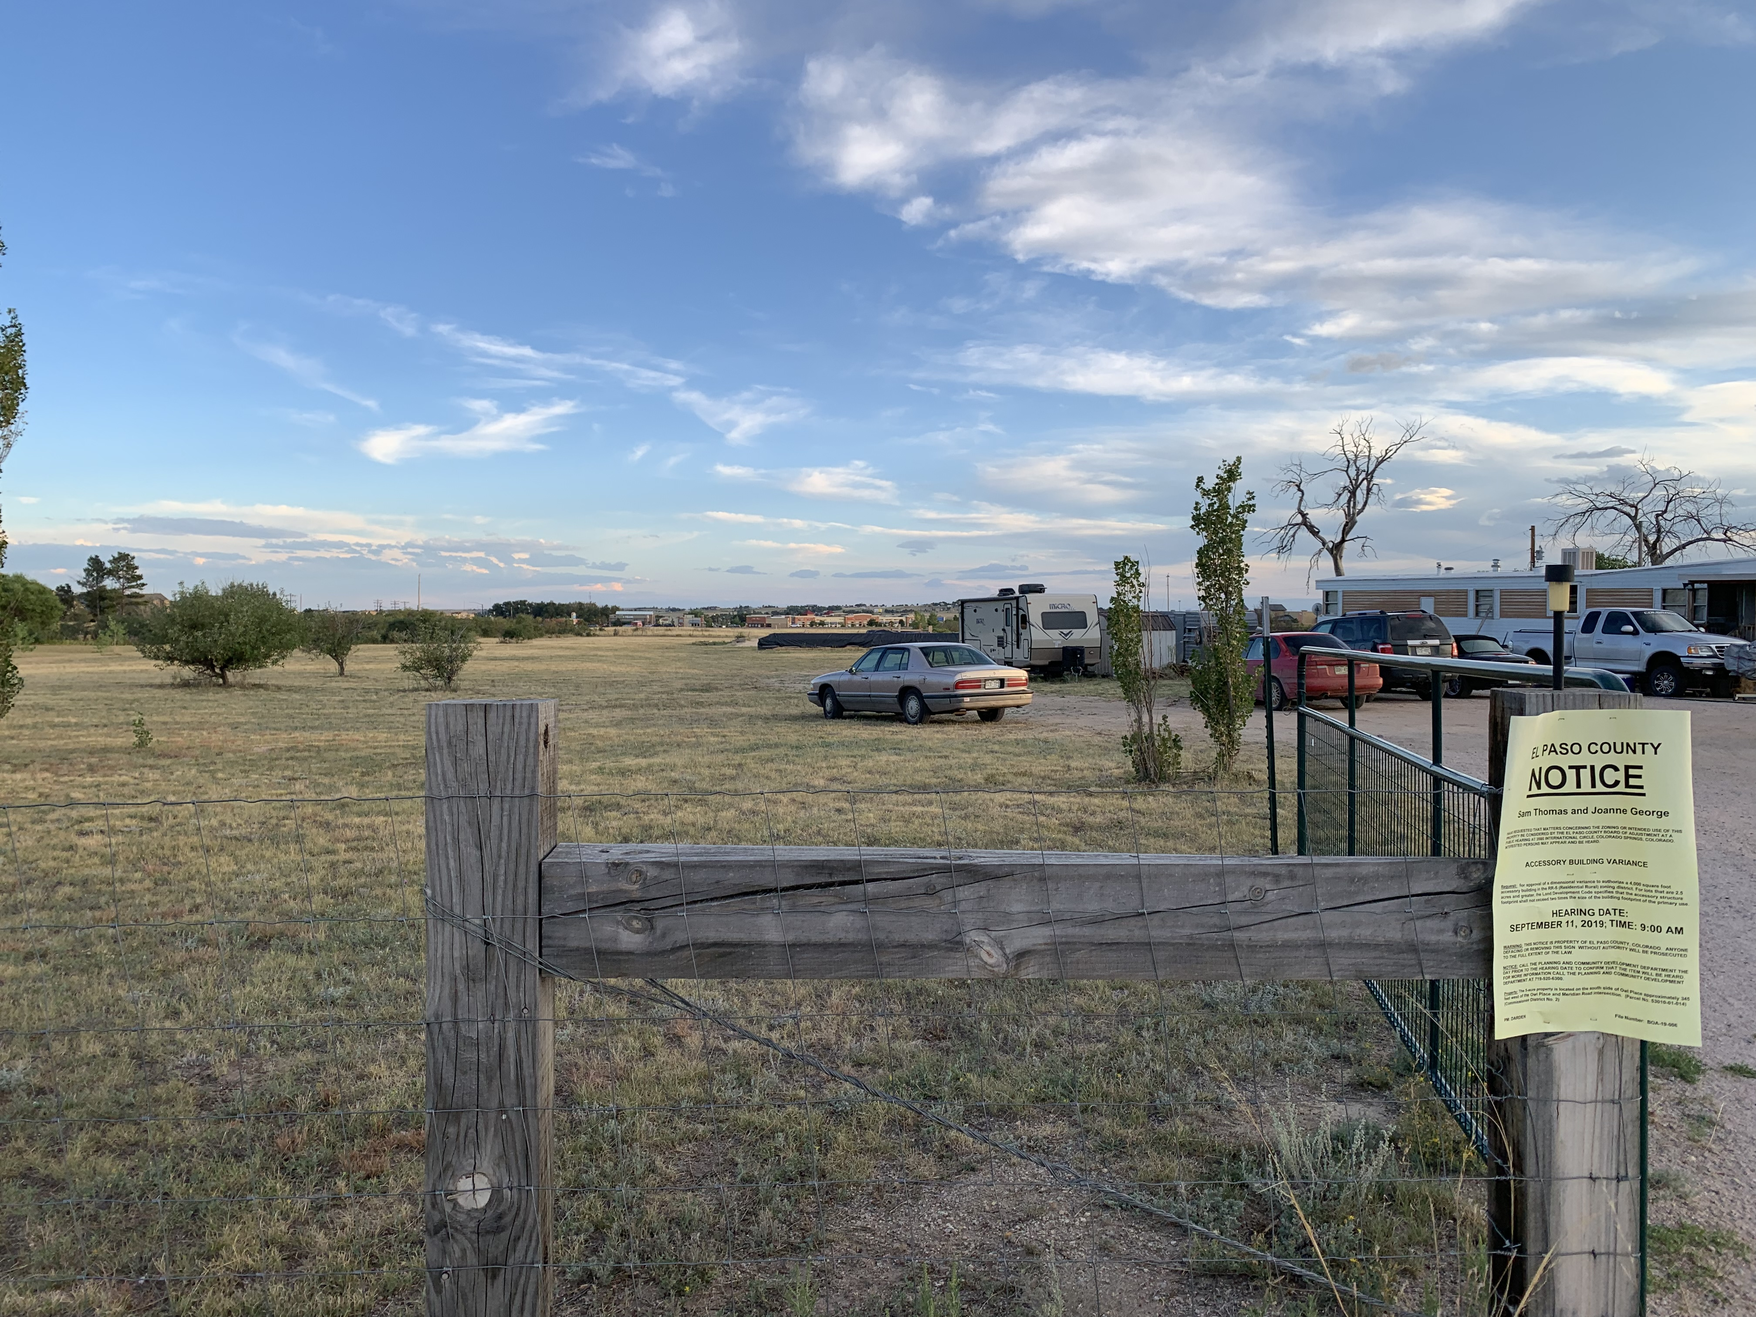
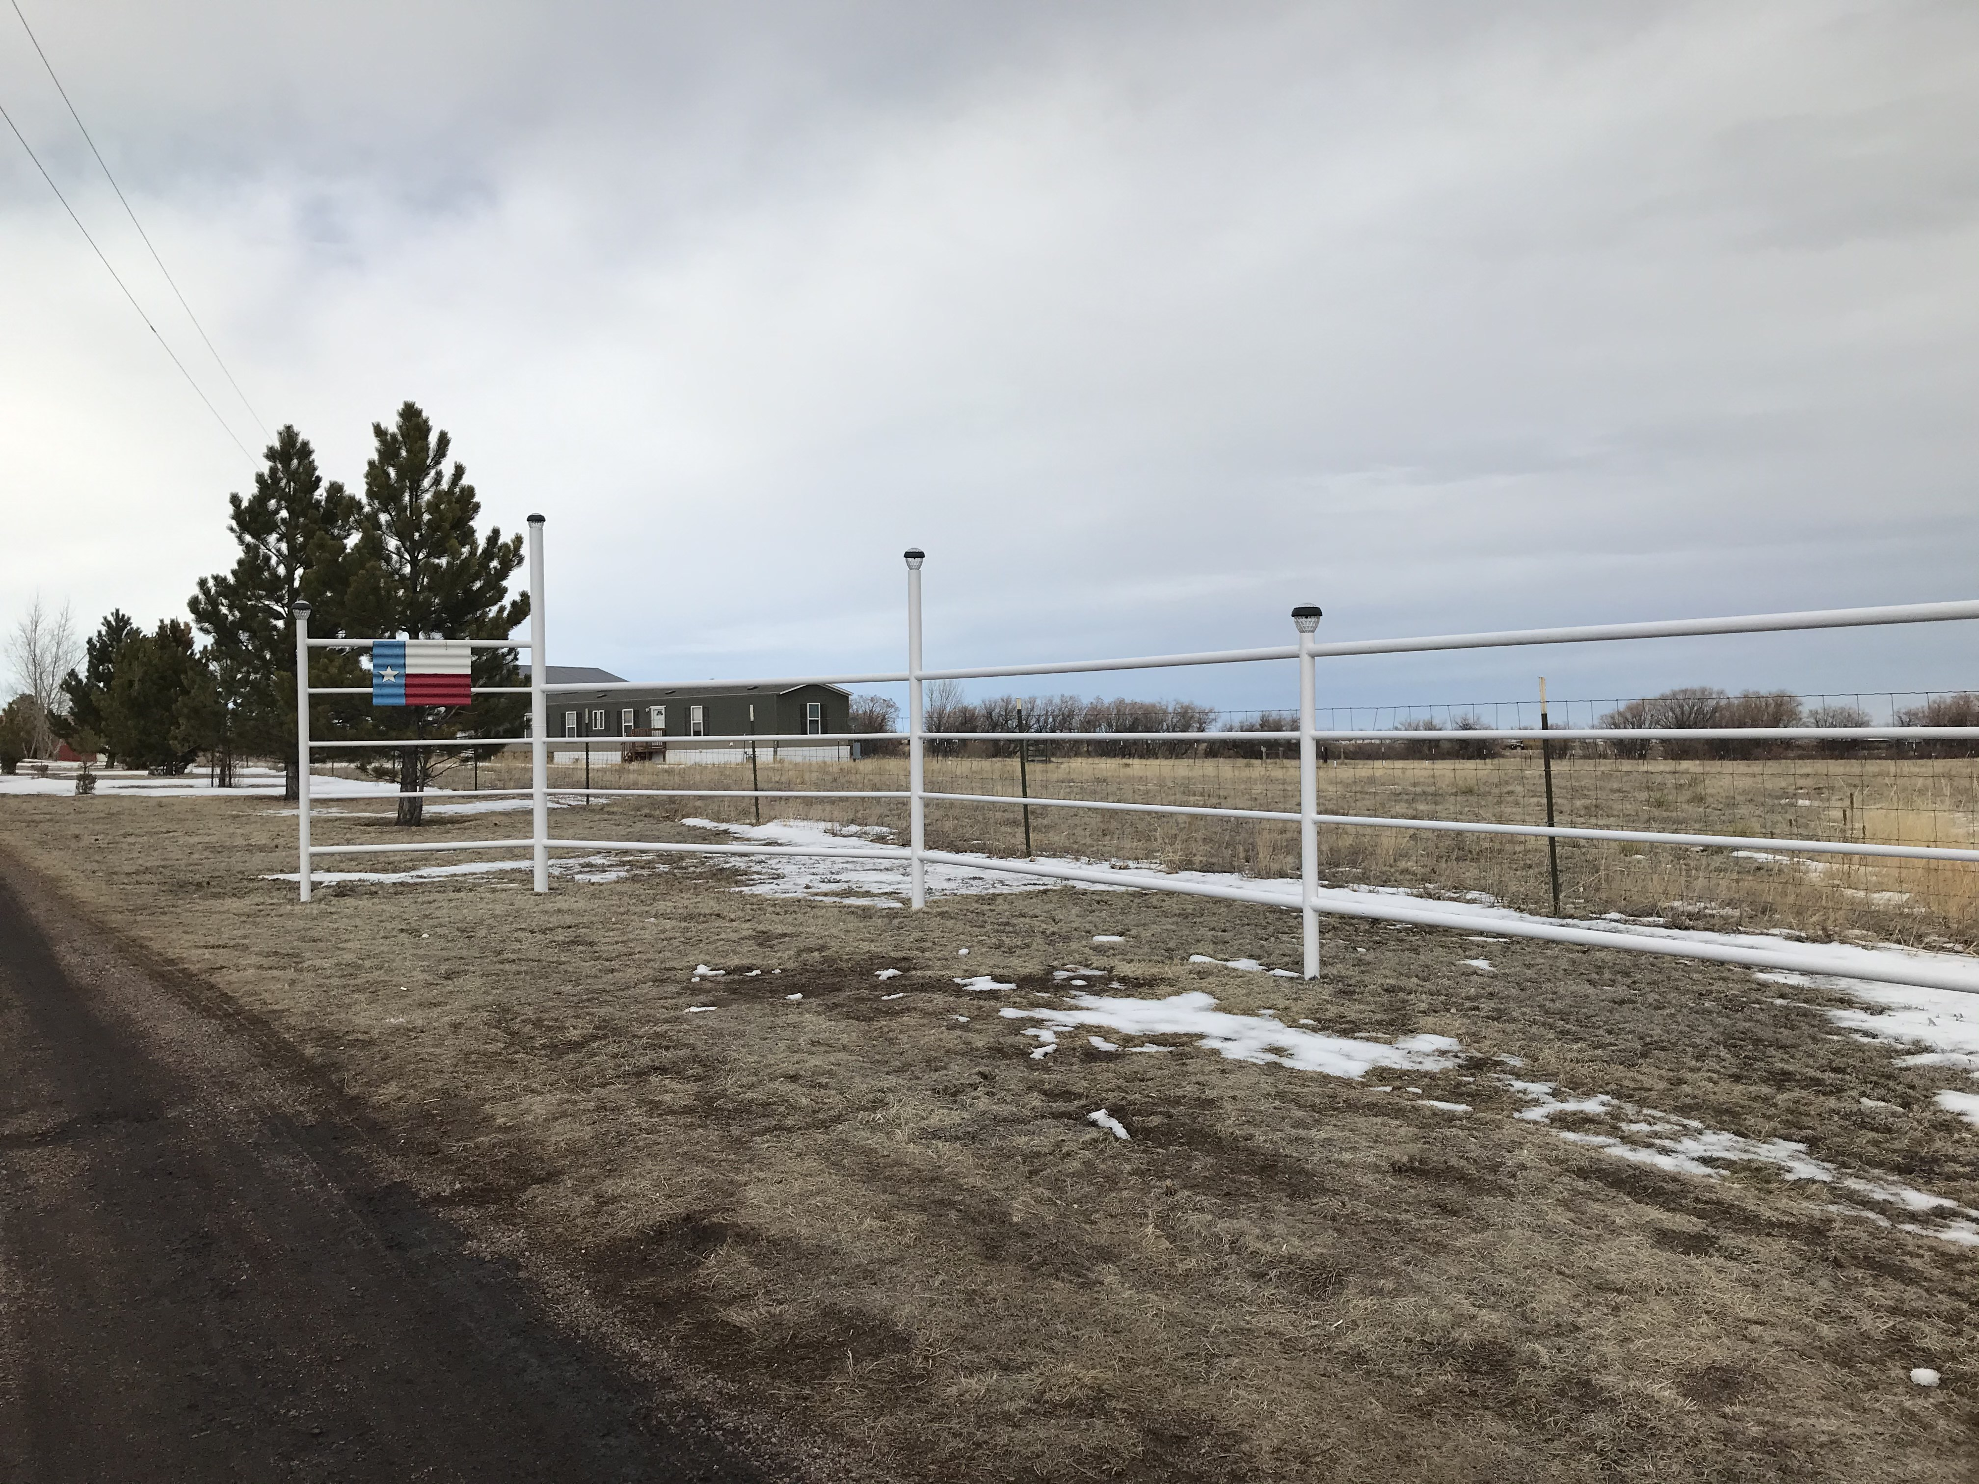
Existing Conditions

Slide 11
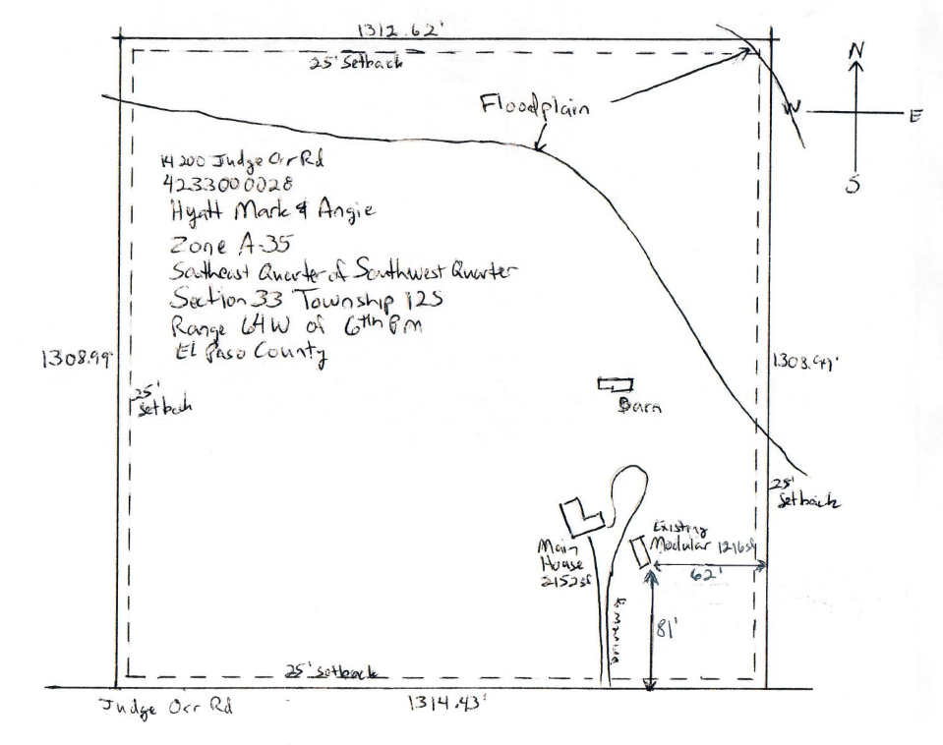
Site Map

Slide 12
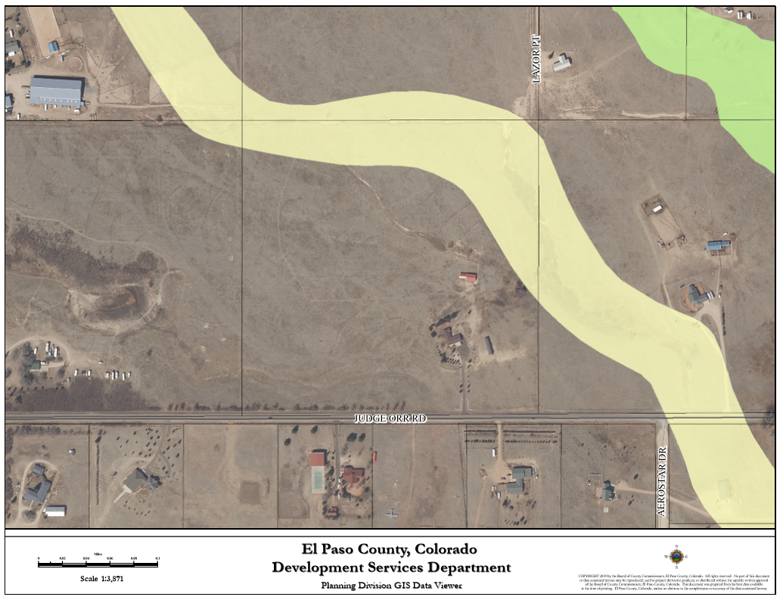
Drainage and Erosion
FEMA Flood Insurance Rate Map (FIRM) panel 08041C0554G, dated December 7, 2018, shows that a portion of the property is within zone A, an area determined to be within the 100-year floodplain. There are no current or proposed structures in the mapped floodplain.
The property is located within the Haegler Ranch Drainage Basin (CHMS0200). No drainage or bridge fees are required for a special use. No public drainage improvements will be required.

Slide 13
Transportation
The property is accessed via Judge Orr Road. A traffic impact study was not required because the proposed special use is not expected to generate 100 daily vehicle trips more than the property would be expected to generate without the approval of the special use request. No public roadway improvements will be required.

Slide 14
Policy Plan Analysis
Goal 13.1- Encourage an adequate supply of housing types to meet the needs of county residents.
Policy 13.1.3- Recognize the need for housing alternatives that provide for the county’s special populations. Special populations may include low income, elderly, and physically and mentally impaired.
The purpose of the special use for extended family housing is to provide housing in the accessory living quarters for an immediate family member to live on the property to assist a family member in need. As indicated in the applicants’ letter of intent, the property owners intend on housing their son in the extended family dwelling to assist them with the upkeep of the large parcel. This application recognizes a need for housing alternatives that provide for the County’s different populations.

Slide 15
Small Area Plan Analysis
The subject parcel is located within the Falcon/Payton Comprehensive Planning Area for which land use decisions are guided by the Falcon/Payton Small Area Master Plan (2008).
The small area masterplan shows the subject parcel as “Proposed Urban Density Development that is suitable for urban density development and should include open space and provide transition zones between higher and lower densities”.
The zoning for the subject parcel is A-35 (Agricultural) with a parcel size that conforms to the dimensional requirements of the A-35 zoning district. The small area plan supports increased future density in this area which would be best accomplished by rezoning and subsequent subdivision. However, the Land Development Code permits development in conformance with the existing zoning district, which is consistent with the applicants’ proposal.

Slide 16
Water Master Plan Analysis
Goal 1.1 – Ensure an adequate water supply in terms of quantity, dependability and quality for existing and future development.
Goal 1.2 – Integrate water and land use planning.
Policy 1.1.1 – Adequate water is a critical factor in facilitating future growth and it is incumbent upon the County to coordinate land use planning with water demand, efficiency and conservation.
Policy 5.2.2 – Recognize the water supply challenges and limitations inherent in each of the regional planning areas, with particular emphasis placed on Regional Planning Area 3 (Falcon), as a result of current reliance on non-renewable Denver Basin wells and the renewable, but limited and over-appropriated, Upper Black Squirrel alluvium.
The proposed special use for the accessory living quarters for continuous occupancy will not impact the current water usage for the parcel. The mobile home is existing and is currently occupied on a full-time basis by the property owners’ son.
If a third detached single-family dwelling is proposed in the future, approval of a major variance would be required by the Upper Black Squirrel Groundwater Management District UBSGMD.

Slide 17
Conditions of Approval
Approval is limited to the extended family dwelling as discussed and depicted in the applicants’ letter of intent and the approved residential site plan drawing.
Any subsequent site plan to add a third dwelling unit on this parcel shall not be approved unless documentation demonstrating that a major variance has been approved by the Upper Black Squirrel Groundwater Management District to permit the third dwelling unit to utilize the existing well.
The detached accessory living quarters for permanent occupancy shall be removed within three (3) months after the need no longer exists or 3 months after the date of the expiration of the special use approved, if one is specified, unless an application to legalize the use is submitted or an application to subdivide the property is submitted.

Slide 18
Notations
Special use approval includes conditions of approval and the accompanying site plan. No substantial expansion, enlargement, intensification or modification shall be allowed except upon reevaluation and public hearing as specified in the El Paso County Land Development Code.
The Board of County Commissioners may consider revocation and/or suspension if zoning regulations and/or special use conditions/standards are being violated, preceded by notice and public hearing.
If the special use is discontinued or abandoned for two (2) years or longer, the special use shall be deemed abandoned and of no further force and effect.

Slide 19
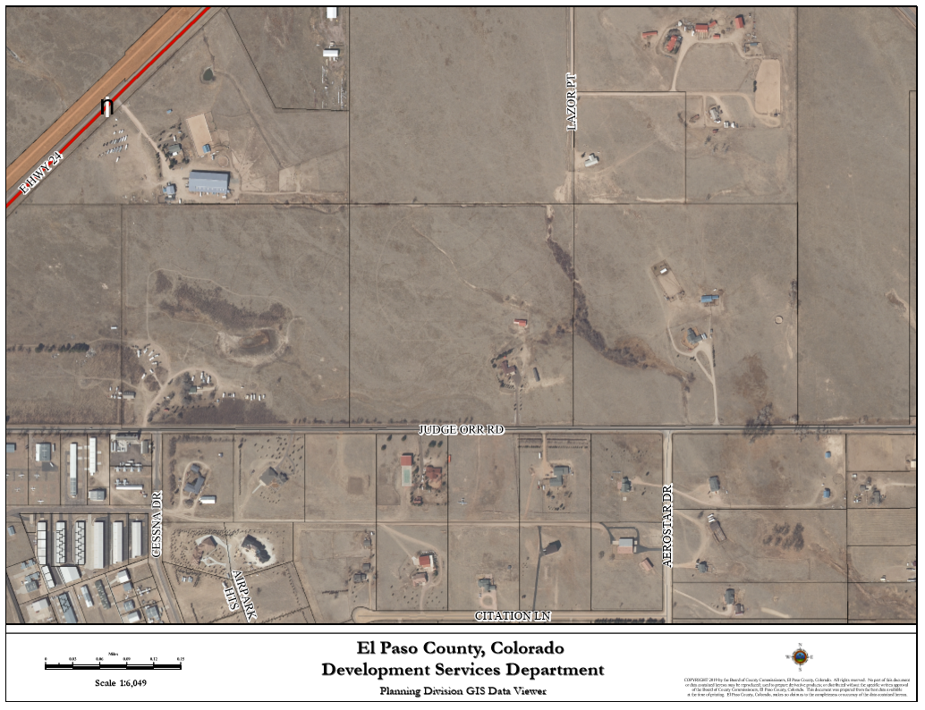
Posting
Nine (9) adjoining property owners were notified for Board of Adjustment Hearing
Notice was mailed on January 29, 2019 for the hearing.
One (1) adjoining property owner responded in favor of the request. (Green Star)
One (1) property owner has responded against the request. (Red Star)
Site

Slide 20
Questions for Staff?

Slide 21
Questions for Staff?

