Slide 1
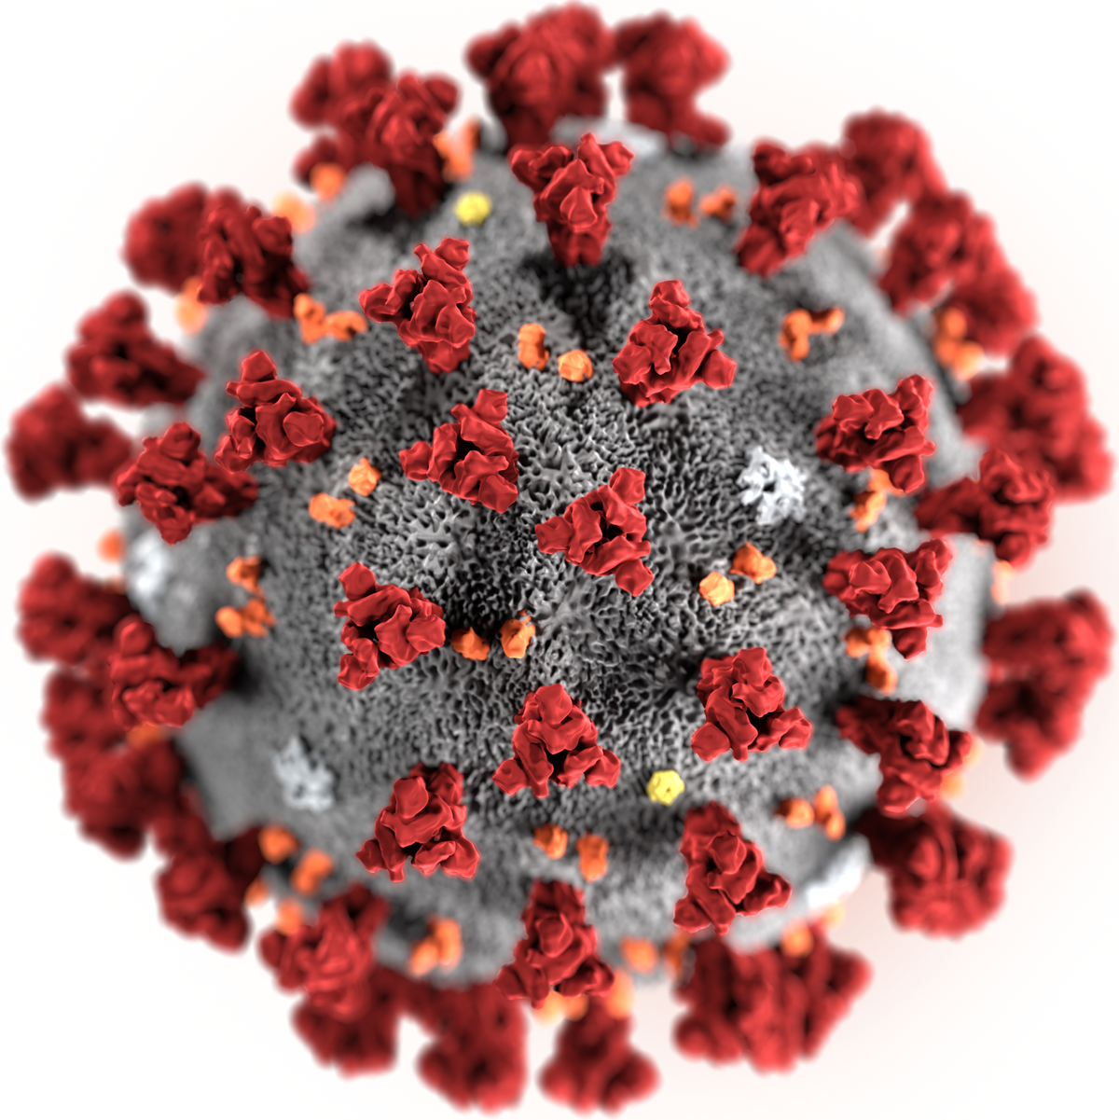

El Paso County Board of County Commissioners COVID-19 Update
Presented by: Dr. Leon Kelly, El Paso County Public Health Deputy Medical Director/El Paso County Coroner
Compiled with assistance from: Dr. Robin Johnson, El Paso County Public Health Medical Director and the Public Health Data and Analytics Office
To: El Paso County Board of County Commissioners
Date: March 31, 2020

Slide 2
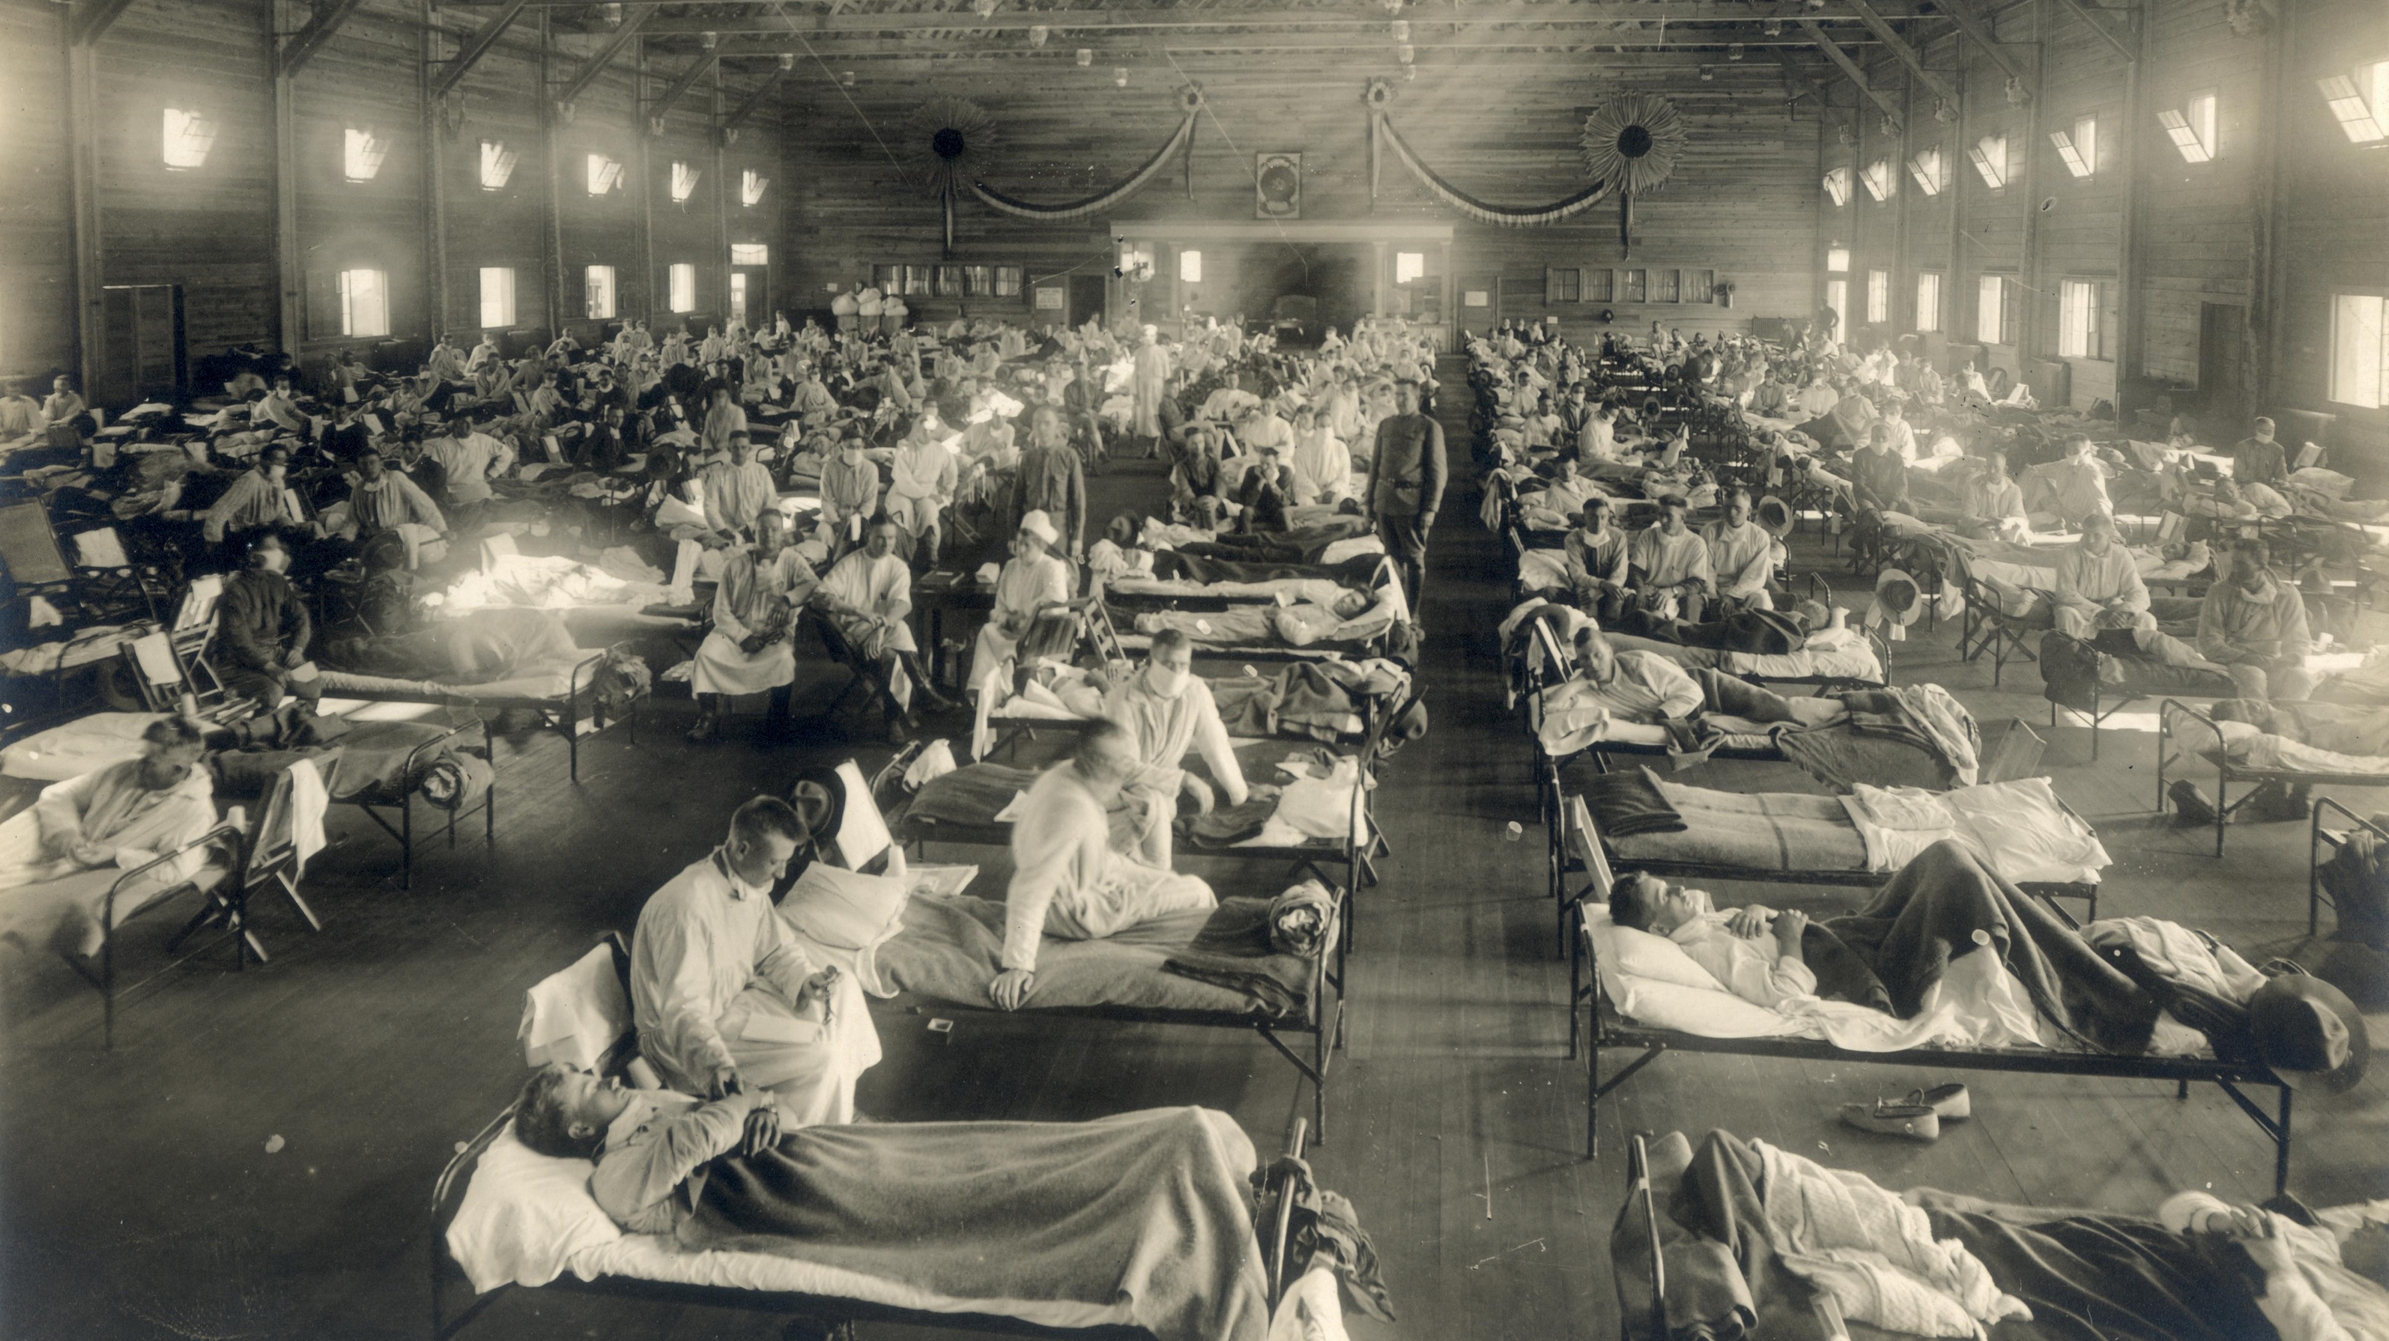
1918 Spanish Flu Epidemic
Prevent • Promote • Protect
www.elpasocountyhealth.org

Slide 3
1918 Spanish Flu Epidemic
First U.S. case occurred on Kansas military base, March 1918
Spread quickly around the world with outbreaks in America, Europe, and Asia due to war efforts
Killed 50-100 million around the world and 500,000 Americans
Marked variability of death rates between U.S. cities depending on measures taken to control the outbreak
Prevent • Promote • Protect
www.elpasocountyhealth.org

Slide 4
In 2007, two studies published in the Proceedings of the National Academy of Sciences sought to understand how responses influenced the disease’s spread in different cities. By comparing fatality rates, timing, and public health interventions, they found death rates were around 50 percent lower in cities that implemented preventative measures early on, versus those that did so late or not at all. The most effective efforts had simultaneously closed schools, churches, and theaters, and banned public gatherings. This allowed time for vaccine development and lessened the strain on health care systems.
National Geographic
How some cities ‘flattened the curve’ during the 1918 flu pandemic
Prevent • Promote • Protect
www.elpasocountyhealth.org

Slide 5
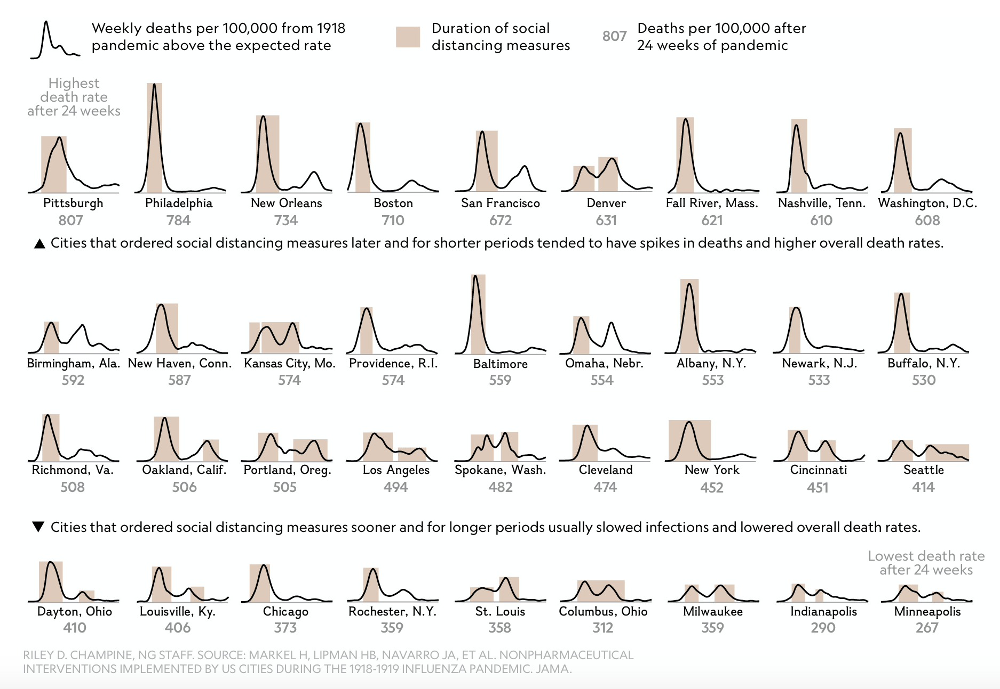
Courtesy of National Geographic
Prevent • Promote • Protect
www.elpasocountyhealth.org

Slide 6
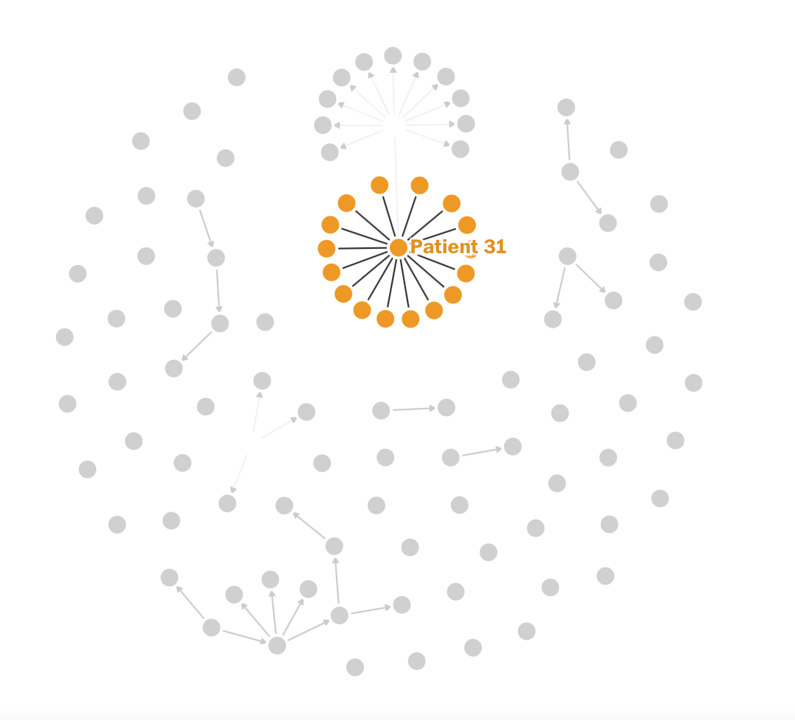
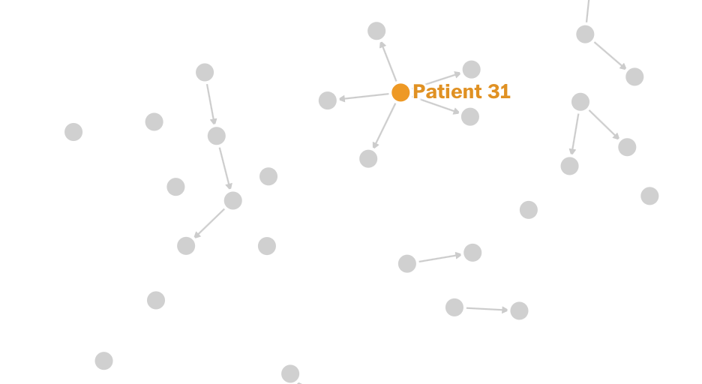
What we can learn from South Korea’s first case January 20, 2020
Courtesy of the Washington Post Online
Aggressive containment limits spread to 30 patients in first month of transmission
Patient 31 attends service at Shincheonji Church of Jesus
Within two days, 15 people associated with church test positive
Prevent • Promote • Protect
www.elpasocountyhealth.org

Slide 7
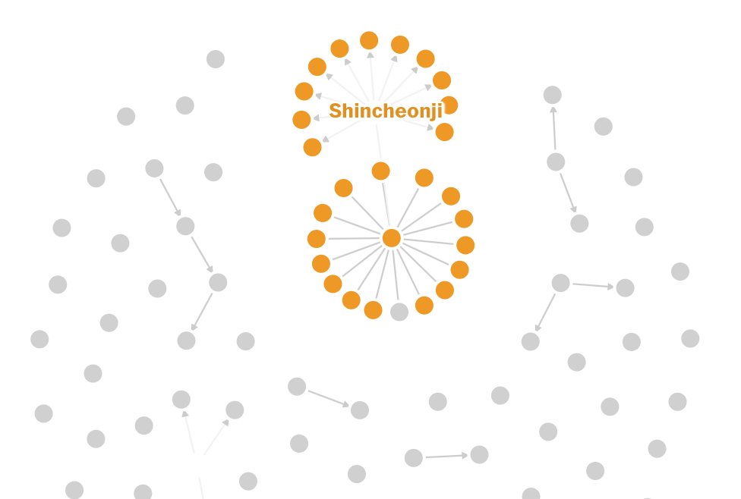

Shincheonji Church becomes the epicenter of the South Korean outbreak
Courtesy of the Washington Post Online
By March 25th (one month after church contagion), South Korea had 9137-plus cases with the church accounting for 5,080 of them
Prevent • Promote • Protect
www.elpasocountyhealth.org

Slide 8
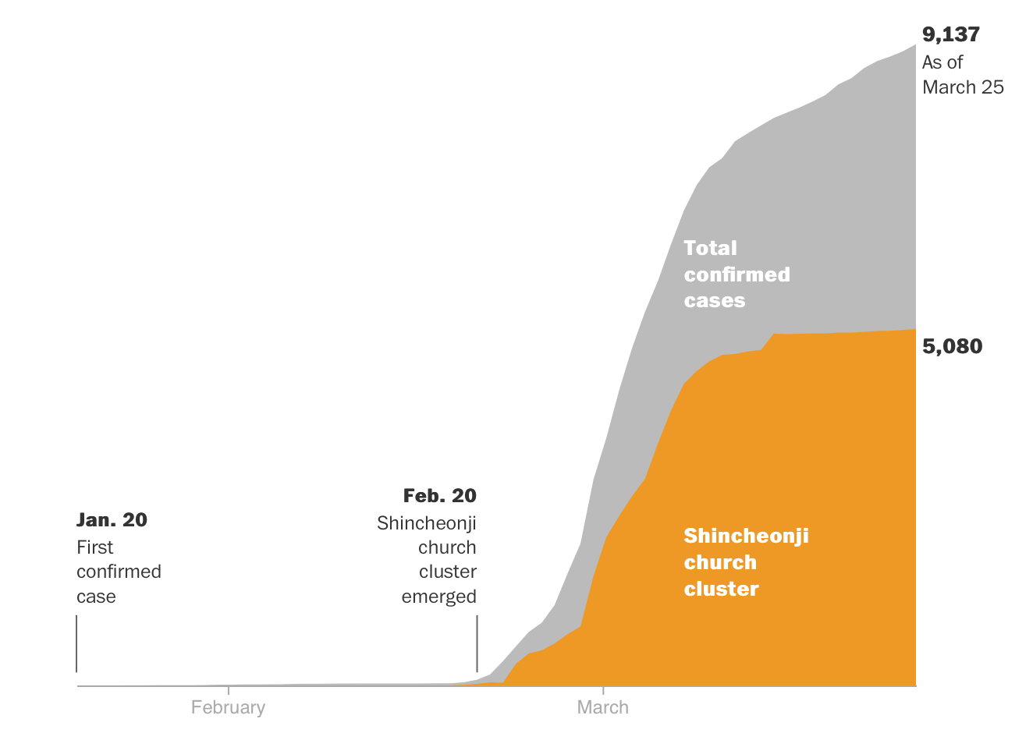
Courtesy of the Washington Post Online
Prevent • Promote • Protect
www.elpasocountyhealth.org

Slide 9
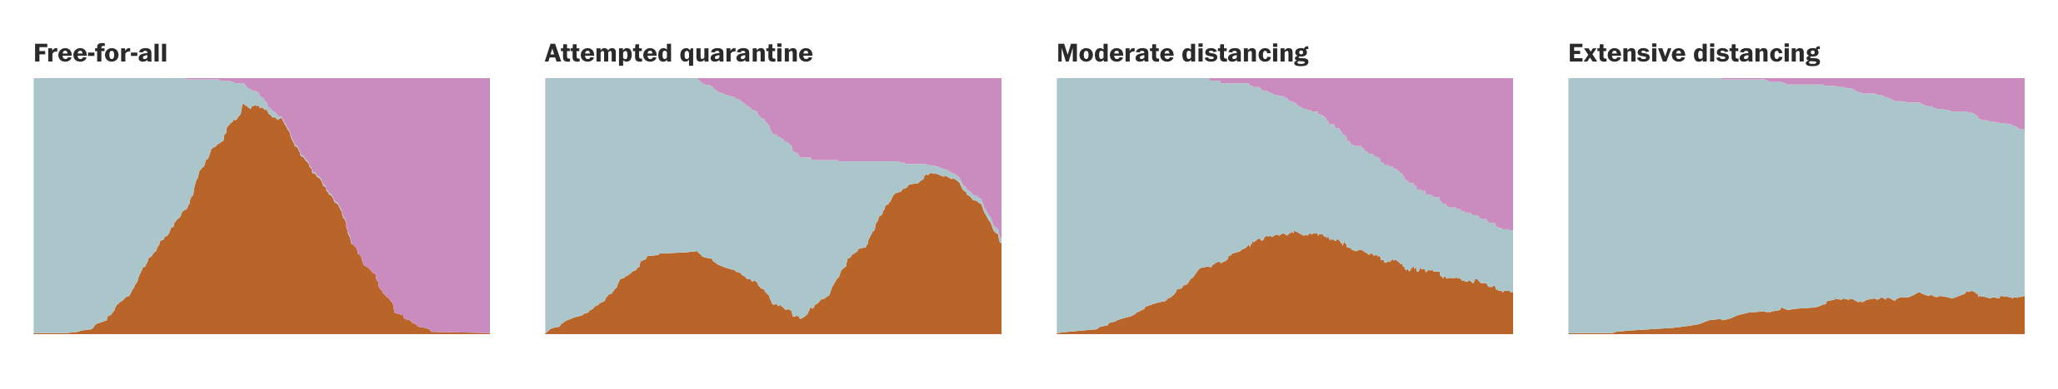
Simulation of Contagion of Disease X
+ Cases
Time
SUSCEPTIBLE
INFECTED
RECOVERED
Courtesy of the Washington Post Online
Prevent • Promote • Protect
www.elpasocountyhealth.org

Slide 10
Where we are now
COVID-19 numbers as of 5 p.m. March 30
Cases | Deaths
245 | 11
2,627 | 51
160,020 | 2,953
777,386 | 37,140
COVID-19 cases and deaths. Data from JHU-JSSE Interactive Map (30-Mar-2020), CEDRS (30-Mar-2020) and CDPHE (30-Mar-2020)
Prevent • Promote • Protect
www.elpasocountyhealth.org

Slide 11
Death counts of the top seven countries in the world in terms of days after the first death. As of 29-Mar-2020, the U.S is at Day 29 since the first death and has intersected China’s trend. Data from JHU-JSSE Interactive Map (30-Mar-2020), analyzed by El Paso County Public Health Data and Analytics Office.
Prevent • Promote • Protect
www.elpasocountyhealth.org

Slide 12
States that have more than 30 COVID-19 cases per 100,000 and El Paso County as of 28-Mar-2020. Data from JHU-JSSE Interactive Map (29-Mar-2020) , analyzed by El Paso County Public Health Data and Analytics Office.
Prevent • Promote • Protect
www.elpasocountyhealth.org

Slide 13
Top 10 US counties for COVID-19 Fatalities/Cases rate (with greater than 100 confirmed cases). Data from JHU-JSSE Interactive Map (29-Mar-2020), analyzed by El Paso County Public Health Data and Analytics Office.
Prevent • Promote • Protect
www.elpasocountyhealth.org

Slide 14
What are we doing about it?
As cases become known, they are investigated by EPCPH which includes collecting information regarding symptoms, home-environment, work-environment, activities and possible exposure points.
Each case results in an average of 10 contacts that are notified by the epidemiological team for consultation and issuing of quarantine/isolation letters. As case numbers increase, processes may be adjusted.
Clusters and suspect cases of high-risk demographics are prioritized by EPCPH.
In addition to case investigations, EPCPH responds to daily calls from residents, providers, businesses, potential cases and others regarding complex COVID inquiries.
Prevent • Promote • Protect
www.elpasocountyhealth.org

Slide 15









Bridge Club Epidemiology
Investigation
Social
Distancing
unknown
infectious contact(s)
patient
dies in hospital
families work with public health (PH) to trace contacts, some develop symptoms, recent Bridge Center contacts identified,
quarantine/isolation letters issued
PH works with Bridge Center to obtain roster to contact members. PH alerts public to potential risk for others who may have attended Bridge Club event
February 27 –March 3
3
additional deaths to date
~ 300 secondary contacts identified, traced and interviewed
Members contacted, symptoms monitored,
quarantine/isolation letters issued
Prevent • Promote • Protect
www.elpasocountyhealth.org

Slide 16

Prevent • Promote • Protect
www.elpasocountyhealth.org

Slide 17

Click here
Prevent • Promote • Protect
www.elpasocountyhealth.org

Slide 18
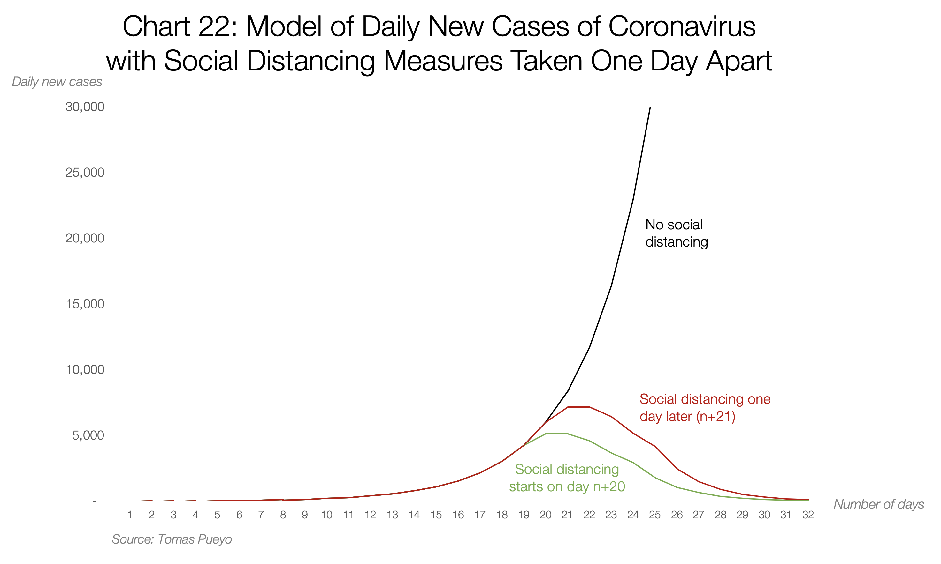
COVID-19: Tomas Pueyo
https://medium.com/@tomaspueyo/coronavirus-act-today-or-people-will-die-f4d3d9cd99ca
Prevent • Promote • Protect
www.elpasocountyhealth.org

Slide 19
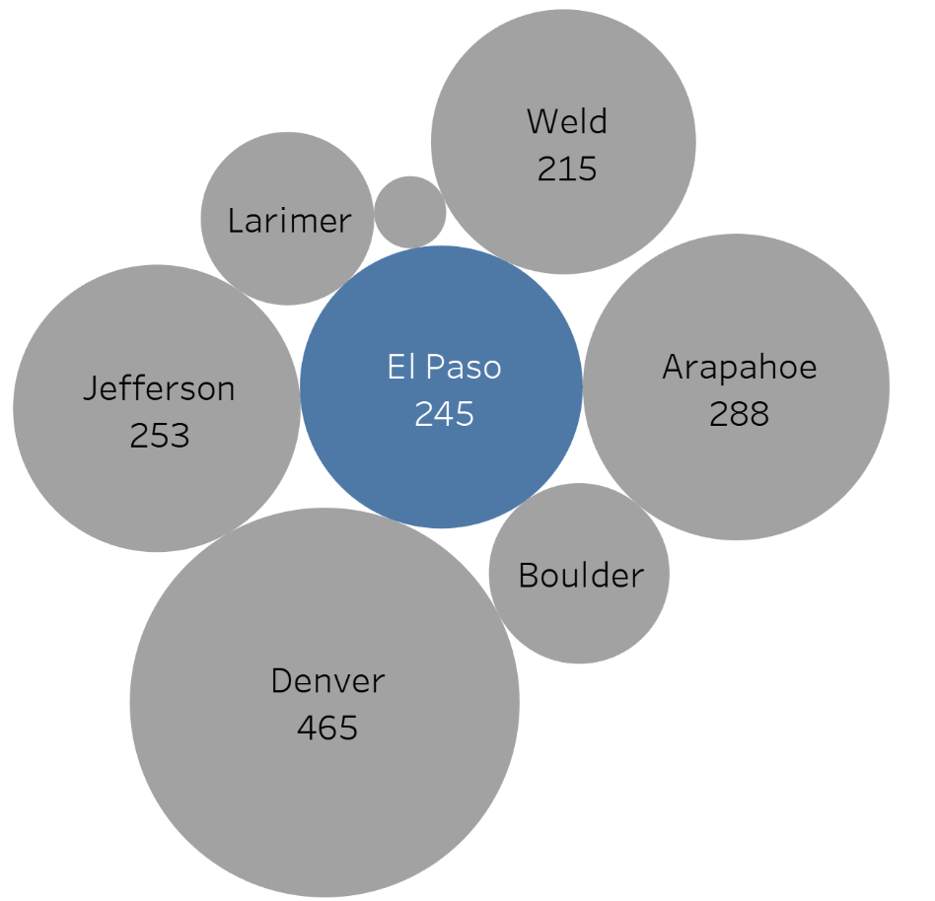
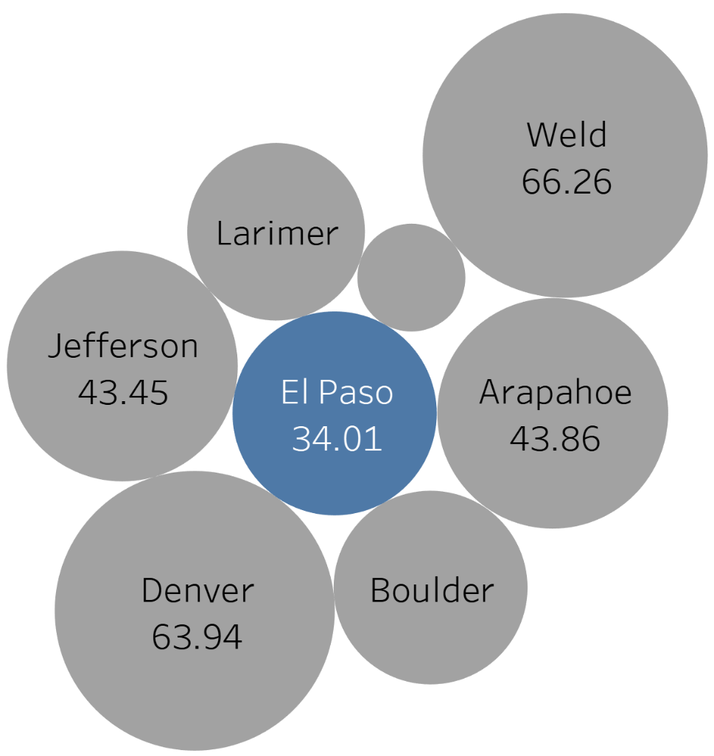
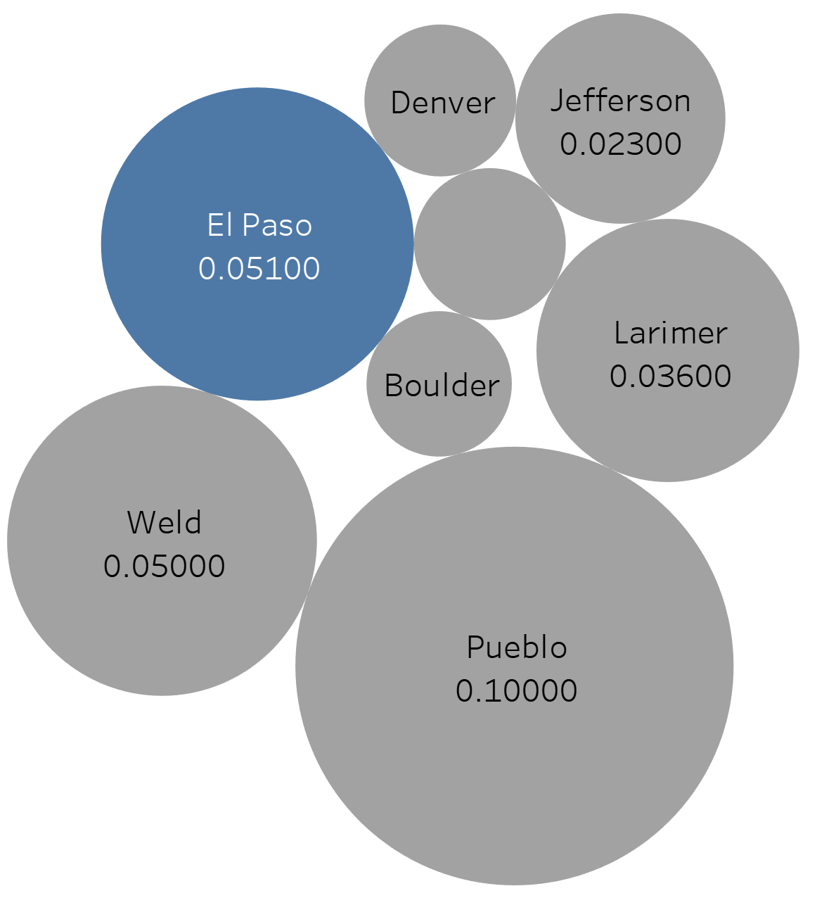
Cases per 100,000
(total cases/population)x100,000
Fatality Rate
(fatalities/number of cases)
Number of cases
Colorado COVID-19 case data as of 30-Mar-2020 at 5 p.m. Data from CDPHE, analyzed by El Paso County Public Health Data and Analytics Office.
Prevent • Promote • Protect
www.elpasocountyhealth.org

Slide 20
El Paso County case data as reported to Colorado Electronic Disease Reporting System (CEDRS) as of 28-Mar-2020 at 10 p.m. Case details and hospitalizations are limited by the lag times of test confirmations. Analyzed by El Paso County Public Health Data and Analytics Office.
Prevent • Promote • Protect
www.elpasocountyhealth.org

Slide 21
El Paso County case demographics as reported to Colorado Electronic Disease Reporting System (CEDRS) as of 28-Mar-2020 at 10 p.m. Case details and hospitalizations are limited by the lag times of test confirmations. Analyzed by El Paso County Public Health Data and Analytics Office.
Prevent • Promote • Protect
www.elpasocountyhealth.org

Slide 22
Prevent • Promote • Protect
www.elpasocountyhealth.org

Slide 23
Prevent • Promote • Protect
www.elpasocountyhealth.org

Slide 24
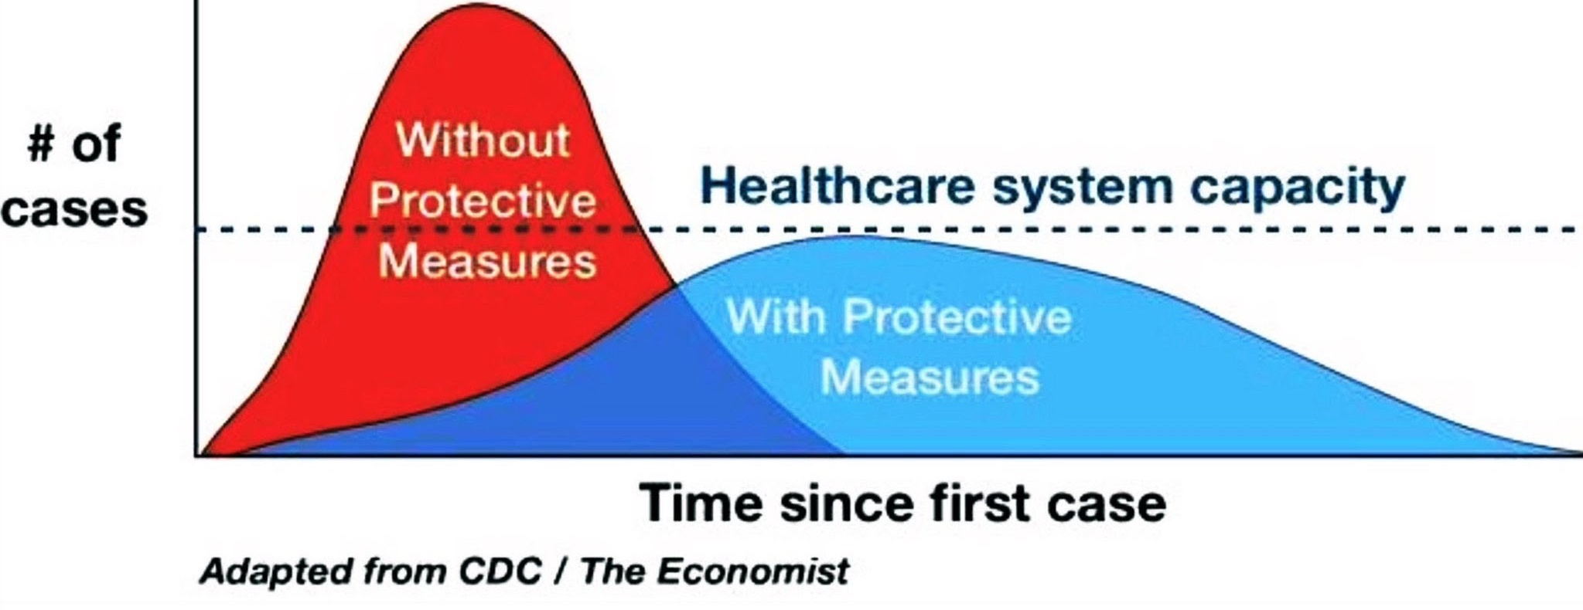
The Public Health Plan to Combat COVID-19: Containment and Mitigation
Prevent • Promote • Protect
www.elpasocountyhealth.org

Slide 25
COVID-19: Gates Foundation Model
usual
Klein D, et. al. Working paper, Institute for Dis Modeling. B&M Gates Foundation.
Baseline estimates: Jan 10 -> April 7
Alternative estimates: Institute social distancing of variable impact on March 10
Prevent • Promote • Protect
www.elpasocountyhealth.org

Slide 26
Prevent • Promote • Protect
www.elpasocountyhealth.org

Slide 27
On-Going Actions
Continuous collaboration with hospitals, long-term care facilities, homeless service providers, law enforcement, the Criminal Justice Center/Sheriff’s Office, first responders, media, schools, emergency response structure and greater community.
Provide engagement, education and subject expertise for city and county leadership and business partners.
Continuous data collection and policy refinement and deployment in coordination with federal, state, and local partners.
Continuous analysis of all local, state, federal and international data in order to drive and evaluate, education, outreach and intervention.
Prevent • Promote • Protect
www.elpasocountyhealth.org

