Slide 1
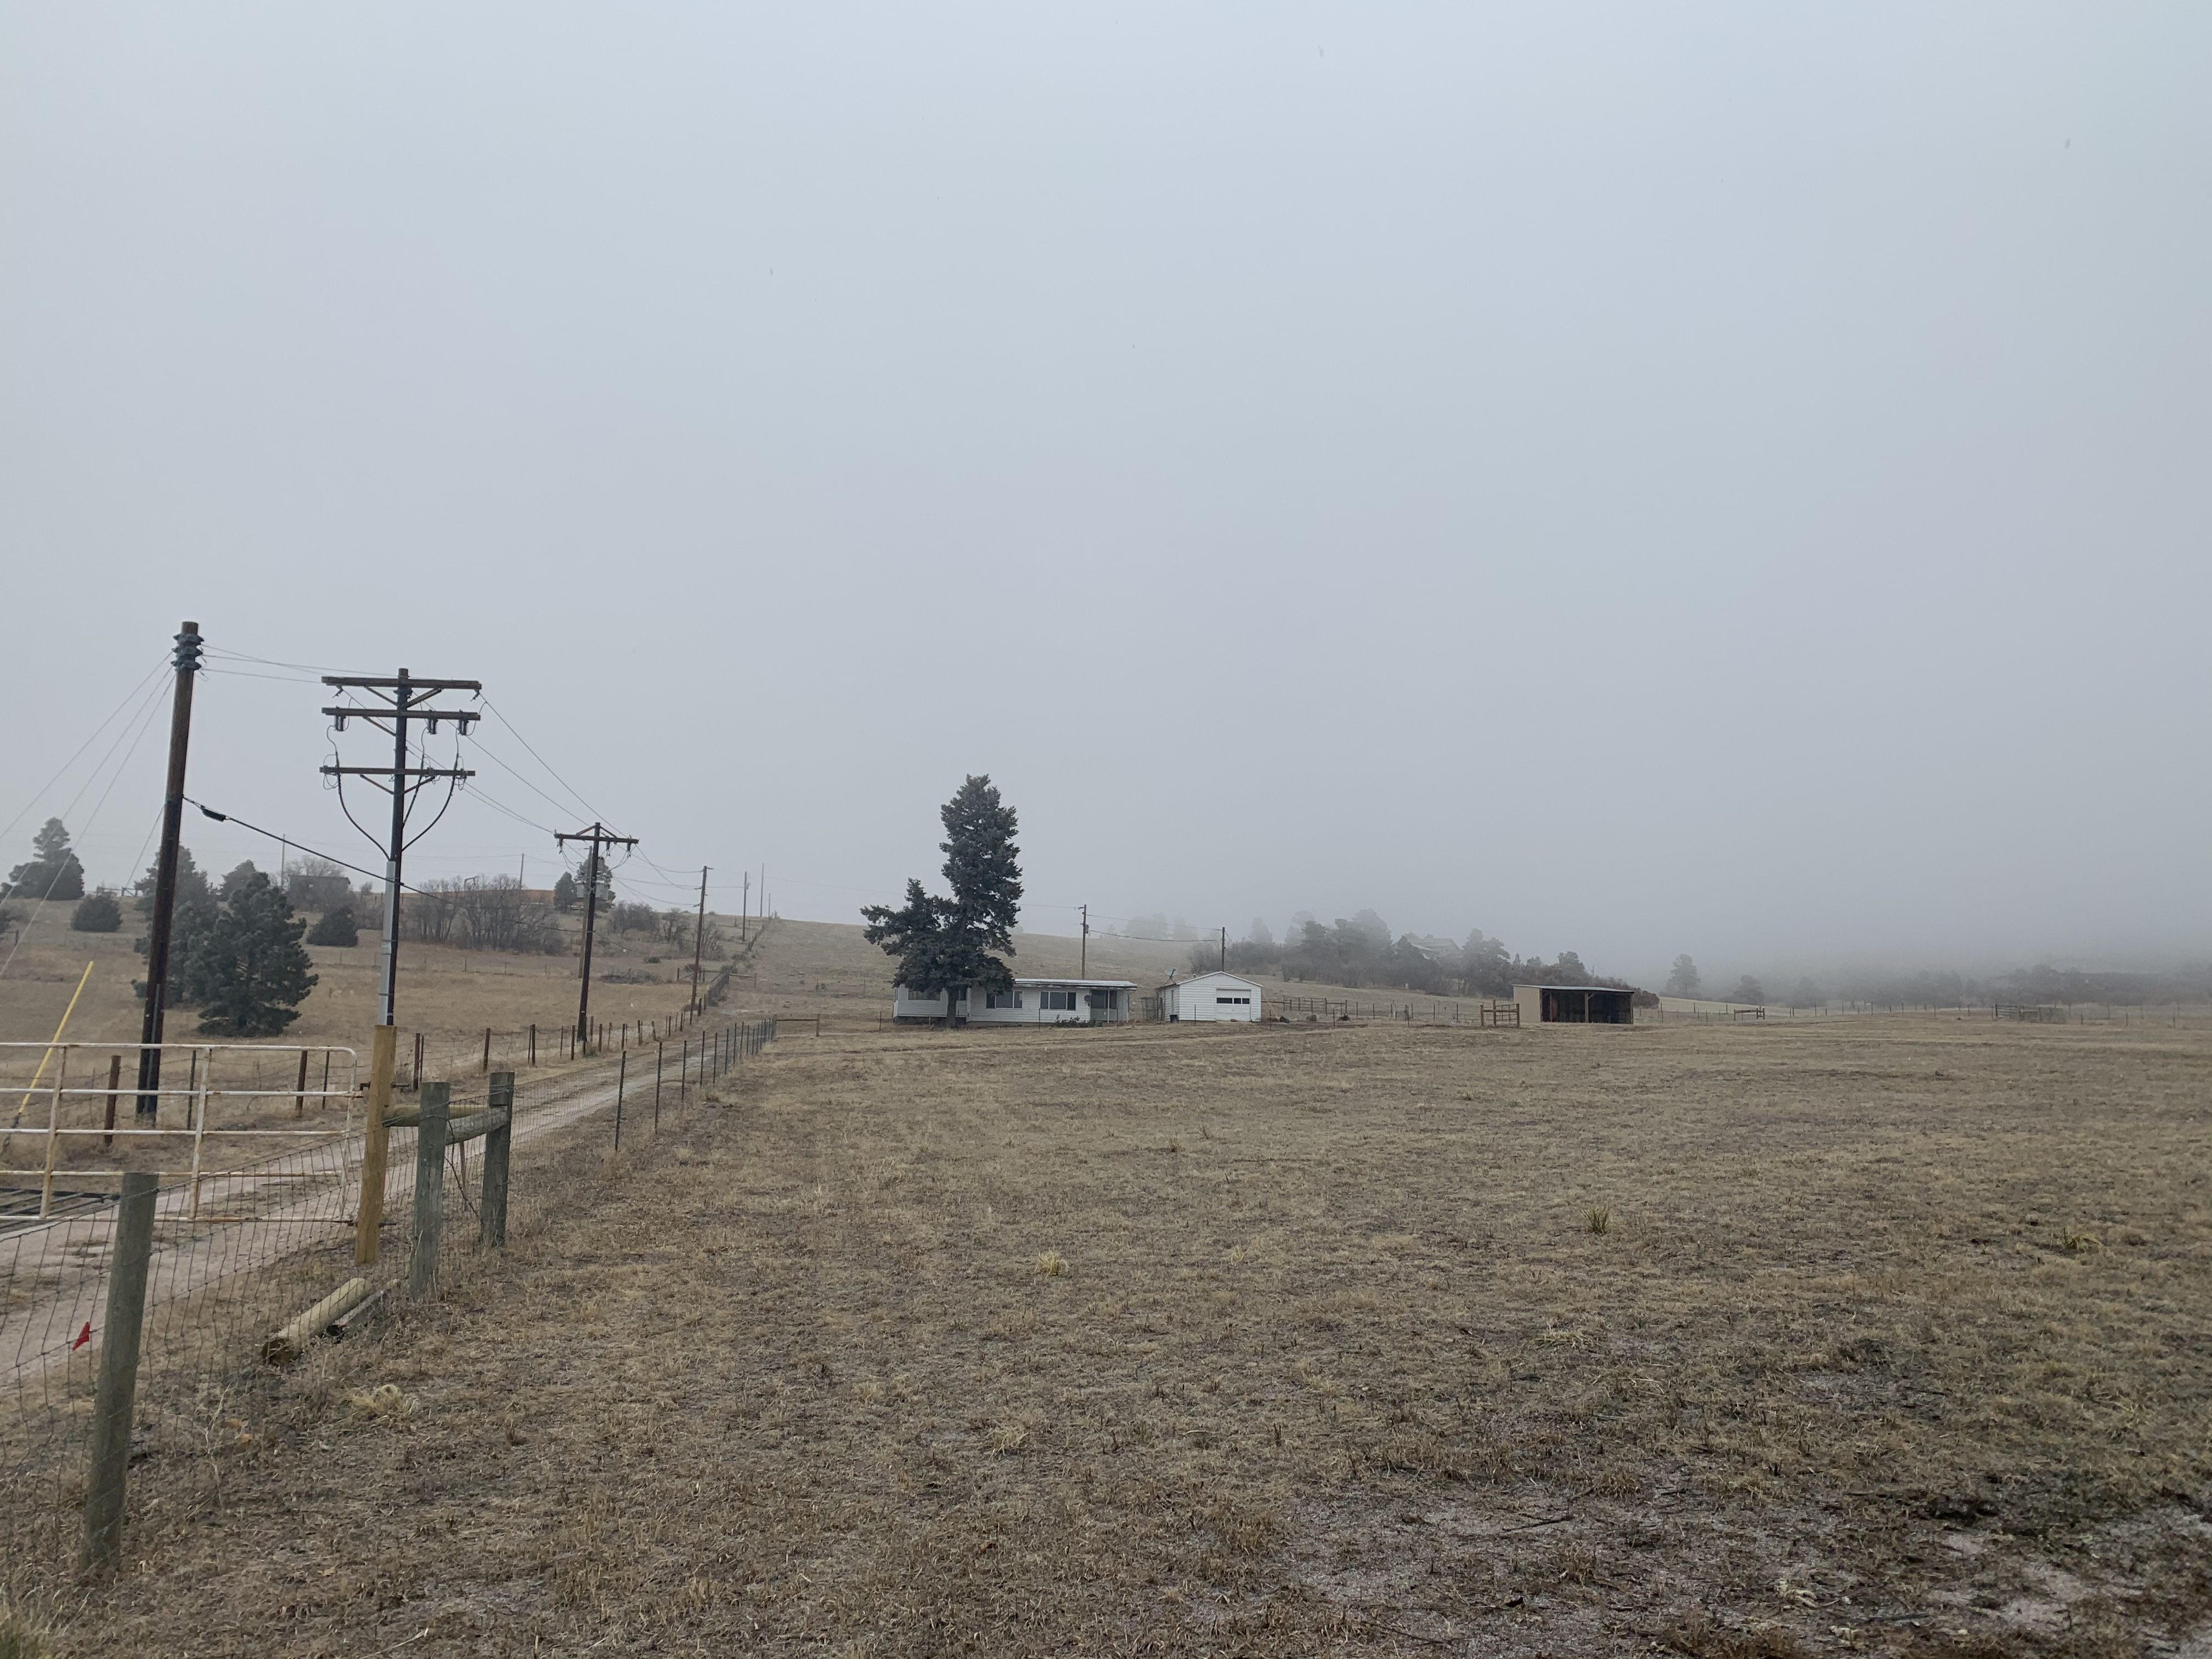
MS-19-008 Wolf Run Estates Minor Subdivision
Lindsay Darden, Planner II
Daniel Torres, PE Engineer II
Elizabeth NijKamp Engineer Review Manager

Slide 2
Review Criteria
Minor Subdivisions shall be required to conform to all preliminary plat and final plat approval criteria, except to the extent that those requirements are modified by the Land Development Code or the Procedures Manual.

Slide 3
Preliminary Plan Review Criteria
“The proposed subdivision is in general conformance with the goals, objectives, and policies of the Master Plan;”
“The subdivision is consistent with the purposes of the El Paso County Land Development Code;”
“The subdivision is in conformance with the subdivision design standards and any approved sketch plan”
“A sufficient water supply has been acquired in terms of quantity, quality, and dependability for the type of subdivision proposed, as determined in accordance with the standards set forth in the water supply standards [C.R.S § 30-28-133(6)(a)] and the requirements of Chapter 8 of the Code.”

Slide 4
Preliminary Plan Review Criteria
“A public sewage disposal system has been established and, if other methods of sewage disposal are proposed, the system complies with the state and local laws and regulations; [C.R.S. § 30-28-133(6)(b)] and the requirements of Chapter 8 of the Code”
“All areas of the proposed subdivision, which may involve soil or topographical conditions presenting hazards or requiring special precautions, have been identified and the proposed subdivision is compatible with such conditions [C.R.S. § 30-28-133(6)(c)] ;”
“Adequate drainage improvements complying with State Law [C.R.S. § 30-28-133(3)(c)(VIII)] and the requirements of the Code and the Engineering Criteria Manual are provided by the design;”

Slide 5
Preliminary Plan Review Criteria
“The location and design of the public improvements proposed in connection with the subdivision are adequate to serve the needs and mitigate the effects of the development”
“Legal and physical access is or will be provided to all parcels by the public rights-of-way or recorded easement, acceptable to the County in compliance with the Code and the ECM;”
“Necessary services, including police and fire protection, recreation, utiliies, open space and transportation system, are or will be available to serve the proposed subdivision;
“The subdivision provides evidence to show that the proposed methods for fire protection comply with Chapter 6 of the Code;

Slide 6
Preliminary Plan Review Criteria
“The proposed subdivision has established an adequate level of compatibility by:
Incorporating natural physical features into the design and providing sufficient open spaces considering the type and the intensity of the subdivision;
Incorporating site planning techniques to foster the implementation of the County’s plans, and encourage a land use pattern to support a balanced transportation system including auto, bike and pedestrian traffic, public or mass transit if appropriate, and the cost effective delivery of other services consistent with adopted plans, policies, and regulations of the County;
Incorporating physical design features in the subdivision to provide a transition between the subdivision and adjacent land uses;
Incorporating identified environmentally sensitive areas, including but not limited to, wetlands and wildlife corridors, into the design;
And Incorporating public facilities or infrastructure, or provisions therefore, reasonably related to the proposed subdivision so the proposed subdivision will not negatively impact the levels of service of County services and facilities; and”

Slide 7
Preliminary Plan Review Criteria
“The proposed subdivision meet other applicable sections of Chapter 6 and 8 of the Code.

Slide 8
Final Plat Review Criteria
“The proposed subdivision is in general conformance with the goals, objectives, and policies of the Master Plan;”
“The subdivision is in general conformance with the preliminary plan;”
“The subdivision is consistent with the subdivision design standards and regulations and meets all planning, engineering, and surveying requirements of the County for maps, data, surveys, analyses, studies, reports, plans, designs, documents, and other supporting materials;
“Either a sufficient water supply has been acquired in terms of quantity, quality, and dependability for the type of subdivision proposed, as determined in accordance with the standards set forth in the water supply standards [C.R.S § 30-28-133(6)(a)] and the requirements of Chapter 8 of the Code, or, with respect to applications for administrative final plat approval, such finding was previously made by the BoCC at the time of preliminary plan approval;”

Slide 9
Final Plat Review Criteria
“A public sewage disposal system has been established and, if other methods of sewage disposal are proposed, the system complies with the state and local laws and regulations; [C.R.S. § 30-28-133(6)(b)] and the requirements of Chapter 8 of the Code;”
“All areas of the proposed subdivision, which may involve soil or topographical conditions presenting hazards or requiring special precautions, have been identified and the proposed subdivision is compatible with such conditions [C.R.S. § 30-28-133(6)(c)] ;”
“Adequate drainage improvements are proposed that comply with State Statute [C.R.S. § 30-28-133(3)(c)(VIII)] and the requirements of the Code and the Engineering Criteria Manual;”
“Legal and physical access is or will be provided to all parcels by the public rights-of-way or recorded easement, acceptable to the County in compliance with the Code and the ECM;”
“Necessary services, including police and fire protection, recreation, utilities, and transportation system, are or will be available to serve the proposed subdivision;

Slide 10
Final Plat Review Criteria
“The final plans provide evidence to show that the proposed methods for fire protections comply with Chapter 6 of this Code;”
“Off-site impacts were evaluated and related off-site improvements are roughly proportional and will mitigate the impacts of the subdivision in accordance with applicable requirements of Chapter 8;”
“Adequate public facilities or infrastructure, or cash-in-lieu, for impacts reasonably related to the proposed subdivision have been constructed or are financially guaranteed through the SIA so the impacts of the subdivision will be adequately mitigated;”
“The subdivision meets other applicable sections of Chapters 6 and 8;”
“The extraction of any known commercial mining deposit shall not be impeded by this subdivision [C.R.S. § § 34-1-302(1), et seq.]

Slide 11
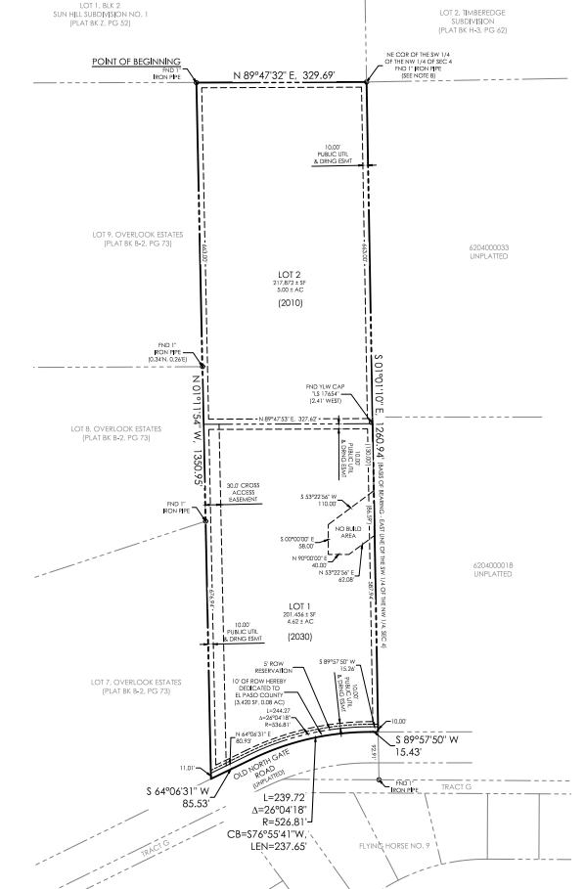
Request
A request by Gregory and Tanya Wolff for approval of a two lot minor subdivision with an associated waiver request to the 30’ minimum required lot frontage for access along a public road that is required by the Code.
On February 4, 2020, the El Paso County Planning Commission recommended approval of this request (5-0 vote in favor).

Slide 12
Property Owner
Property Owner/Applicant: Gregory and Tanya Wolff
Applicant’s Representative: David Gorman of M.V.E., Inc.

Slide 13
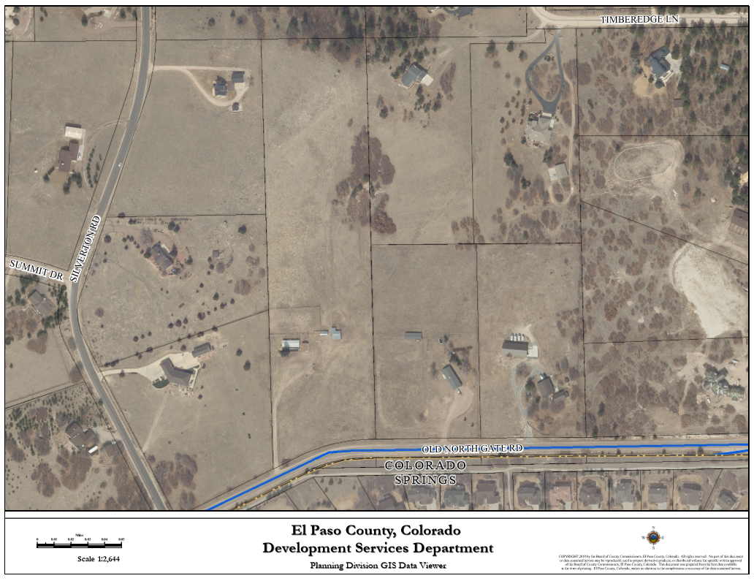
Vicinity Map
The property is located approximately 364 feet east of the intersection of Old North Gate and Silverton Roads
Site

Slide 14
Background and Existing Conditions
The subject property was initially zoned on January 4, 1955 and, due to nomenclature changes in the zoning districts over the years is within the RR-5 (Residential Rural) zoning district.
The 9.68-acre property has an existing single-family residence, garage, and barn, which are anticipated to remain on the proposed 4.62 acre lot adjacent to Old North Gate Road (Lot 1) until such time as the lot is sold and redeveloped.

Slide 15
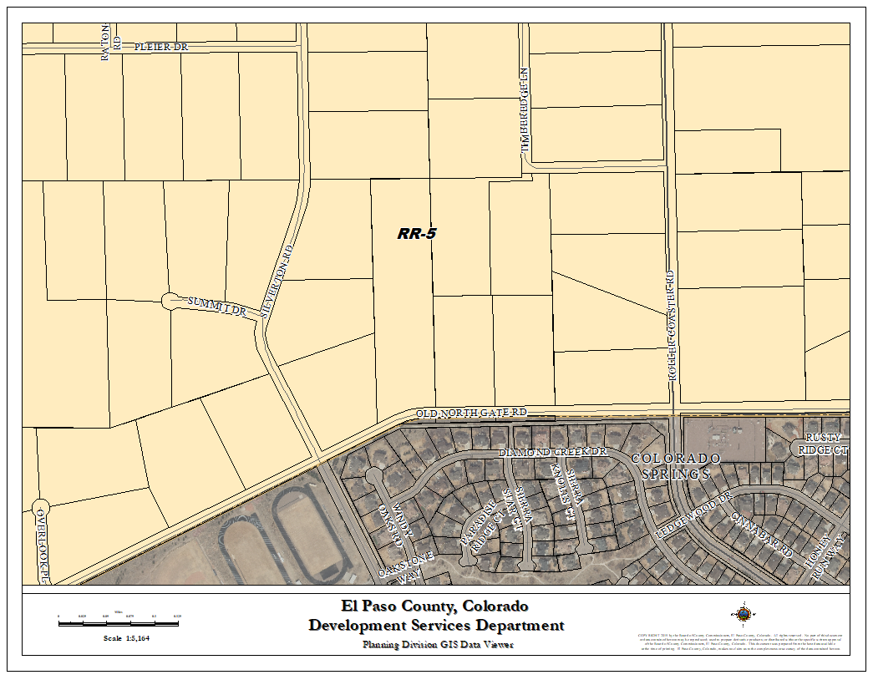
Zoning
The property is zoned RR-5 (Residential Rural).
The parcel is adjacent to property zoned RR-5 (Residential Rural) to the North, East, and West.
To the South are smaller single-family residential parcels within the City of Colorado Springs.
Site

Slide 16
Drainage And Erosion
The property is located within the Smith Creek (FOMO4000) and Monument Branch (FOMO3800) drainage basins. These drainage basins are studied and have drainage fees. All fees shall be due at time of final plat recordation.
A permanent water quality facility is not required per Appendix I of the El Paso County Engineering Criteria Manual (2019).
Furthermore, on-site detention was not required due to the minimal increase in impervious surface created by the additional residential lot. Per the associated drainage letter, the proposed minor subdivision will have no adverse impacts to the adjacent downstream lots.

Slide 17
Transportation
The property is accessed via Old Northgate Road which is an existing public local road. A traffic impact study was not required as the proposed minor subdivision is not expected to generate 100 daily vehicle trips more than the property would be expected to generate currently.
The subdivision is subject to the El Paso County Road Impact Fee Program.
The applicant will dedicate additional right-of-way along Old Northgate Rd.
10’ Right-of-Way Dedication along Old North Gate Road

Slide 18
Hazards
The soils and geology report indicated an area on Lot 1 where there is potential for shallow groundwater.
The report indicated that construction in this area should be avoided and would not be suitable for onsite wastewater treatment system (septic system).
No Build Area

Slide 19
Waivers
The Code requires that each lot have a minimum of 30 feet of frontage along a public roadway.
The applicant is requesting a waiver to that requirement for Lot 2 and instead proposes a 30 foot wide common access easement to serve both lots.
Proposed 30’ wide common access easement

Slide 20
Land Development Code Analysis
The final plat application meets the final plat submittal requirements, the standards for Divisions of Land in Chapter 7, and the standards for Subdivision in Chapter 8 of the El Paso County Land Development Code (2019).
The subject parcel meets all of the minimum dimensional requirements of the RR-5 (Residential Rural) zoning district except that Lot 1 does not meet the minimum lot size of five (5) acres.
On October 3, 2019, the Planning and Community Development Director approved administrative relief (ADR-19-014)to allow a lot size of 4.62 acres where 5 acres is the minimum lot size in the RR-5(Residential Rural) zoning district.

Slide 21
Policy Plan Analysis
Policy 6.1.3 - Encourage new development which is contiguous and compatible with previously developed areas in terms of factors such as density, land use, and access.
Policy 6.1.11- Plan and implement land development so that it will be functionally and aesthetically integrated within the context of adjoining properties and uses.
Policy 9.2.2 – Require advance right-of-way reservation and/or dedication for transportation facilities as part of the land development process.
Development on three sides of the subject parcel (west, north, and east) is similar density to the proposal with four to five acre lots and is utilized for single-family residential housing.
South of the parcel is also single-family residential development within the City of Colorado Springs with lot sizes generally ranging from 1/3 acre to 1/2 acre in size.
As previously mentioned, the applicant will be dedicating additional right-of-way along Old North Gate Road.

Slide 22
Small Area Plan Analysis
The property is located within the Smith Creek Sub-Area of the Tri-Lakes Comprehensive Plan (2000), which recommends that development should remain rural residential with an overall density of one dwelling unit per five acres and should not detract from natural forests, rolling hills, and open character of the area.
The RR-5 zoning of the area supports this goal of the Tri-Lakes Comprehensive Plan and the proposal is generally in keeping with the recommended density with one 5 acre lot and one 4.62 acre lot. The lots surrounding the subject parcel in the County range from 4.81 acres to 5.81 acres in size.

Slide 23
Water Master Plan Analysis
Goal 1.1 – Ensure an adequate water supply in terms of quantity, dependability and quality for existing and future development.
Goal 1.2 – Integrate water and land use planning.
The property is adjacent to the City of Colorado Springs to the south (directly across Old North Gate Road). The applicant contacted Colorado Springs Utilities (CSU) to determine whether utilities could be extended to the subject site. CSU indicated that this site did not meet the criteria for annexation; therefore, central utilities would not be extended.
The State Engineer and the County Attorney’s Office have recommended that the proposed minor subdivision has an adequate water supply in terms of quantity and dependability. The application was submitted prior to the date that the Code was revised to require a finding of water quality. The Code in effect at the time of application allowed for an assumption of water quality for minor subdivisions.

Slide 24
Conditions of Approval
All Deed of Trust holders shall ratify the plat. The applicant shall provide a current title commitment at the time of submittal of the Mylar for recording.
Colorado statute requires that at the time of the approval of platting, the subdivider provides the certification of the County Treasurer’s Office that all ad valorem taxes applicable to such subdivided land, or years prior to that year in which approval is granted, have been paid. Therefore, this plat is approved by the Board of County Commissioners on the condition that the subdivider or developer must provide to the Planning and Community Development Department, at the time of recording the plat, a certification from the County Treasurer’s Office that all prior years’ taxes have been paid in full.
Park fees in lieu of land dedication for regional parks (Area 2) in the amount of $912.00 shall be paid at time of plat recordation. No urban park fees are due with this minor subdivision.
The Applicant shall submit the Mylar to Enumerations for addressing.
Developer shall comply with federal and state laws, regulations, ordinances, review and permit requirements, and other agency requirements, if any, of applicable agencies including, but not limited to, the Colorado Division of Wildlife, Colorado Department of Transportation, U.S. Army Corps of Engineers and the U.S. Fish and Wildlife Service regarding the Endangered Species Act, particularly as it relates to the Preble's Meadow Jumping Mouse as a listed species.
Access (driveway) permits will be required for each access to an El Paso County owned and maintained roadway. Access permits are obtained from the El Paso County Planning and Community Development Department.

Slide 25
Conditions of Approval
The Subdivider(s) agrees on behalf of him/herself and any developer or builder successors and assignees that Subdivider and/or said successors and assigns shall be required to pay traffic impact fees in accordance with the El Paso County Road Impact Fee Program Resolution (Resolution No. 18-471), or any amendments thereto, at or prior to the time of building permit submittals. The fee obligation, if not paid at final plat recording, shall be documented on all sales documents and on plat notes to ensure that a title search would find the fee obligation before sale of the property.
Drainage fees for the Monument Branch basin in the amount of $7,629.93 shall be paid at time of plat recordation. Drainage and bridge fees for the Smith Creek basin in the amounts of $699.10 and $93.82, respectively, shall be paid at the time of final plat recordation
Park fees in lieu of land dedication for regional parks (Area 2) in the amount of $912.00 shall be paid at the time of plat recordation. No urban park fees are due with this minor subdivision.
Fees in lieu of school land dedication in the amount of $612.00 shall be paid to El Paso County for the benefit of Academy School District No. 20 at the time of final plat recording.
The County Attorney’s Conditions of Compliance shall be adhered to at the appropriate time.
All driveways shall comply with Appendix D of the adopted 2009 IFC for Fire Department access.

Slide 26
Notations
Final plats not recorded within 24 months of Board of County Commissioner approval shall be deemed expired, unless an extension is approved.

Slide 27
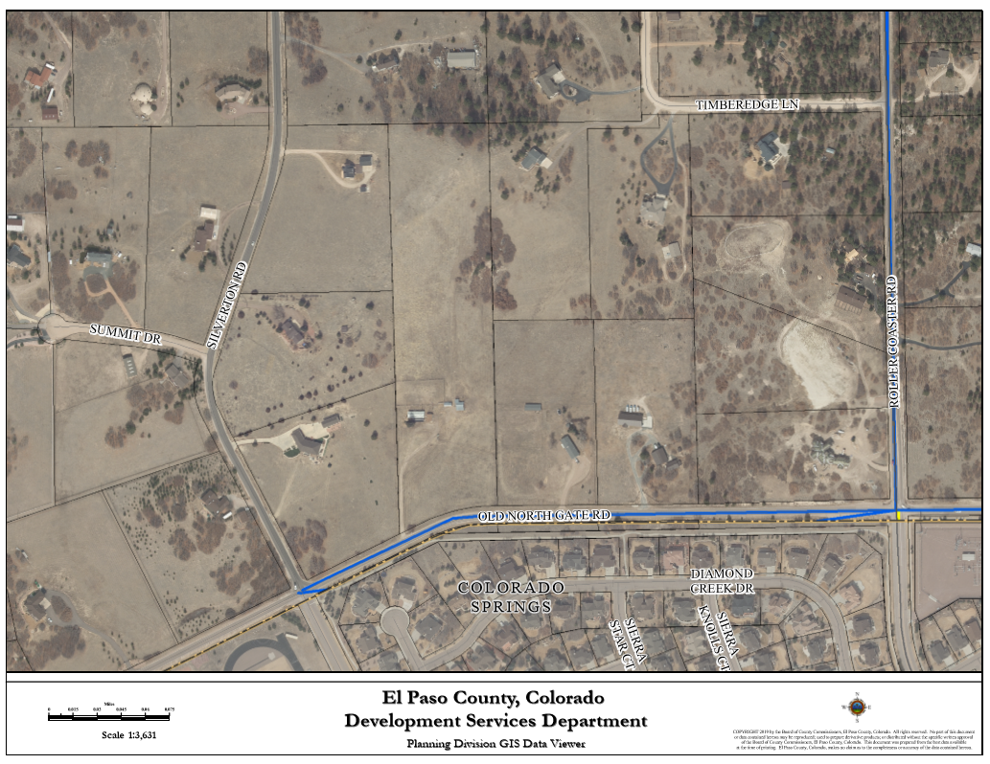
Posting
Fifteen (15) adjoining property owners were notified on January 15, 2020 for the February 25, 2020 Board of County Commissioners Hearing.
Three property owners oppose the request (Red).
Site
v

Slide 28
Questions for Staff

