Slide 1
Falcon field metropolitan district
ID-19-005
Gabe Sevigny
Daniel Torres

Slide 2
Mandatory Criteria for Disapproval
The BoCC shall disapprove the draft service plan unless evidence satisfactory to it of each of the following is presented or, in the BoCC ' s discretion, the BoCC conditionally approves the draft service plan to cause compliance with these criteria (C.R.S. § 32-1-203(2)):
There is sufficient existing and projected need for organized service in the area to be served by the proposed special district;
The existing service in the area to be served by the proposed special district is inadequate for present and projected needs;
The proposed special district is capable of providing economical and sufficient service to the area within its proposed boundaries;
The area to be included in the proposed special district has, or will have, the financial ability to discharge the proposed indebtedness on a reasonable basis.

Slide 3
Discretionary Criteria for Disapproval
The BoCC may disapprove the draft service plan if evidence of the following, at the BoCC ' s discretion, is not presented (C.R.S. § 32-1-203(2.5)):
Adequate service is not, or will not be, available to the area through the County or other existing municipal or quasi-municipal corporations, including existing special districts, within a reasonable time and on a comparable basis;
The facility and service standards of the proposed special district are compatible with the facility and service standards of each County within which the proposed special district is to be located and each municipality which is an interested party as defined in C.R.S. § 32-1-204 and this Code;
The proposal is in substantial compliance with the El Paso County Master Plan;
The proposal is in compliance with any duly adopted County regional, or State long-range water quality management plan for the area; or
The creation of the proposed special district will be in the best interests of the area proposed to be served.

Slide 4
Applicant
Applicant: Falcon Field, LLC
Representative: White Bear Ankele Tanaka & Waldron, P.C.

Slide 5
Staff Report
Standard staff report template
June 25, 2007 County Special District Policies attached
Complete Service Plan provided as supplemental attachment
Plan follows Model Service Plan as adopted by BoCC on 6/25/2007

Slide 6
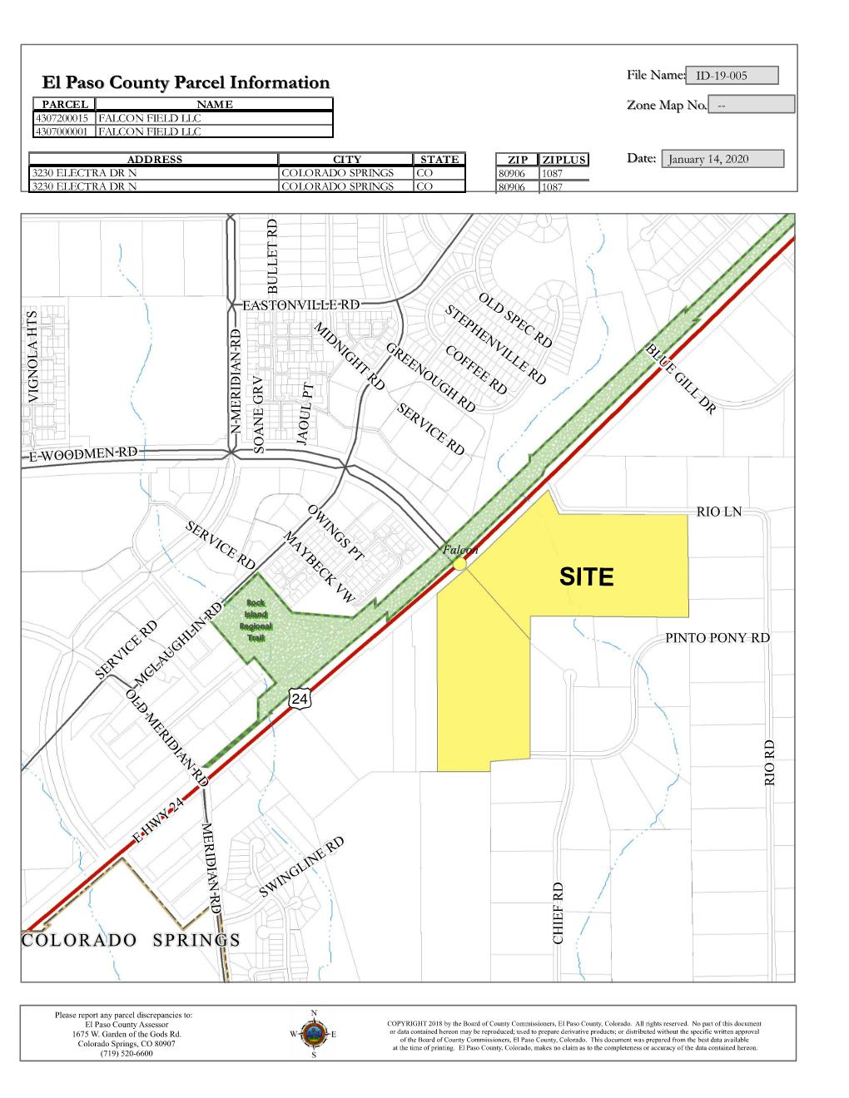
Vicinity

Slide 7
Background
The current configuration of the two parcels was created April 3, 2006, which is after the modern subdivision regulations went into effect on July 17, 1972, making these parcels the result of an illegal subdivision of land.
A condition has been added that approval of a preliminary plan and a final plat, and recording of the final plat is required prior to land disturbance, unless approval of a pre-development site grading request is granted by the BoCC at preliminary plan stage.
A condition has been added to prevent the issuance of debt until the preliminary plan and final plat have been approved.
Current zoning is RR-5, there is a concurrent request for a map amendment to CR, however, approval has not be received.
A condition has been added to prevent the issuance of debt until the map amendment has been approved.
The County Attorney has also advised the applicant of a condition added in the proposed service plan that prevents issuance of debt until zoning is completed. This action has been completed with the updated service plan.
The intent of the development is for 1 big box store and 12 individual pad sites that if approved would have commercial uses.

Slide 8
Purposes of the districts
Roadway infrastructure (construction)
Drainage facilities (construction, maintenance, ownership)
Recreation facilities (construction, maintenance, ownership)
Covenant enforcement
Mosquito control
Water and Wastewater (construction/extension only, service and maintenance by Woodmen Hills Metro District)
Security Services
Television Relay and translation facilities (construction, maintenance)

Slide 9
Service area
Service area is 57.67 Acres and in current configuration is comprised of:
2 Residential Lots
There is an application for a proposed CR zoning district, unless the zoning is approved and any future preliminary plan and final plat is approved, and the final plat recorded, there is no need for the formation of the district.

Slide 10
Mill Levy and bonding
30 Mills for debt service- improvements to be financed:
Water, streets, traffic and safety controls, parks and recreation, drainage, including storm water drainage, sanitary sewer, and related grading, and television relay and translation.
Anticipated infrastructure cost $13,110,000
5 Mills for operations and maintenance- proposed ongoing services:
Public Improvements not conveyed to the County, Woodman Hills Metro District, specifically storm drainage/detention ponds, and covenant control for the project and properties included within the District’s boundaries.
1 Mills for special purpose levy-
a special purpose levy that is anticipated to be remitted to Woodman Hills Metro District, to allocate towards its Park and Recreation Fund.
Maximum combined 36 Mills
$20 million authorized debt

Slide 11
Existing Mill Levies 2019
El Paso County 7.222
El Paso County Road and Bridge 0.330
School District No. 49 43.189
Pikes Peak Library District 3.731
Falcon Fire Protection District 14.886
Upper Black Squirrel Creek Ground Water 1.029
TOTAL: 70.387
PROPOSED NEW DISTRICT TOTAL: 106.387
*The current assessed rate of 7.15 is a residential rate, if the zoning is approved, and the lots are developed, a new assessment of 29.00 can be assessed to each individual lot. This will be a drastic change in the taxes assessed against each property.

Slide 12
Disclosure
Standard Disclosure will be required
Exhibit to service plan
Will be required with subsequent plats
Updates required annually thereafter
To be posted on County web site

Slide 13
Staff Analysis and Issues
There presently is no need for the district. The subject parcels require approval of the above applications prior to any development. If approvals are secured, then such development and the provision of ongoing maintenance of the associated utilities would establish sufficient need for the proposed District. Condition 10 prevents the proposed District from imposing any debt until such approvals have been obtained.
Adequate Service is Not or Will Not be Available Through Other Sources
Water/Wastewater by Woodmen Metropolitan District
Infrastructure to be maintained by EPC
Exception: detention ponds/open space
Potential Rational for District
Ability to secure upfront financing to construct infrastructure
The applicant is assuming that full build-out will capitalize on the growing need of retail shopping and restaurants in this area of the County. If their assumptions are incorrect and the additional need for commercial development in this area of the County does not develop, the ability of the District to service the issued debt could be compromised.

Slide 14
Recommended Conditions and Notations
Standard Conditions along with 2 additional conditions
10. The District shall not be authorized to issue debt until and unless approval of a rezoning, preliminary plan, and final plat have been obtained and unless such approvals are consistent with the assumed land uses and densities identified within the service plan and are consistent with the associated financial plan.
11. Any future proposed development of the subject parcels will require approval of a preliminary plan and final plat(s), and the final plat(s) must be recorded prior to land disturbance, unless approval a pre-development site grading request is granted by the Board of County Commissioners at the preliminary plan stage.

Slide 15
Finance Department analysis
Based on the data provided by the developer, the effect on EPC specific ownership tax revenues would be:
Start with an estimated reduction of $90 in year 2024, growing to a reduction of $1,220 in 2027, and staying at that amount in perpetuity until the metro district closed (2053, according to financial projections).
This would be more than offset by increased property tax collections based on the increased market/assessed valuations provided by the development.
* Information provided by Nikki Simmons

Slide 16
Questions?

