Slide 1
Walden Preserve 2 Flg No 4 SF-18-034
Nina Ruiz
Gilbert LaForce

Slide 2
Stormwater Violation Update
Strive for transparency
Ensure health, safety, and welfare for EPC
Standard operating procedure does not allow for items to continue on for approval without addressing ongoing violations

Slide 3
Outstanding Violation
A stop work order was issued on January 14, 2020 for construction activities beyond the approved Grading and Erosion Control (GEC) Plans for Monument Academy.
No construction BMPs were implemented
Land disturbance outside the limits of construction defined in the GEC Plans.
1.7 ac, Approved limits of disturbance
7.2 ac, 30 ft of disturbance on either side of the Road
Borrow/Fill sites
1.52 ac, Site A
1.84 ac, Site B
4.75 ac, Site C
15.3 acres of additional land disturbance

Slide 4
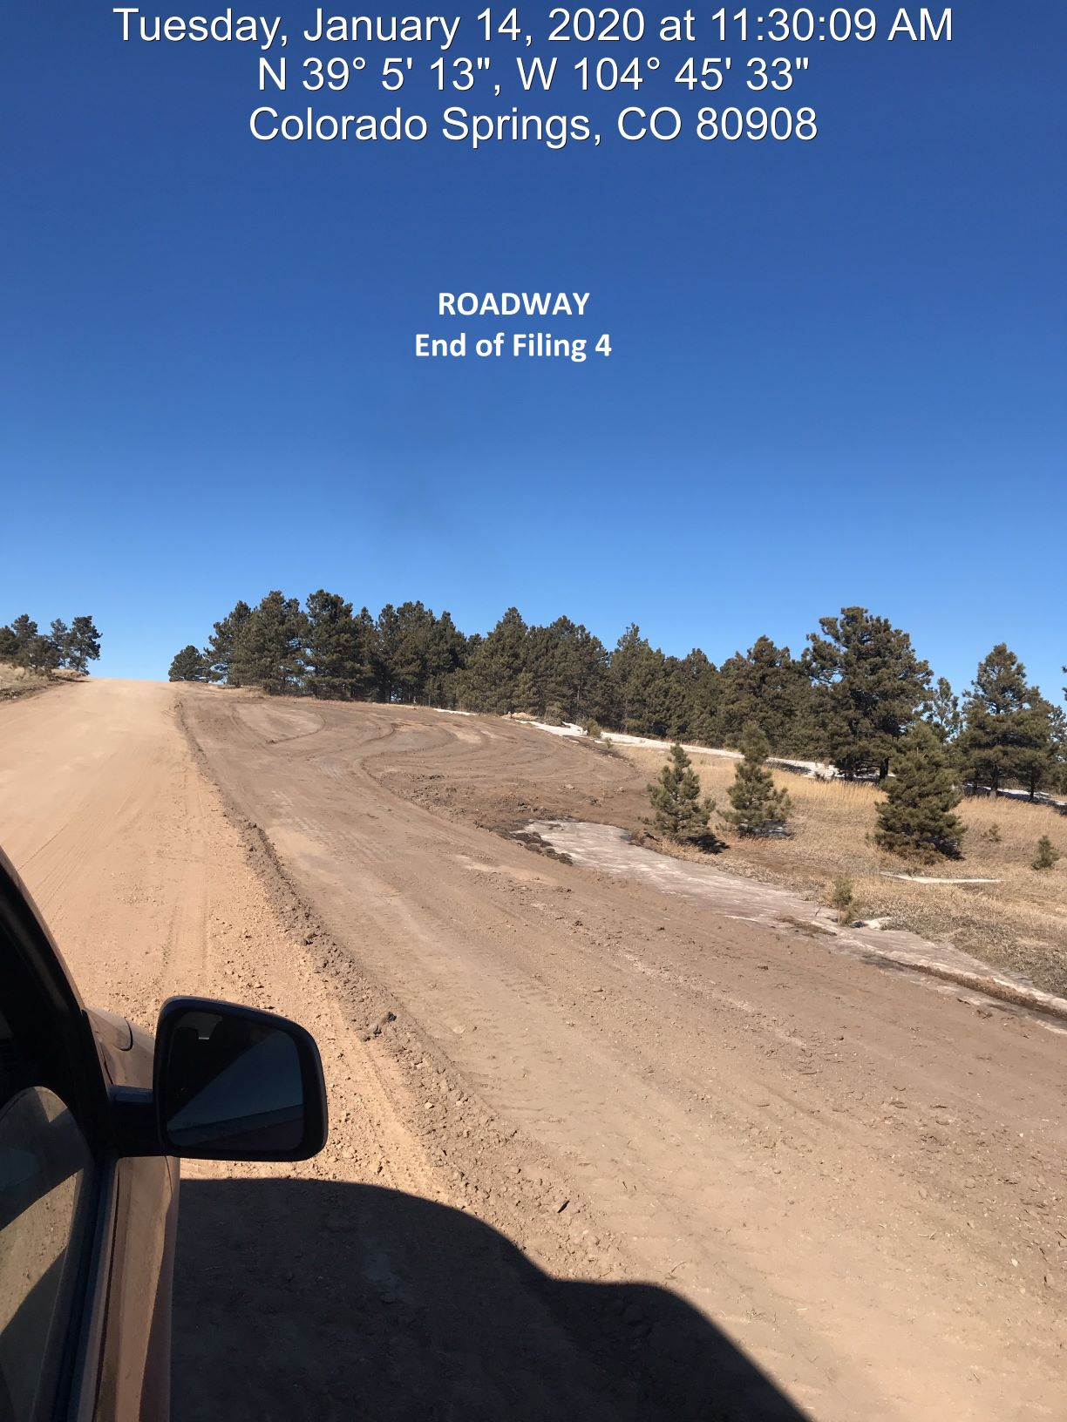
1.7 ac, Approved limits of disturbance
7.2 ac, 30 ft of disturbance on either side of the Road
Borrow/Fill sites
1.52 ac, Site A
1.84 ac, Site B
4.75 ac, Site C
15.3 acres of additional land disturbance

Slide 5
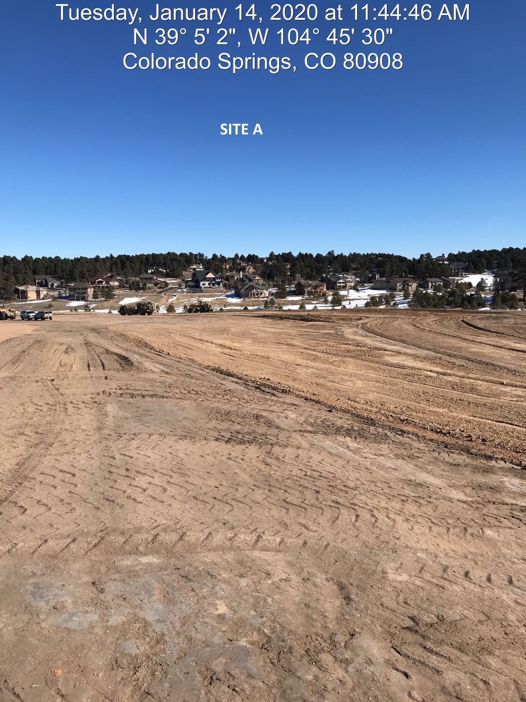
1.7 ac, Approved limits of disturbance
7.2 ac, 30 ft of disturbance on either side of the Road
Borrow/Fill sites
1.52 ac, Site A
1.84 ac, Site B
4.75 ac, Site C
15.3 acres of additional land disturbance

Slide 6
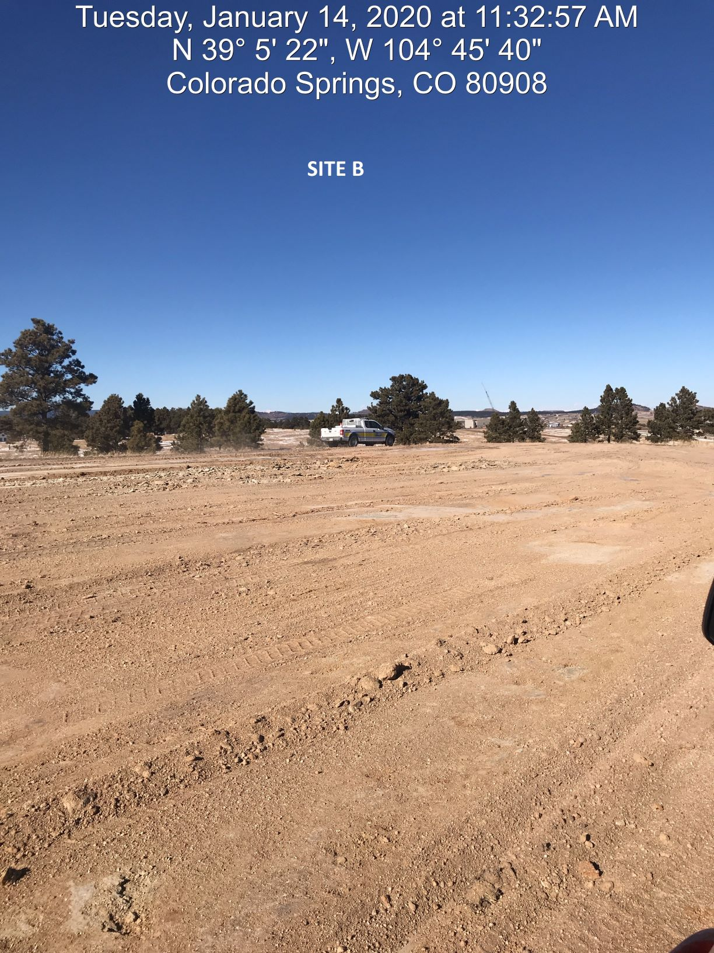
1.7 ac, Approved limits of disturbance
7.2 ac, 30 ft of disturbance on either side of the Road
Borrow/Fill sites
1.52 ac, Site A
1.84 ac, Site B
4.75 ac, Site C
15.3 acres of additional land disturbance

Slide 7
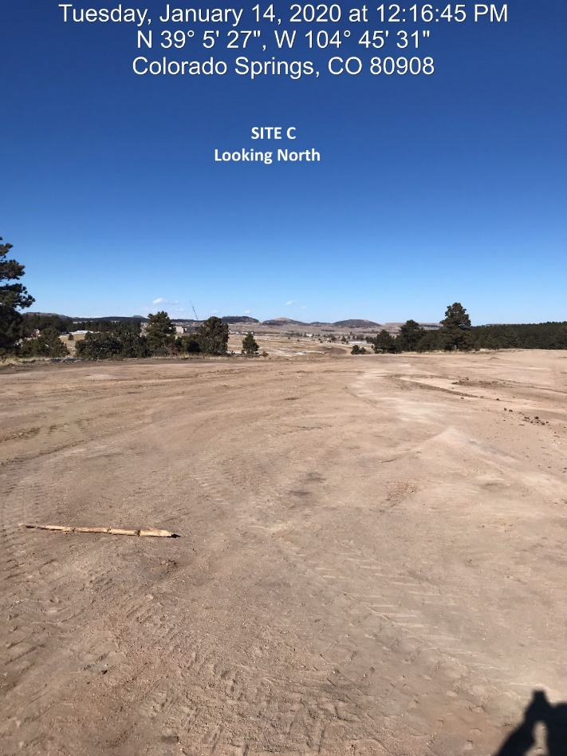
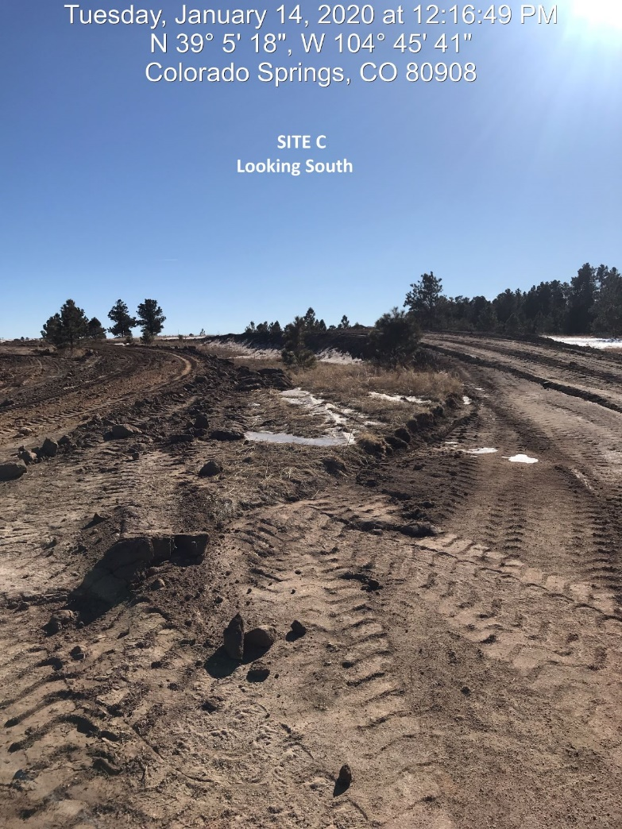
3.6 ac, Approved limits of disturbance
7.2 ac, 30 ft of disturbance on either side of the Road
Borrow/Fill sites
1.52 ac, Site A
1.84 ac, Site B
4.75 ac, Site C
15.3 acres of additional land disturbance

Slide 8
How do you wish to proceed?
Due to the outstanding violation of the County’s stormwater standards, PCD staff feels that it is appropriate to seek direction from the Board of County Commissioners regarding the stormwater violation, particularly with regard to whether this final plat application should proceed to hearing and/or approval prior to resolution of the existing stormwater and construction permit violations.
Postpone the hearing until the violation has been cured.
Hear the item today with a condition which would require the applicant to remedy the violation prior to recording the final plat.
Other.

Slide 9
Proposed Condition
The final plat shall not be recorded until the site is in full compliance with all El Paso County regulations and the stormwater violation has been resolved.

Slide 10
Criteria for Approval
7.2.1.D.3 Final Plat
The subdivision is in conformance with the goals, objectives, and policies of the Master Plan;
The subdivision is in substantial conformance with the approved preliminary plan;
The proposed subdivision is consistent with the subdivision design standards and regulations and meets all planning, engineering, and surveying requirements of the County for maps, data, surveys, analyses, studies, reports, plans, designs, documents, and other supporting materials;
A sufficient water supply has been acquired in terms of quantity, quality, and dependability for the type of subdivision proposed, as determined in accordance with the standards set forth in the water supply standards [C.R.S. §30-28-133(6)(a)] and the requirements of Chapter 8 of this Code;
A public sewage disposal system has been established and, if other methods of sewage disposal are proposed, the system complies with state and local laws and regulations. [C.R.S. §30-28-133(6)(b)] and the requirements of Chapter 8 of this Code;

Slide 11
Criteria for Approval
All areas of the proposed subdivision, which may involve soil or other topographical conditions presenting hazards or requiring special precautions, have been identified and the proposed subdivision is compatible with such conditions [C.R.S. 30-28-133(6)(c)];
Adequate drainage improvements are proposed that comply with State Statute [C.R.S. §30-28-133(3)(c)(VIII) and the requirements of this Code and the ECM;
Legal and physical access is provided to all parcels by public rights-of-way or recorded easement, acceptable to the County in compliance with this Code and the ECM;
Necessary services, including police and fire protection, recreation, utilities, and transportation system, are or will be made available to serve the proposed subdivision;
The final plans provide evidence to show that the proposed methods for fire protection comply with Chapter 6 of this Code;
Off-site impacts were evaluated and related off-site improvements are roughly proportional and will mitigate the impacts of the subdivision in accordance with applicable requirements of Chapter 8;
Adequate public facilities or infrastructure, or cash-in-lieu, for impacts reasonably related to the proposed subdivision have been constructed or are financially guaranteed through the SIA so the impacts of the subdivision will be adequately mitigated;
The subdivision meets other applicable sections of Chapter 6 and 8; and
The extraction of any known commercial mining deposit shall not be impeded by this subdivision [C.R.S. §§34-1-302(1), et. seq.]

Slide 12
Criteria for Approval
7.3.3 Criteria for Approval of Waivers- A waiver from standards shall be approved only upon the finding, based upon the evidence presented in each specific case, that:
The waiver does not have the effect of nullifying the intent and purpose of the Code
The waiver will not result in the need for additional subsequent waivers;
The granting of the waiver will not be detrimental to the public safety, health, or welfare or injurious to other property;
The conditions upon which the request for a waiver is based are unique to the property for which the waiver is sought and are not applicable to other property;
A particular non-economical hardship to the owner would result from a strict application of the Code;
The waiver will not in any manner vary the zoning provisions of the Code
The proposed waiver is not contrary to any provision of the Master Plan

Slide 13
Park Land Agreement
Discussion at Planning Commission regarding the trail.
The trail was never constructed to regional trail standards
The applicant has just entered into a new Park Lands Agreement and the Developer will pay fees in lieu for the remaining filings

Slide 14
Walden Preserve 2 Filing 4
Owner: Walden Holdings I LLC
Representative: Land Resources Associates

Slide 15
Background
12/16/04 Walden Preserve PUD
Overall density of 1DU/3.16 ac
Minimum lot size 2.5 ac
03/20/14 Walden Preserve 2 PUD
Overall density of 1DU/1.8 ac
Minimum lot size of 1 ac
12/17/19 Walden Preserve 2 PUD Amendment
Amendment to lot configuration

Slide 16
Request

Slide 17
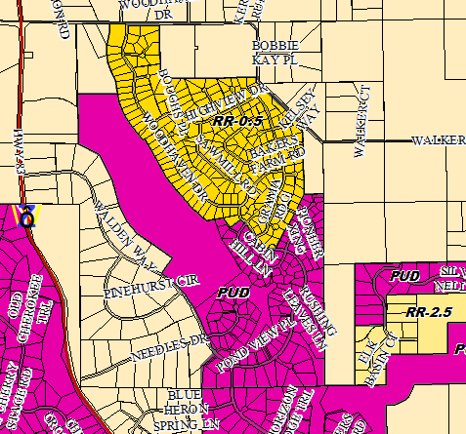
Zoning
X

Slide 18
Policy Plan
Policy 6.1.3- Encourage new development which is contiguous and compatible with previously developed areas in terms of factors such as density, land use, and access.
Policy 6.1.6- Direct development toward areas where the necessary urban-level supporting facilities and services are available or will be development concurrently.
Policy 6.1.11- Plan and implement land development so that it will be functionally and aesthetically integrated within the context of adjoining properties and uses.
Policy 6.1.13- Encourage the use of carefully planned and implemented clustering concepts in order to promote efficient land use, conservation of open space and reduction of infrastructure costs.

Slide 19
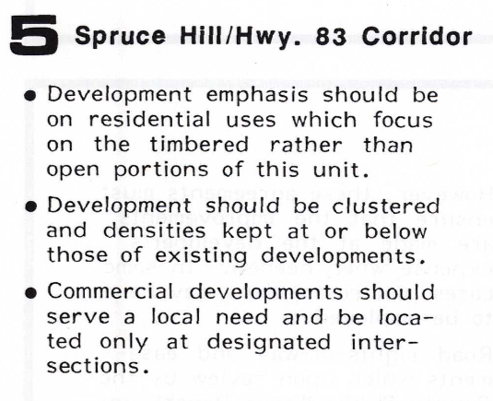
Small Area Plan

Slide 20
Water Master Plan
For Background ONLY:
Goal 1.1 – Ensure an adequate water supply in terms of quantity, dependability and quality for existing and future development.
Goal 1.2 – Integrate water and land use planning.
Policy 6.0.11 – Continue to limit urban level development to those areas served by centralized utilities.

Slide 21
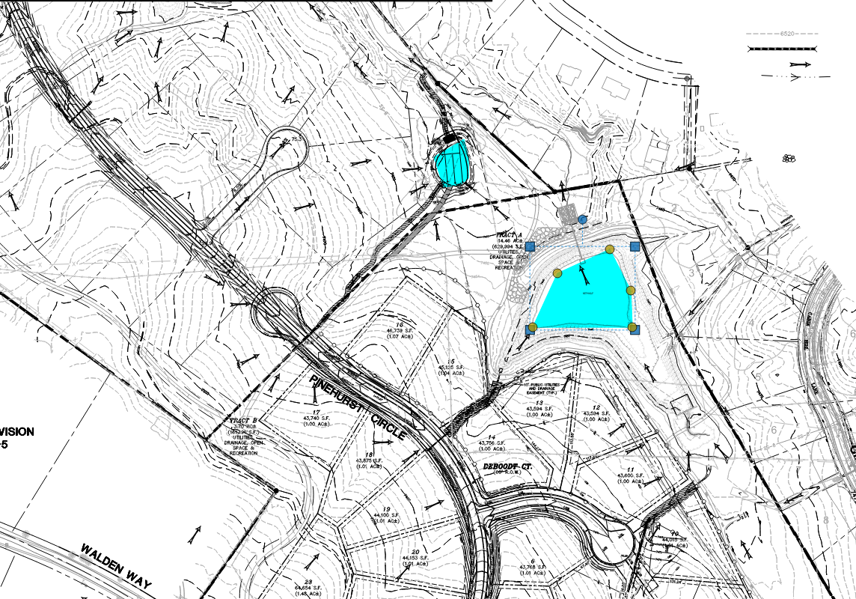
Floodplain & Drainage
No lots are impacted by the floodplain
West Cherry Creek basin (no fee)
Utilizing existing retention pond and proposed water quality facility

Slide 22
Transportation
The subdivision is accessed from Walden Way via an extension of Pinehurst Circle.
All streets are planned to be public roads and will be dedicated to El Paso County.
The platting of this subdivision will result in the dedication of approximately 0.35 miles of developer-constructed rural local roadways for ongoing County ownership and maintenance.
Deviation request to ECM Appendix B Section B.1.3 was approved. Full traffic impact study will be required with the next filing when the planned through connection to the north is proposed.

Slide 23
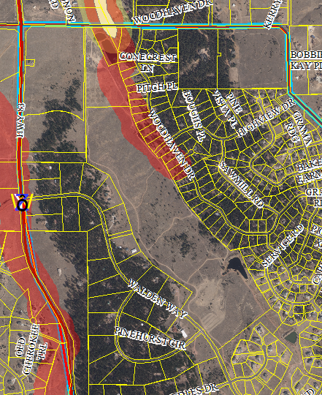
Notification
December 19, 2019 (56)

Slide 24
Questions?

