Slide 1
WALDEN PRESERVE 2

Slide 2
WALDEN PRESERVE 2 FILING NO. 4A
FINAL PLAT APPROVAL APPLICATION
SF-18-034
WALDEN HOLDINGS I, LLC
APPLICANT
EL PASO COUNTY
BOARD OF COUNTY COMMISSIONERS
JANUARY 28, 2020

Slide 3
VICINITY MAP
TOTAL SITE AREA – 135.05 AC
APPROVED USES
SINGLE FAMILY RESIDENTIAL – 73 LOTS
OPEN SPACE – 59.94 AC
EXISTING ZONING – PUD

Slide 4
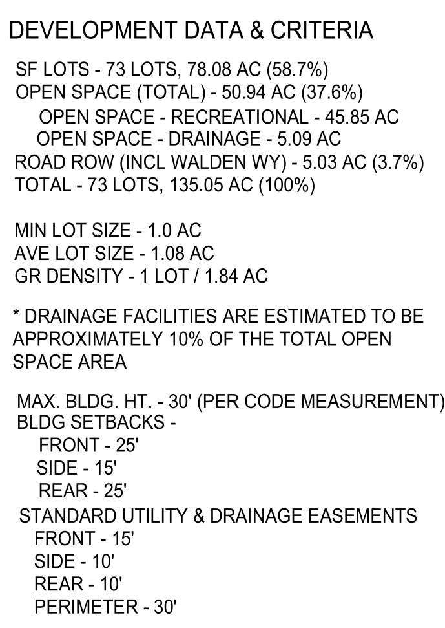
MASTER PLAN

Slide 5
FINAL PLAT WALDEN PRESERVE 2 FILING NO. 4A
DEVELOPMENT DATA
TOTAL AREA – 45.27 AC
TOTAL LOTS – 23
OPEN SPACE – 18.16 AC
MIN LOT SIZE – 1.0 AC
AVE LOT SIZE – 1.06 AC
GR DENSITY – 1 LOT / 1.97 AC

Slide 6
TRANSPORTATION

Slide 7
TRAILS, OPEN SPACE & RECREATION

Slide 8
WALDEN REGIONAL TRAIL

Slide 9
WALDEN REGIONAL TRAIL

Slide 10
WALDEN
REGIONAL
TRAIL

Slide 11
WALDEN REGIONAL TRAIL INVOICE TOTAL - $107,700.30

Slide 12
APPROVAL CRITERIA

Slide 13
APPROVAL CRITERIAL cont.

