Slide 1
Chuck Broerman
El Paso County Clerk and Recorder
Commissioner Update
January 28, 2020

Slide 2
Motor Vehicle Kiosk
Kiosk program started-Late September 2017
Location | Transactions
Union Town Center | 46,484
Powers | 33,443
Centennial Hall | 24,370
Citizens Service Center | 19,757
Total | 124,054

Slide 3
Motor Vehicle Kiosk 2019
2019 Kiosk Statistics
Location | Transactions
Union Town Center | 26,868
Powers | 17,209
Centennial Hall | 12,728
Citizens Service Center | 10,372
Stetson Hills King Soopers | 1,021 |  | Open 10/9/2019
Academy King Soopers | 669 |  | Opened 10/24/2019
Other | 9,904

Slide 4
Motor Vehicle Kiosk- Statewide
County | Completed English Count | Completed Spanish Count | Completed Total Trans_Count
El Paso County | 67443 | 2008 | 69470
Arapahoe County | 57918 | 2779 | 60701
Douglas County | 21165 | 88 | 21261
Weld County | 13687 | 434 | 14129
Adams County | 12484 | 559 | 13060
Mesa County | 11941 | 301 | 12257
Boulder County | 11115 | 266 | 11385
Larimer County | 6594 | 222 | 6817
Jefferson County | 6535 | 38 | 6582
Broomfield County | 1753 | 5 | 1759
Pueblo County | 1409 | 7 | 1420
Fremont County | 1393 | 0 | 1394
La Plata County | 1297 | 3 | 1305
Garfield County | 74 | 4 | 78
Teller County | 65 | 1 | 66
Grand County | 31 | 1 | 32
Routt County | 29 | 1 | 30
Clear Creek County | 26 | 0 | 26
Chaffee County | 18 | 0 | 18
Logan County | 18 | 0 | 18
Gilpin County | 17 | 0 | 17
Yuma County | 15 | 1 | 16
Eagle County | 11 | 1 | 12
Custer County | 10 | 0 | 10
Kit Carson County | 10 | 0 | 10
Dolores County | 2 | 0 | 2
 |  |  | 221875

Slide 5
Motor Vehicle Kiosk- Statewide

Slide 6
DMV Transactions Five Year Data
 | DMV transactions |  | total
 | 2015 | 2016 | 2017 | 2018 | 2019
Total Transactions | 552,095 | 500,238 | 553,692 | 518,282 | 471,282
Express | 159,787 | 139,240 | 141,768 | 73,768 | 59,222
Titles | 224,599 | 207,210 | 239,671 | 283,460 | 274,628
DL | 117,638 | 113,190 | 123,852 | 112,325 | 104,723
Military | 43,321 | 33,120 | 41,732 | 43,321 | 26,636

Slide 7
DMV Wait Times Five Year Data
 | DMV wait times |  | Total
 | 2015 | 2016 | 2017 | 2018 | 2019
Total Transactions | 20 | 23 | 24 | 25 | 26
Express | 9 | 8 | 9 | 10 | 9
Titles | 29 | 37 | 38 | 36 | 36
DL | 18 | 20 | 20 | 17 | 16
Military | 14 | 11 | 9 | 6 | 10
 |  | Fort Carson came on-line in August 2016
 |  | DRIVES implemented in August 2018
 |  | Kiosk Q4 2017

Slide 8
DMV Transactions Five Year Data
 | Transactions by office
 | 2015 | 2016 | 2017 | 2018 | 2019
Chall | 101,610 | 87,933 | 90,582 | 77,196 | 71,831
Union | 175,177 | 166,468 | 183,820 | 168,158 | 161,376
Powers | 170,830 | 142,302 | 138,648 | 129,357 | 127,138
CSC | 107,478 | 94,372 | 102,265 | 97,573 | 90,480
Fort Carson | 0 | 9,108 | 38,367 | 46,999 | 20,763
 |  |  |  | Hailstorms
 |  |  |  |  | Two brigades deployed

Slide 10
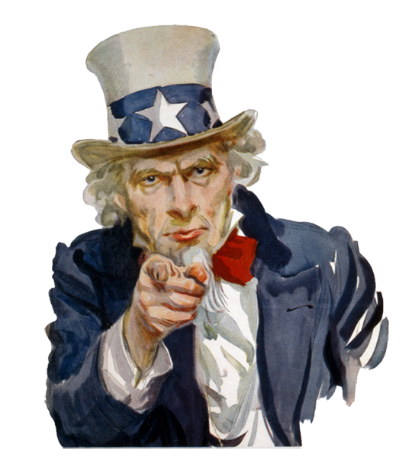
2020 Presidential Primary Election Tuesday, March 3, 2020

Slide 11
2020 Presidential Primary Timeline
January 17- 4024 UOCAVA Ballots Sent
Ballots Returned as of 1-27-2020
54 Total
February 3 - Last day for voters who are affiliated with a political party to change or withdraw their affiliation if they wish to vote in a different party's primary election
February 4 – Logic and Accuracy Test on Election equipment
February 10 - Ballots Mailed
34 Secure 24-Hour Ballot Boxes open

Slide 12
2020 Presidential Primary Timeline
February 18- Citizens Service Center VSPC (Voter Service and Polling Center) open
February 24 – Clerk’s branch offices and UCCS VSPC Open
February 24 -Recommended last day to return ballots by USPS, and have a ballot mailed
March 2 –All VSPCs open
Clerk’s branch locations
UCCS
PPCC (both campuses)
Town of Monument
Fountain Library
Victory World Outreach
March 3 – Election Day, Ballots must be received by 7 p.m.

Slide 13
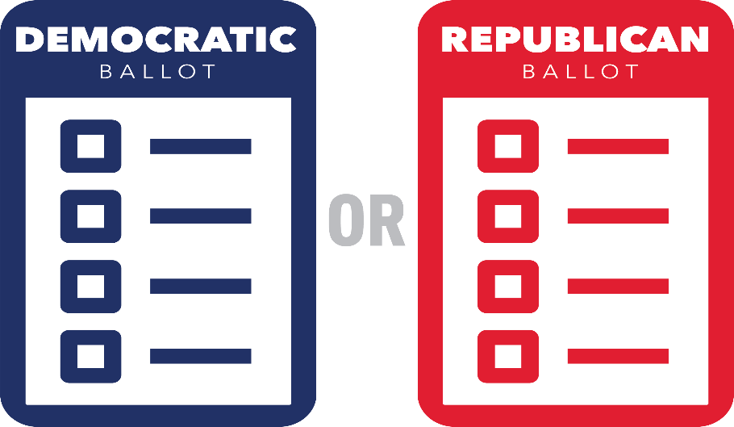
Unaffiliated Voters
Unaffiliated voters are eligible to vote in primary elections.
For each primary, if you are unaffiliated, you will receive a mail ballot packet with a Democratic Party ballot and a Republican Party ballot. You may vote only one ballot.
As an alternative, you may choose a major political party preference to receive only one party’s ballot. Choosing a party preference does not affiliate you with that party. Your status remains unaffiliated. Party Preference Deadline is February 3, 2020.

Slide 14
Legislative Update
HB20-1081 Multilingual Ballot Access
Provide notice of hotline electors through election day
Ensures translators who provide translations are qualified
Minority language is spoken by at least 2,000 citizens in the county
Minority language spoken by at least 2.5% of citizens
Sample ballots must be in Spanish for general elections
Impact 18 Colorado Counties (4 Counties already have Multilanguage ballots)
Fiscal Impact- $2,268,919

Slide 15
Legislative Update
HB20-1073 Drawing of Voting Districts by County Governments
Specifies commissions consist of:
7 members
2 of whom must be with the state’s largest political party
2 with state’s 2nd largest political party
3 of whom not registered with any political party
Requires the commissions to provide the opportunity for public involvement, including multiple hearings, the ability to propose maps, and to testify at commission hearings
Establishes prioritized factors for the commissions to use in drawing districts, including federal requirements, the preservation of communities of interest and political subdivisions, and maximizing the number of competitive districts

Slide 16
Legislative Update
HB20-1132 County Reimbursement For Local Elections Supplies
Concerning county reimbursements for election supplies from the local elections assistance cash fund
The bill expands the types of election equipment and supplies for which counties can be reimbursed from the local elections assistance cash fund. It also allows counties to be reimbursed for the incremental increase in costs to lease that equipment, in addition to purchases of equipment that are currently eligible for reimbursement

Slide 17
Legislative Update
HB20-1149 16 Year Old's in School District Elections
The bill allows a person who is preregistered to vote in school district elections beginning at 16 years of age
A school district election is defined as an election to recall a school district officer
The state board of education;
School district officers;
Referred measures to impose or increase mill levies or to raise and expend property taxes;
Referred measures relating to the organization of or plan of representation for school districts; and
Referred measures related to the financial obligations and indebtedness of school districts

Slide 18
KUDOS
Election Assistance Commission - 2019 CLEARING HOUSE “CLEARIE” AWARD Recipient
An innovative program was developed in 2019 to improve and enhance this component of the election process and created a video classroom for our Election Judge training
Clerk and Recorder’s staff members working on the project were:
Kristi Ridlen, PIO, Clerk and Recorder’s Office
Angie Leath, Elections Director
Greg Chandler, Elections Specialist
Rebecca Roberson, Voter Outreach & VSPC Coordinator
El Paso County staff Members:
Blake Nielsen, Public Communications Office
Joe Yates, Audio/Visual Technical Supervisor
Christian Wright, Public Communications/ Audio/Visual Department
Nancy Nelsen, Public Communications/ Audio/Visual Department

Slide 19
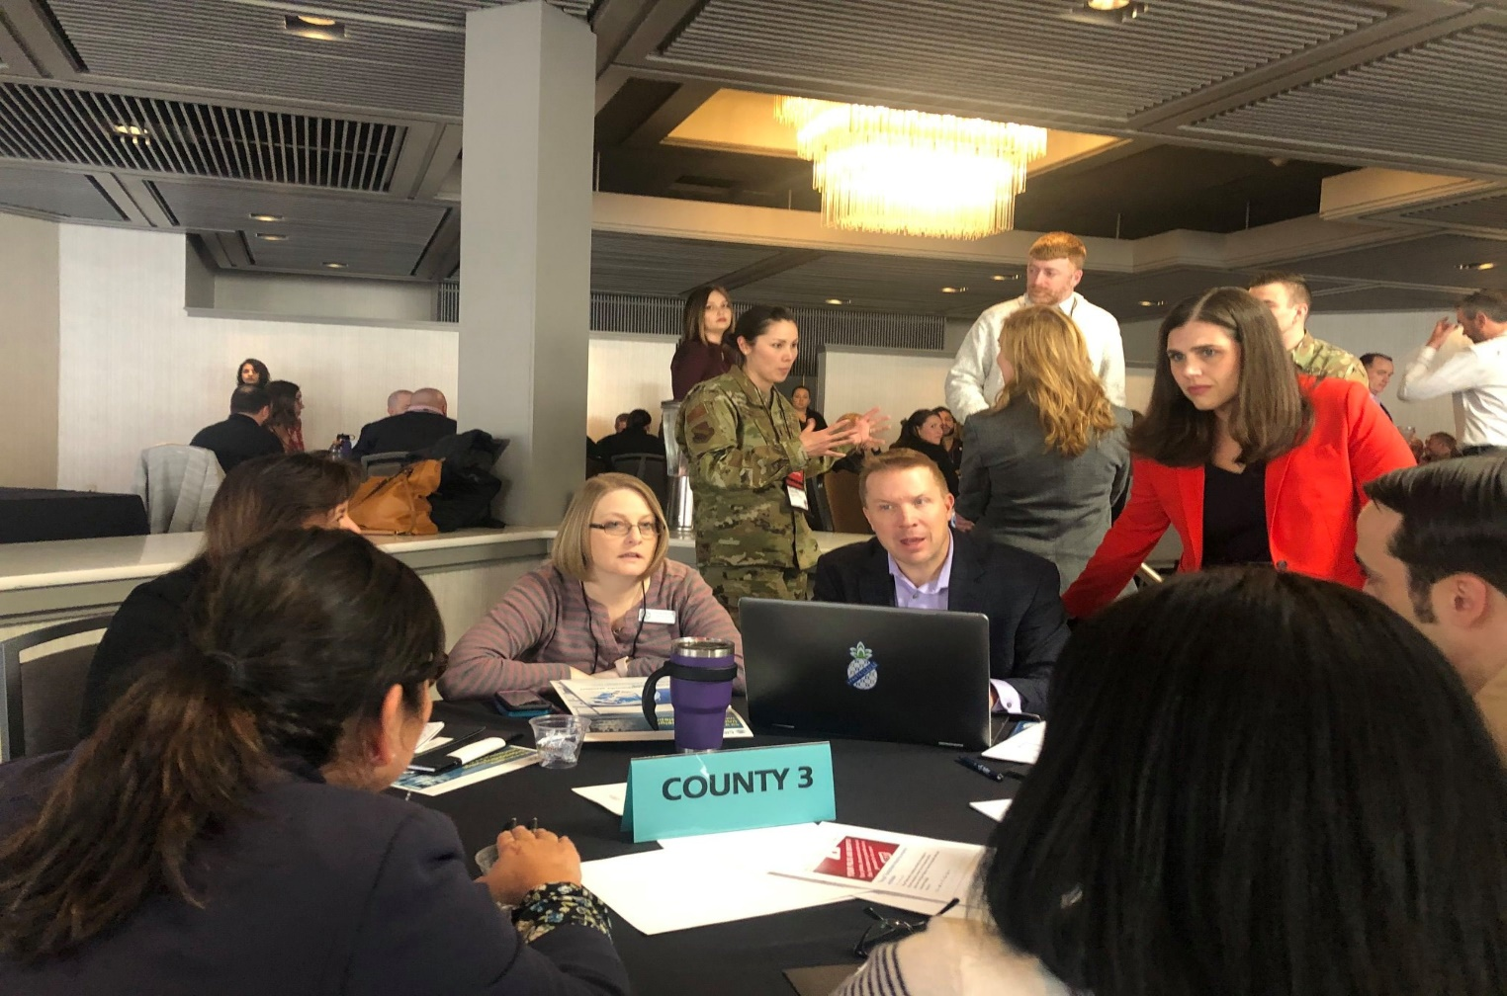
EPIC 2020

Slide 20
Questions?
Election Information:
www.epcvotes.com
719-575-VOTE (8683)

