Slide 1
Revocation of A Variance of Use gabe sevigny Mindy madden
Mountain Splendor Services
VA-17-010

Slide 2
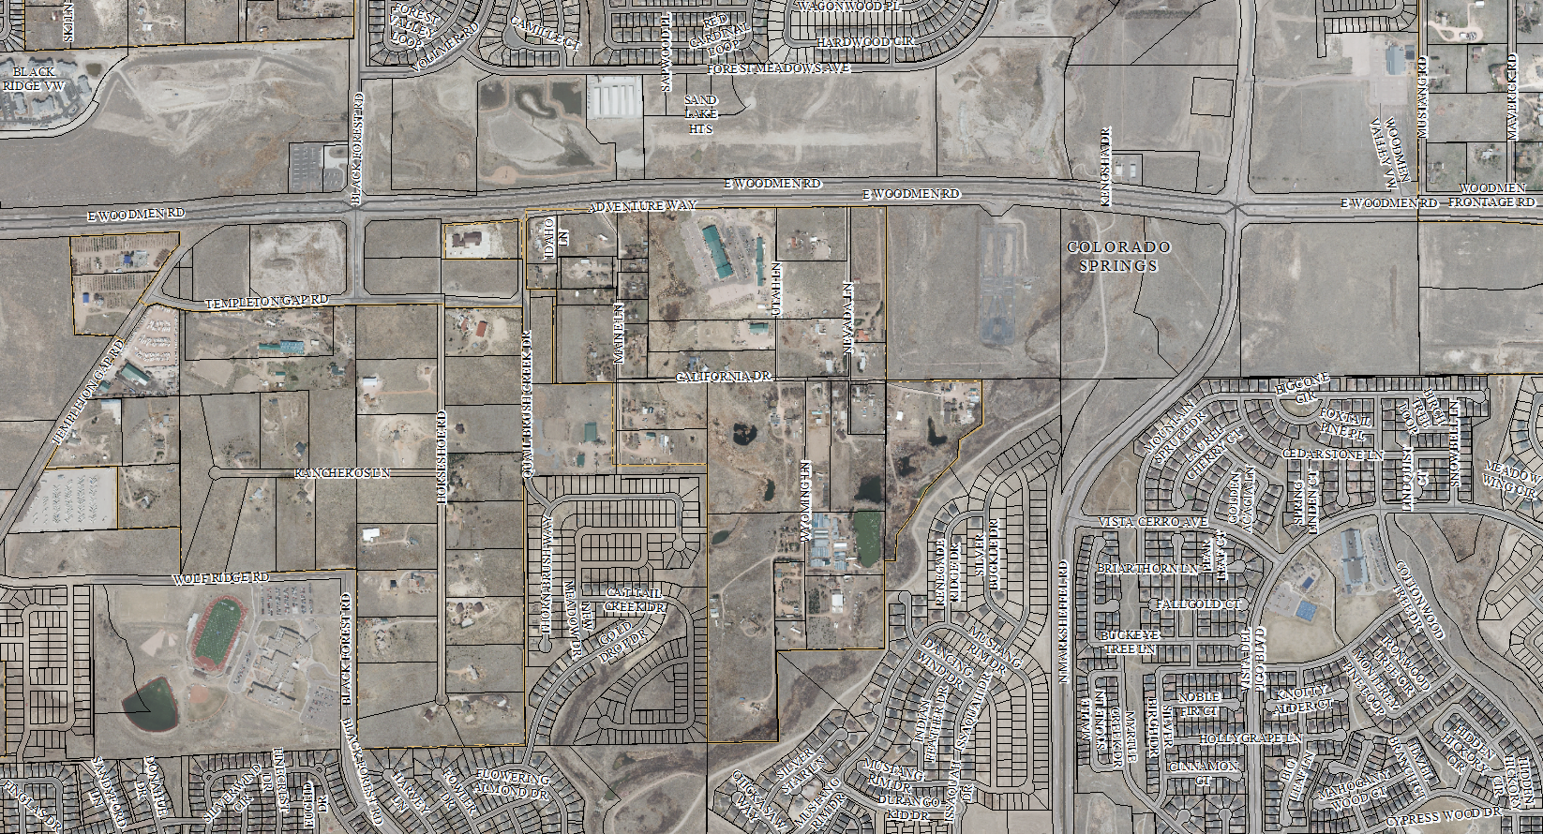
Vicinity Map
X

Slide 3
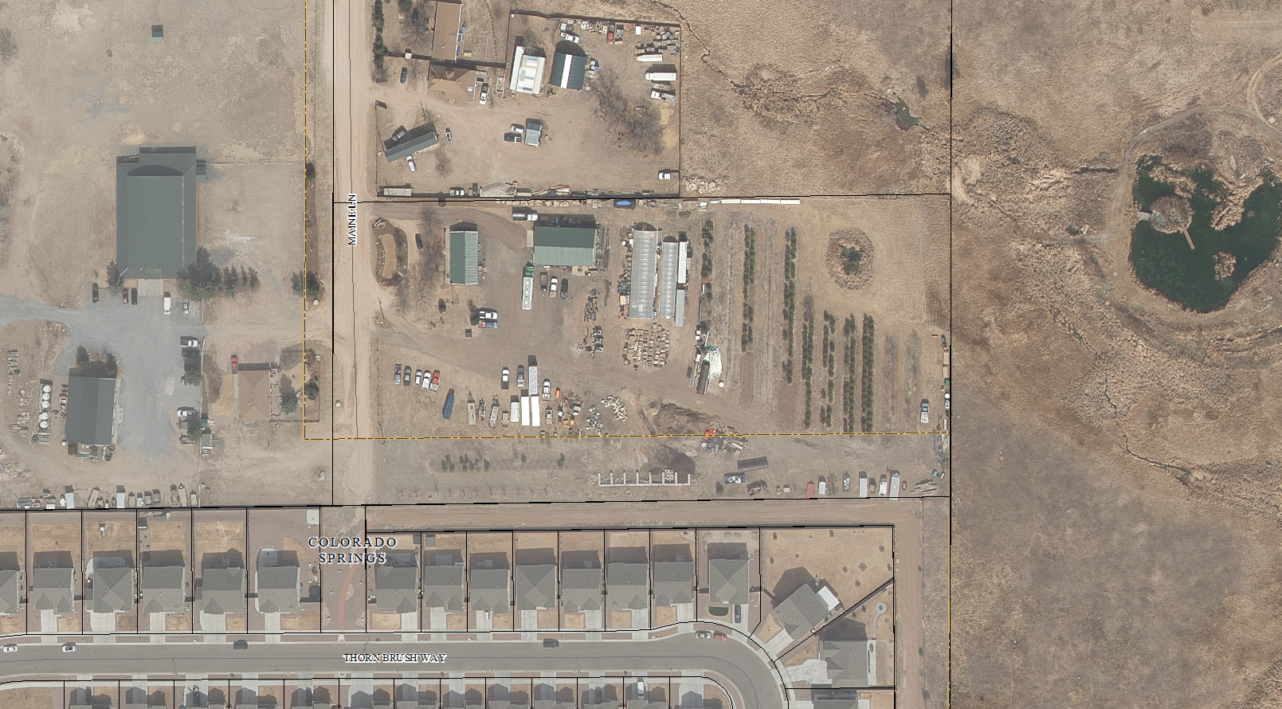
Aerial map

Slide 4
Mountain splendor services, inc
Property Owner: Daniel Combs
Property address: 7205 Maine Lane
(Parcel No. 53080-00-048)
Zoned A-5 (Agricultural)
Daniel Combs received approval on February 27, 2018, for a variance of use (VA-17-010) to allow for a contractor’s equipment yard, Mountain Splendor Services, in the A-5 zoning district.
Six (6) Conditions of Approval
Three (3) Notations

Slide 5
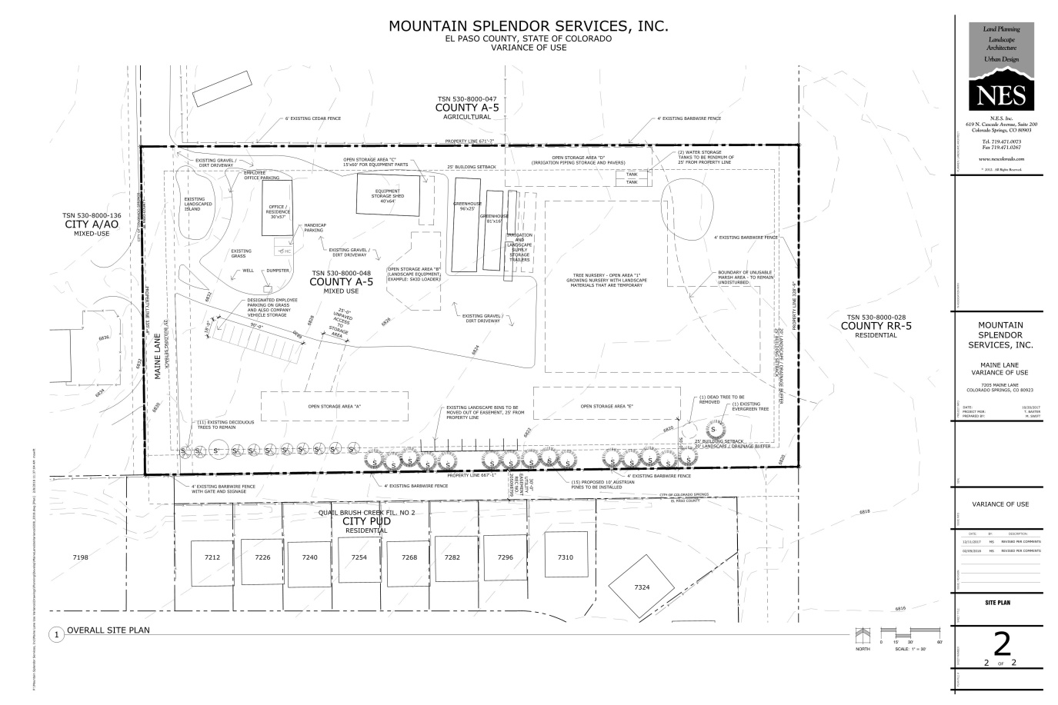
VA-17-005

Slide 6
VA-17-010 Violation of Conditions of Approval
Within 60 days from the date of approval, the applicant shall submit a site development plan for review and approval by the Planning and Community Development Department. The site development plan shall provide a detailed depiction of existing and proposed structures and improved surfaces associated with the approved variance of use permit.
A Site Development Plan was approved on 9/27/18 satisfying this condition.
Within 60 days from the date of approval, the applicant shall submit all necessary applications for building permitting for each structure located on this property to Pikes Peak Regional Building Department.
To date, no building permits have been issued. Incomplete plans were submitted to PPRBD on 8/8/19 and disapproved on 8/12/19.

Slide 7
Enforcement Action
Previous Enforcement Action
A Notice of Violation was sent in April 2017 after a complaint was received on a landscaping business operating without zoning approval.
Early Assistance meeting held in August 2017
Submittal for a variance of use received in November 2017
Variance of use approved in February 2018
Current Enforcement Action
A Notice of Violation was issued on May 30, 2019 after a complaint was received that the property owner was in violation of conditions of approval and the approved site development plan.
An Executive Determination was issued on June 17, 2019. A request for an appeal was not received.

Slide 8
Revocation authorization
Land Development Code Section 5.3.4(G)
The violation of any applicable requirement or standard of this Code, or of any condition, safeguard or commitments of record of the variance of use permit shall constitute sufficient grounds for suspension or revocation of the variance of use permit by the BoCC, subject to the requirements of Chapter 11.
Resolution No. 18-079, Notation #2
The Board of County Commissioners may consider revocation and/or suspension if zoning regulations and/or Variance of Use conditions/standards are being violated, preceded by notice and public hearing.

Slide 9
options
1. Revoke the variance of use approval (VA-17-010) and
Discontinue the prohibited use and/or;
Deadline?
Submit a new application for a variance of use
Deadline to submit complete application and payment by?
2. Deny the request to revoke variance of use approval (VA-17-010) and provide additional time to comply with condition of approval #2.
Deadline?

Slide 10
Questions?

