Slide 1
Retreat Metropolitan District 1-2
ID-17-002

Slide 2
Mandatory Criteria for Disapproval
The BoCC shall disapprove the draft service plan unless evidence satisfactory to it of each of the following is presented or, in the BoCC ' s discretion, the BoCC conditionally approves the draft service plan to cause compliance with these criteria (C.R.S. § 32-1-203(2)):
There is sufficient existing and projected need for organized service in the area to be served by the proposed special district;
The existing service in the area to be served by the proposed special district is inadequate for present and projected needs;
The proposed special district is capable of providing economical and sufficient service to the area within its proposed boundaries;
The area to be included in the proposed special district has, or will have, the financial ability to discharge the proposed indebtedness on a reasonable basis.

Slide 3
Discretionary Criteria for Disapproval
The BoCC may disapprove the draft service plan if evidence of the following, at the BoCC ' s discretion, is not presented (C.R.S. § 32-1-203(2.5)):
Adequate service is not, or will not be, available to the area through the County or other existing municipal or quasi-municipal corporations, including existing special districts, within a reasonable time and on a comparable basis;
The facility and service standards of the proposed special district are compatible with the facility and service standards of each County within which the proposed special district is to be located and each municipality which is an interested party as defined in C.R.S. § 32-1-204 and this Code;
The proposal is in substantial compliance with the El Paso County Master Plan;
The proposal is in compliance with any duly adopted County regional, or State long-range water quality management plan for the area; or
The creation of the proposed special district will be in the best interests of the area proposed to be served.

Slide 4
Applicant
Applicants:
TimberRidge Development Group, LLC
TimberRidge Estates, LLC
Representative:
Spencer Fane, LLP

Slide 5
Request
Request for approval of a Colorado Revised Statute Title 32 Multiple Special District service plan for Retreat Metropolitan Districts Nos. 1 and 2.
The applicant is proposing the following:
a maximum debt authorization of $14.5 million
a debt service mill levy of 50 mills
an operations and maintenance mill levy of 10 mills
5 mills for covenant enforcement
a maximum combined mill levy of 65 mills
The statutory purposes of the proposed Districts include:
water and sewage disposal services
street improvements, transportation and safety protection
design, construction, and maintenance of drainage facilities
design, acquisition of land, construction, and maintenance of recreation facilities
mosquito control
covenant enforcement
television relay and translation
security services

Slide 6
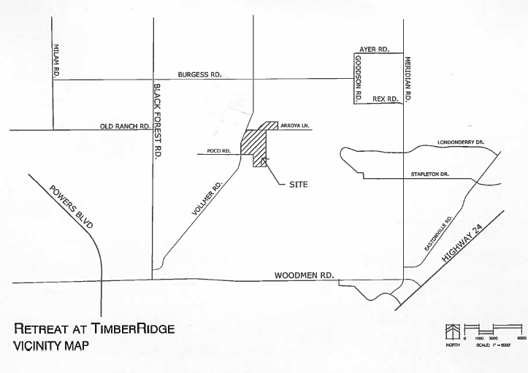
Proposed District Boundary (227 acres)

Slide 7
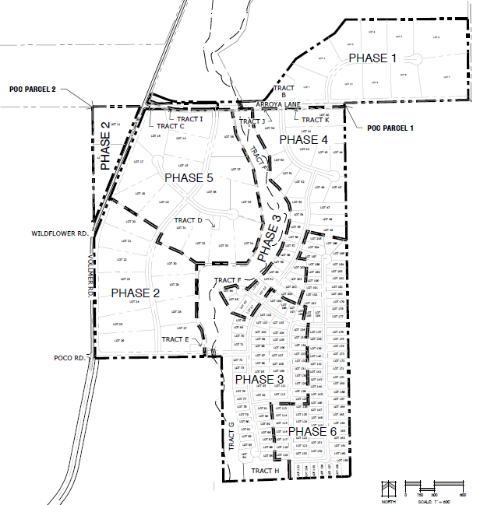
Retreat at TimberRidge Preliminary Plan
A Planned Unit Development rezoning for the Retreat at TimberRidge PUD development Plan (PUD-17-003) was approved by the Board of County Commissioners on March 27, 2018.
The 234 acre Retreat at TimberRidge preliminary plan (SP-18-002), which included :
205 single-family lots, 27.17 acres of right of way, and 10 open-space, trail corridor, detention, and utilities tracts totaling 27.58 acres was approved by the Board of County Commissioners on October 23, 2018.

Slide 8
Existing Mill Levies
El Paso County 7.738
El Paso County Road and Bridge .330
School District No. 20 or 60.216
School District No. 49 43.044
Pikes Peak Library District 4.000
Black Forest Fire Protection District 10.052
EXISTING TOTAL: D-20 82.336
D-49 65.164
Proposed Retreat Mill Levy 65.000
PROPOSED NEW DISTRICT TOTAL: D-20 147.336
D-49 130.164

Slide 9
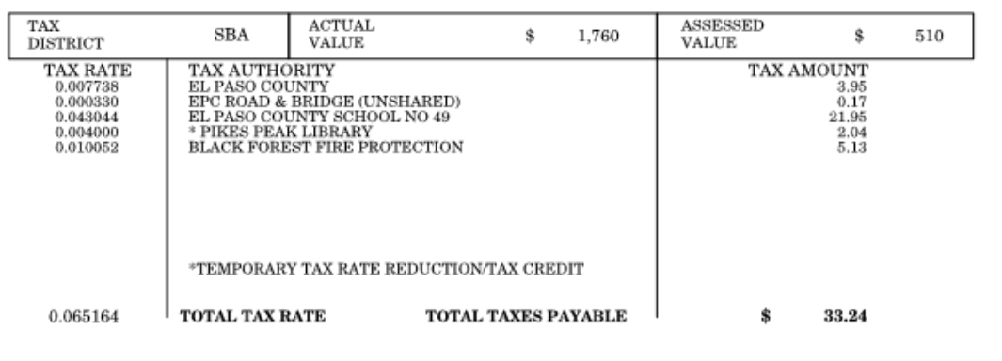
What does that equate to… mill = 1000th of a cent
.065 Retreat Metro District $33.15
New Total $66.39

Slide 10
Staff Analysis
District No. 1 is the Control District
Includes property owned by the Districts; directs the activities of the Districts
District No. 2 includes residential development, generates tax revenue to fund improvements, operations & maintenance
Financial Plan
193 homes
3 year absorption (2020-2023)
Average cost- $675,000
Standard Conditions & Notations are recommended
Standard Disclosure will be required
Exhibit to service plan
Will be required with subsequent plats
Updates required annually thereafter
To be posted on County web site

Slide 11
Questions?

