Slide 1
Motor Vehicle Update
Chuck Broerman,
El Paso County Clerk and Recorder
July 30, 2019

Slide 3
MVExpress Kiosk Locations
95,581 transactions since inception
30,000 Views on Kiosk Video
Coming soon – two additional locations
Partnership with King Soopers
Stetson Hills and Powers
Academy and Hancock

Slide 4
Title Backlog Two hailstorms-DRIVES implementation

Slide 5
Total Fees Collected YTD 2010-19

Slide 6
Dealer Desk Wait Times

Slide 7
Express Wait Times

Slide 8
Driver’s License Wait Times

Slide 9
Title Wait Times

Slide 10
Military Wait Times

Slide 11
Fort Carson Total Transactions

Slide 12
Saturday Office-Union Town Center

Slide 13
Saturday Wait Times

Slide 14
Elections Update

Slide 15
Elections
Acquisition of 16 additional mail ballot drop boxes and 4 VSPC locations
Possible Governor Recall – Cost $4.00 per Voter
Possible recall in Senate District 11 on Senator Pete Lee - Cost $4.00 per Voter
Petitions approved by the Secretary of State
60 days to collect signatures-September 10
Total number of signatures needed-11,304
Recall Election Date set by the Governor

Slide 16
Entities Coordinating in November
 | TABOR | Candidate | Question
City of Manitou Springs | 1 | X | 1
Town of Palmer Lake | 1 possibly more
City of COS | 1 |  | 3
City of Fountain | 1 | X
Peyton Fire | 2
Hanover Fire | 1
Stratmoor Hills Water | 1
Stratmoor Hills Sanitation | 1
Stratmoor Hills Fire Protection Dist. | 1
Tri-Lakes/Monument Fire Protection Dist. |  |  | 1

Slide 17
School District | Candidate | TABOR
Calhan Dist. RJ-1 | X | 1
Miami Yoder Dist. JT-60 | X | 1
Lewis Palmer Dist. 38 | X | 1
Big Sandy 100J | X
Cheyenne Mountain Dist. 12 | X
Edison School Dist. 54 | X
Ellicott School Dist. 22 | X
Ftn/FT. Carson School Dist. 8 | X
El Paso County School Dist. 49 | X
Manitou Springs Dist. 14 | X
Hanover School Dist. 28 | X
Widefield School Dist. 3 | X
RE-2 Fremont/Florence | X
Academy School Dist. 20 | X
Peyton School Dist. 23 | X
Harrison School Dist. 2 | X
COS School Dist. 11 | X

Slide 18
2019 Statewide Initiatives
Proposition CC
Retain revenue for education and transportation
Proposition DD
Authorize and tax sports betting

Slide 19
Election Timeline
Coordinated Election-November 5, 2019
August 27, 2019
Last day for participating jurisdictions to return IGA.
UOCAVA Ballots Sent
Friday, September 20
Logic & Accuracy Test
First week in October
Ballots Mailed
October 11, 2019
Voter Service and Polling Centers
Phase 1- October 13,2019 (Citizens Service Center)
Phase 2- October 28, 2019 (4 Clerk branch locations)
Phase 3-November 4, 2019 (Town of Monument and Victory World Outreach)
Risk Limiting Audit
November 15, last day for SOS to notify counties of the ballots selected for audit (by 11:59 pm)
2020 Elections
Presidential Primary-March 3, 2020
Primary – June 30, 2020
Presidential General Election- November 3, 2020
Four Elections in 12 month span

Slide 20
Office Challenges
Motor Vehicle recruitment and retention
Election judge recruitment
www.epcjobs.info

Slide 21
Outreach
World Affairs Council
hosted a group from Africa to discuss elections and accessibility for voters with disabilities
Peak Military Care Network
Partnership discussion in support of military personnel & their families for Motor Vehicle and Elections needs
El Paso County Democratic Party
Election Planning
UCCS and Pikes Peak Community College
Election Planning – implementation of VSPC on Campus
Voter Drives at MV Branch Offices
City of Colorado Springs
Tour of potential secure 24-hour boxes (16)

Slide 22
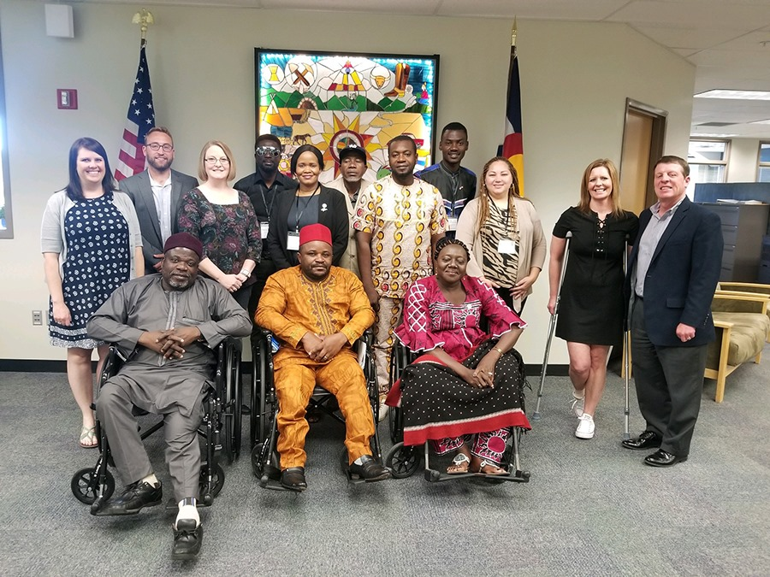
Outreach
- World Affairs Council

Slide 23
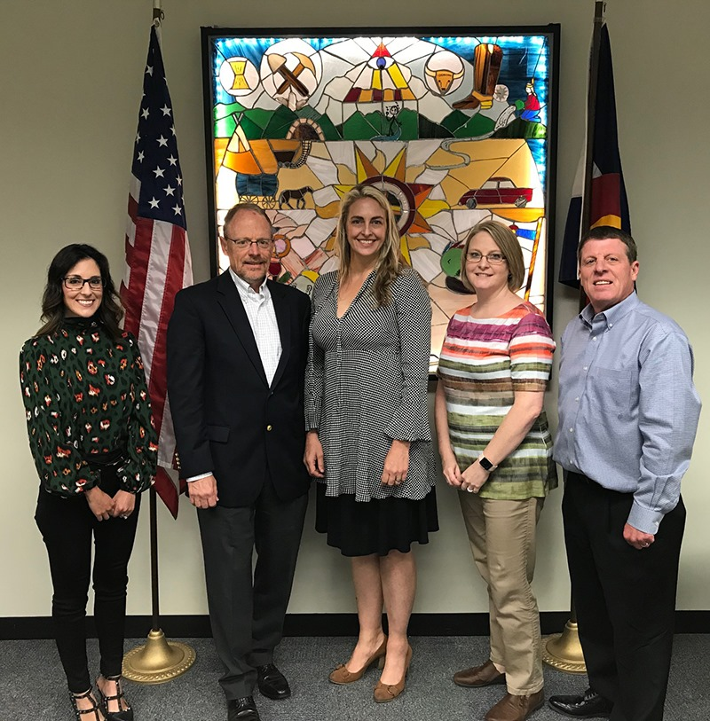
Outreach
- El Paso County Democratic Party

Slide 24
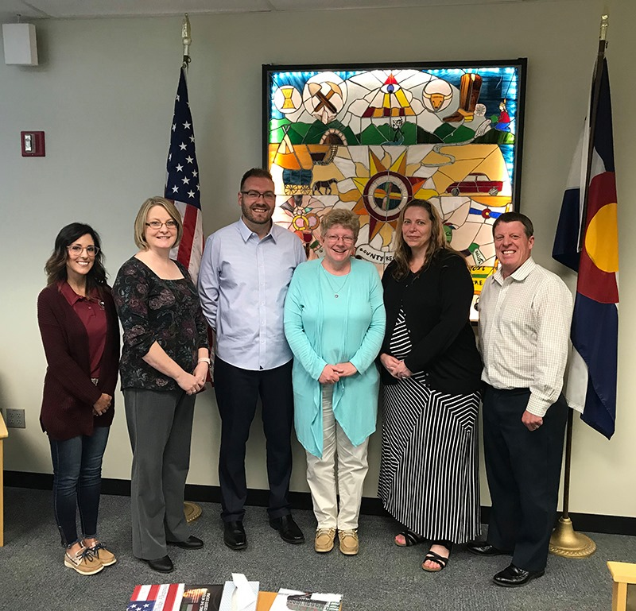
Outreach
- Peak Military Care Network

Slide 25
Questions ?

