Slide 1
Winning in Colorado Springs & El Paso County:
A transformative strategy for positive change
July 30, 2019

Slide 2
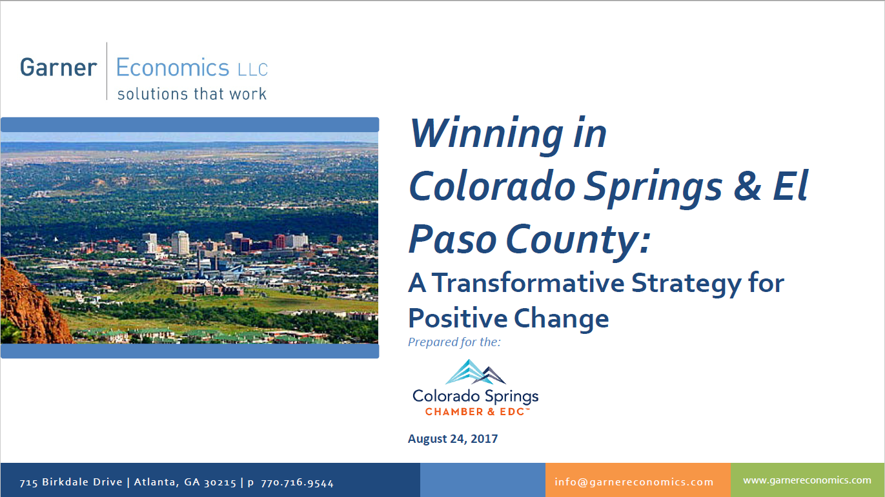
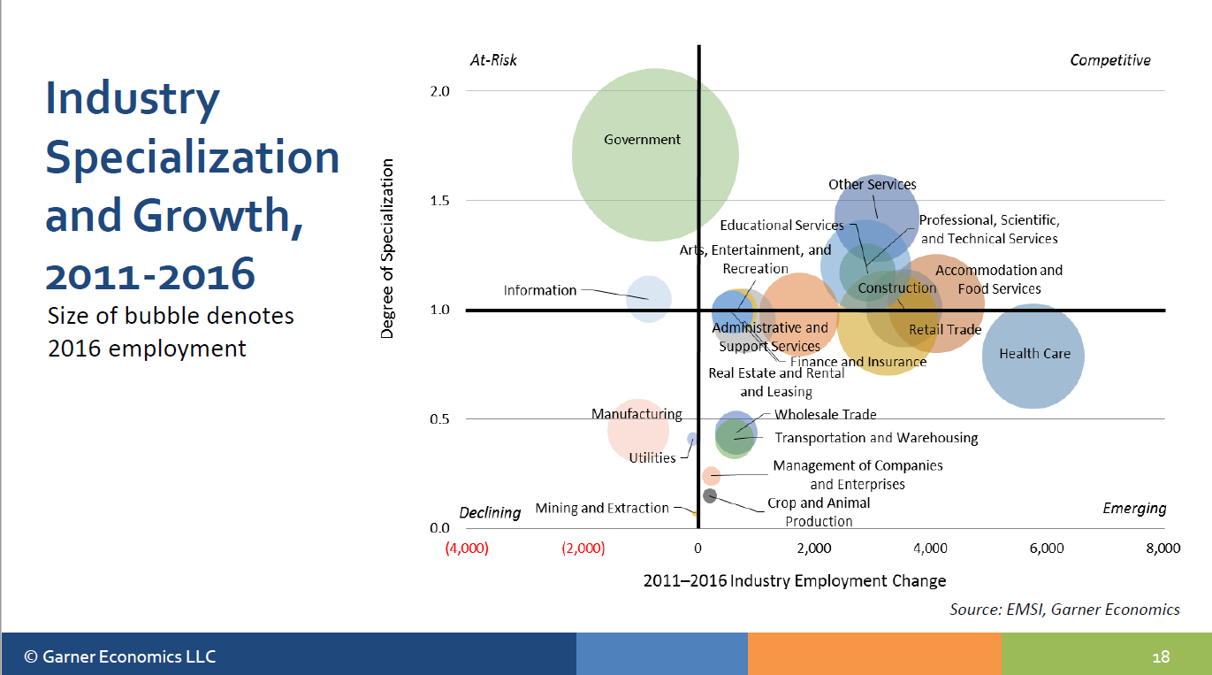
Economic Development: Strategic Plan
National site selector hired for plan
Benchmark cities
  Boise, Reno, Phoenix, Salt Lake City,
  Colorado and U.S.
Completed in late 2017
Five-year strategy
Notes:
County helped fund the plan, and we are grateful for support
Today describe status and describe progress toward recommendations

Slide 3
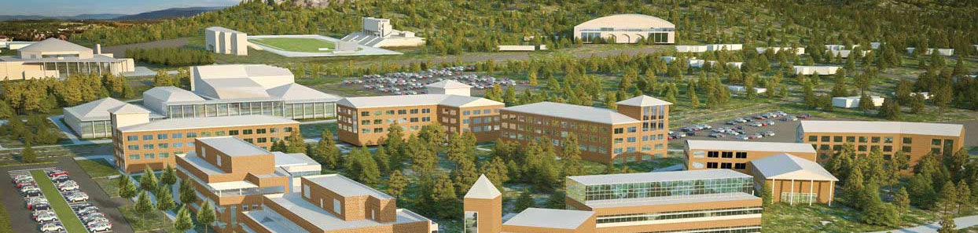
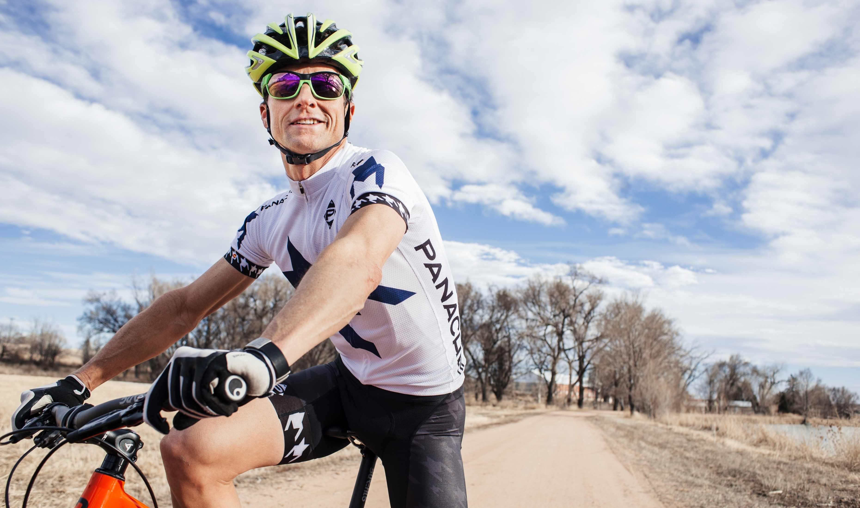

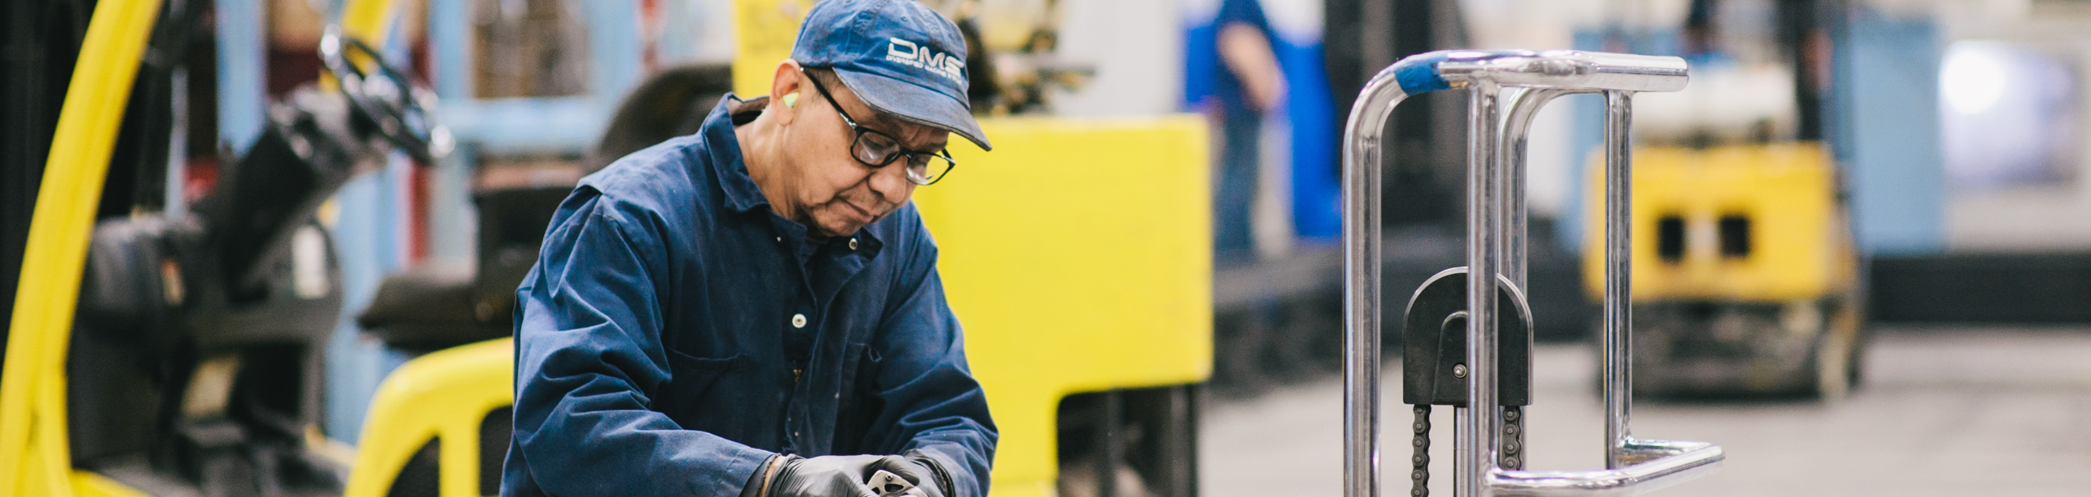
Target Industry Groups
Sports Medicine & Related Health Services
+
Professional, Scientific & Technical Services
The Experience Economy
Aviation & Specialty Manufacturing
Notes:
Based on the site-specific characteristics of Colorado Springs and El Paso County – the intersection of desirability / feasiblity
Three core industry targets chosen based on best match with unique competitive advantages of the region
Broad groups, based on NAICS codes
Sports – med equipment, physicians offices, Hybl Sports Medicine at Performance Center
Professional – cyber, aerospace, software development,
data centers
Aviation – Aircraft manufacturing, electronic mfg,
small arms mfg
Experience – hospitality, outdoor rec, retail

Slide 4
10 Recommendations to Leverage Success
Execute effectively
  Enhance marketing budget and staff
  Create a workforce alliance leadership group
  Conduct community benchmarking visits
Tell the story
  Implement marketing blueprint
  Enhance additional tools and tactics
Enhance the product
  Sustainably fund catalytic programs for economic development infrastructure
  Establish a deal-closing fund
  Develop a real estate portfolio for manufacturing
  Grow the talent pipeline
  Support entrepreneurship in El Paso County
Execute Effectively
Tell the Story
Enhance the Product
Notes:
Report contained 10 recommendations to implement in 5 years
Today’s presentation share progress made toward those 10

Slide 5
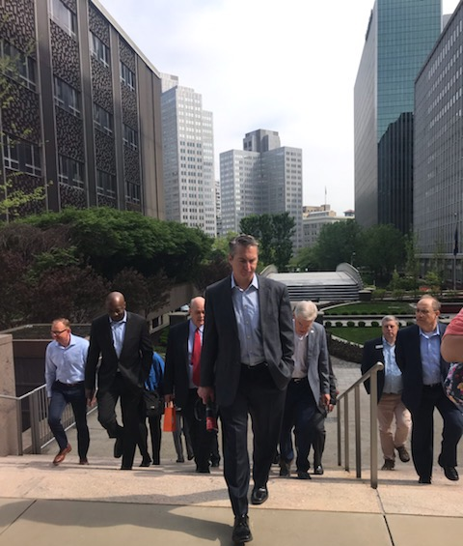



Execute Effectively
LART Funding Increase
+
2019 Regional Leaders Trip: Pittsburgh
Execute Effectively
Tell the Story
Enhance the Product
Notes:
Three goals under Execute Effectively
Enhance Marketing Budget and Staff. Increased LART was major step toward this goal. Allowed us to retain DCI and Magneti, double marketing staff to two. Increase from $25,000 in 2017 to $300,000 last two years.
Create a workforce alliance – WAT, PP Workforce Center, Business & Education Alliance. Major concern for employers.
Community benchmarking trips for past 11yrs
2019 – Pittsburgh: Tech, AI, autonomous vehicles, universities
2018 – Boise: Tech, culture, downtown, regionalism

Slide 6


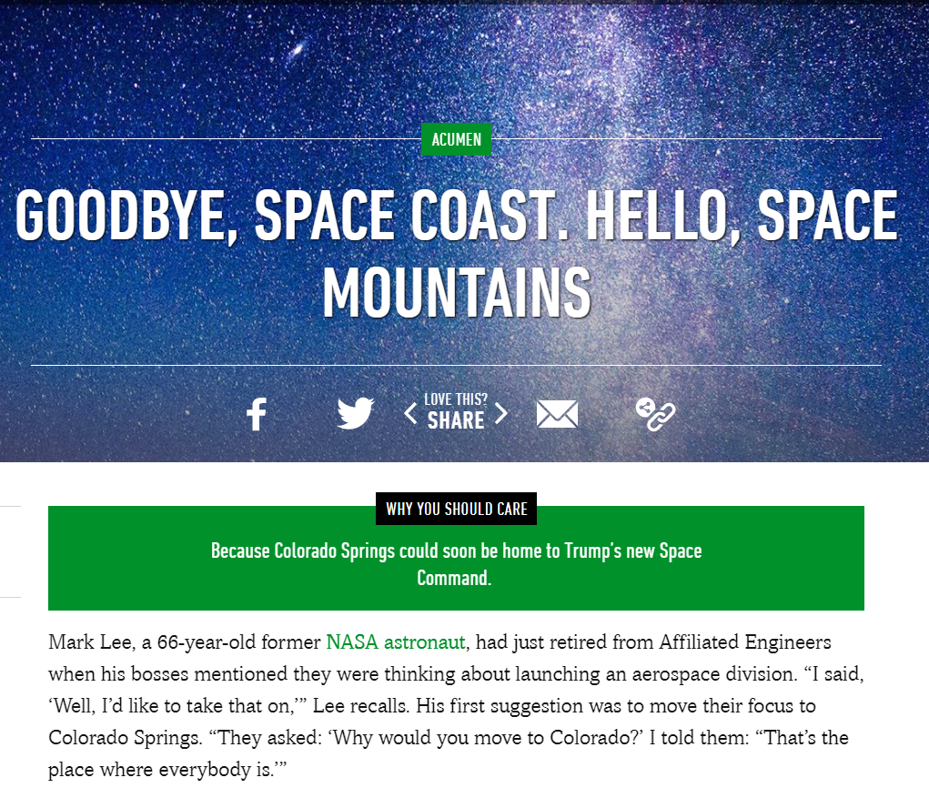
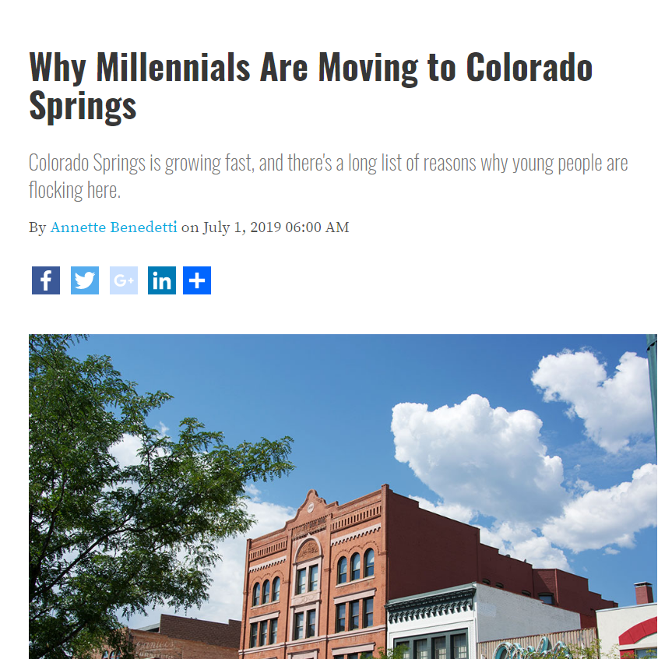
Implement Marketing Blueprint
Execute Effectively
Tell the Story
Enhance the Product
Notes:
Marketing Blueprint developed by DCI in 2017
The OZY and Livability placements have earned 7.5M impressions and an ad equivalency value of $70K as of June 30.
When potential businesses and workers are researching a new place to move, these headlines are important in shaping the perception of what it’s like to live and do business in Colorado Springs.
TOTAL since 2017 thru JUNE 30, 2019: 30 placements in national and Front Range media, 104M impressions, $530K ad equivalency

Slide 7


Implement Marketing Blueprint: 2019 Metrics
 |  |  |  |  |  |  |  |  | 2019 Goal
1 | 2 | 3 | 4 | 5 | 6 | 7 | 8 | 9 | 10
28M impressions
$
Execute Effectively
Tell the Story
Enhance the Product
167K ad equivalency
Notes:
Earned media value
Hosted journalists to visit city
3rd party authenticity
We have had 7 placements thru June 30, 2019.
Inc. magazine, Hemispheres on United Airlines
Metrics: 28M impressions and an equivalency value $167K.

Slide 8
Enhance Marketing Tools, Tactics
Conduct in-market sales missions
Create outreach between hotels and executives staying as guests
Execute a process for lead generation and business target profiling with the targeted companies
Create a cadre of Economic Development Ambassadors to extend the region’s brand
Execute Effectively
Tell the Story
Enhance the Product
Notes:
4 activities recommended
Sales missions – staff to Bay Area and Dallas for marketing with OEDIT, Airport staff
Hotel outreach – Broadmoor just approved this week
Work to do on the others

Slide 9
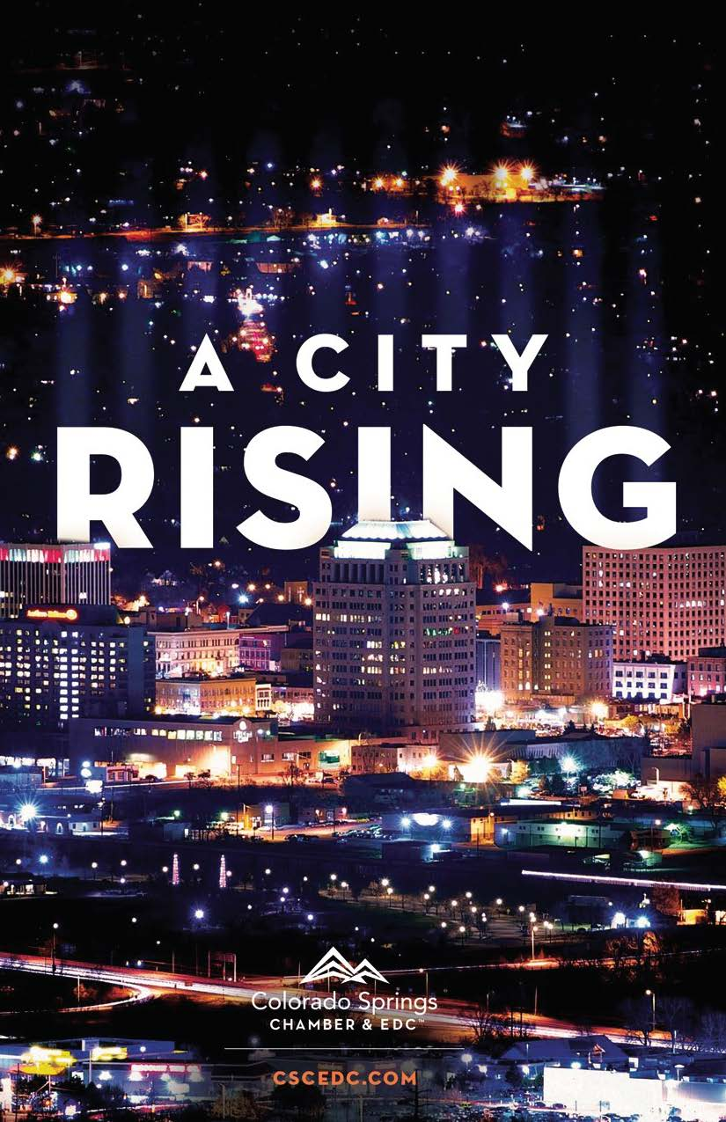
Sustainably Fund Catalytic ED Programs
Board Funding Initiative raised $700,000
sustainable new funding in 2018
Recommendation to pursue funding from sales tax deemed not feasible at present
Execute Effectively
Tell the Story
Enhance the Product

Slide 10
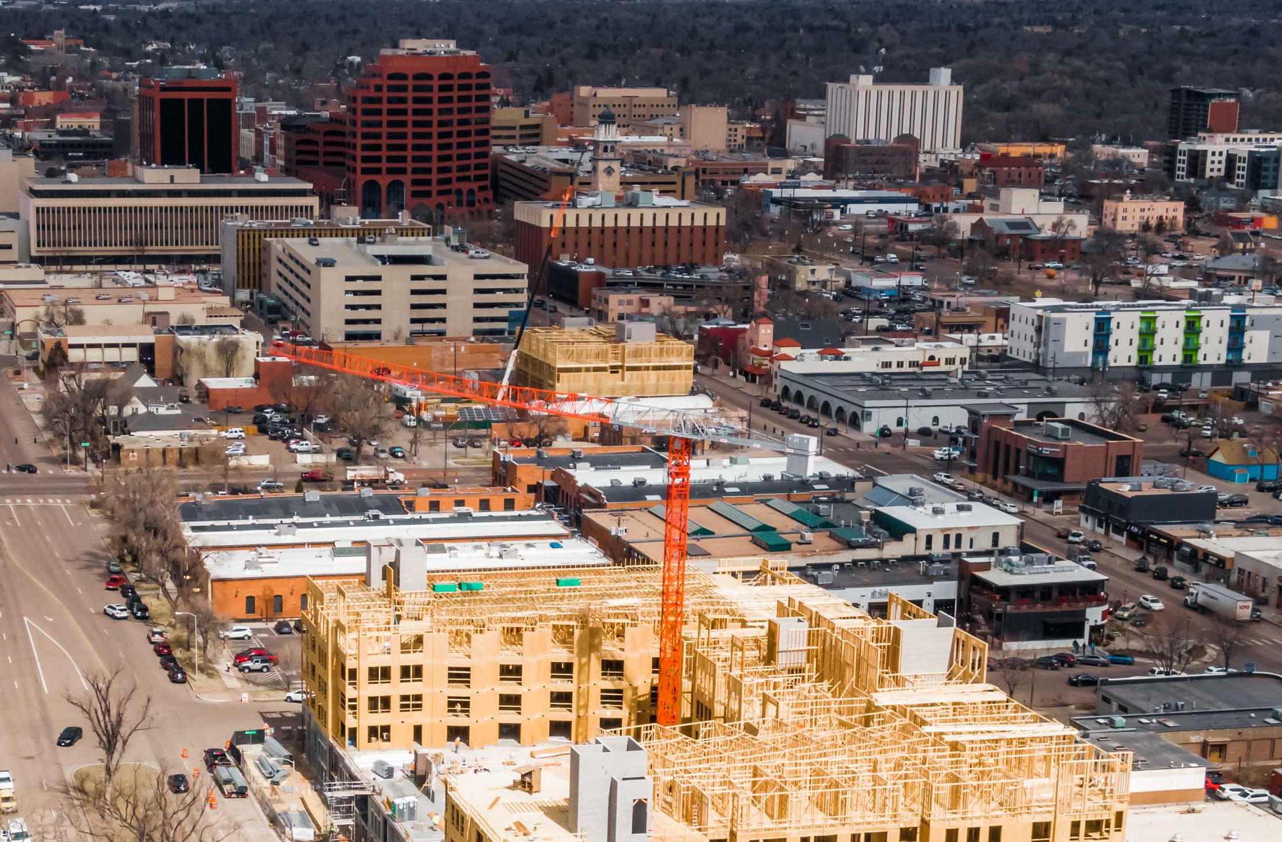
Establish a Deal Closing Fund
Task Force designed framework in December
  3-year Pilot Program P3
  Proposed $250,000 funding each for 3 years
  from Chamber/members, County, and City
Local control under Chamber & EDC 501(c)(3) Foundation
  Board to include County Commissioner
  and County Administrator
Metrics to ensure accountability
Continue meetings with County, City
Execute Effectively
Tell the Story
Enhance the Product
Notes:
Three-year pilot program
A public-private partnership between City, County, Chamber
Local control under Chamber & EDC 501c3 foundation
Work tabled for changes at County staff and City elections
Major initiative – goal to launch for operation in 2020.
Work to be done.

Slide 11
Develop R/E Portfolio for Manufacturing
Rail-served Industrial Yard would add to our industrial land offerings…
and provide Fort Carson with second rail access.
Execute Effectively
Tell the Story
Enhance the Product
Notes:
Approx 2,000 acres
P3 among County, City COS and Fountain, Utilities, Chamber & EDC, Edward C. Levy Co. (landowner)
Provide rail access for manufacturing, industrial businesses
Feasibility study, environmental analyses, concept plans. Just applied for $900K BUILD grant to advance engineering designs.

Slide 12
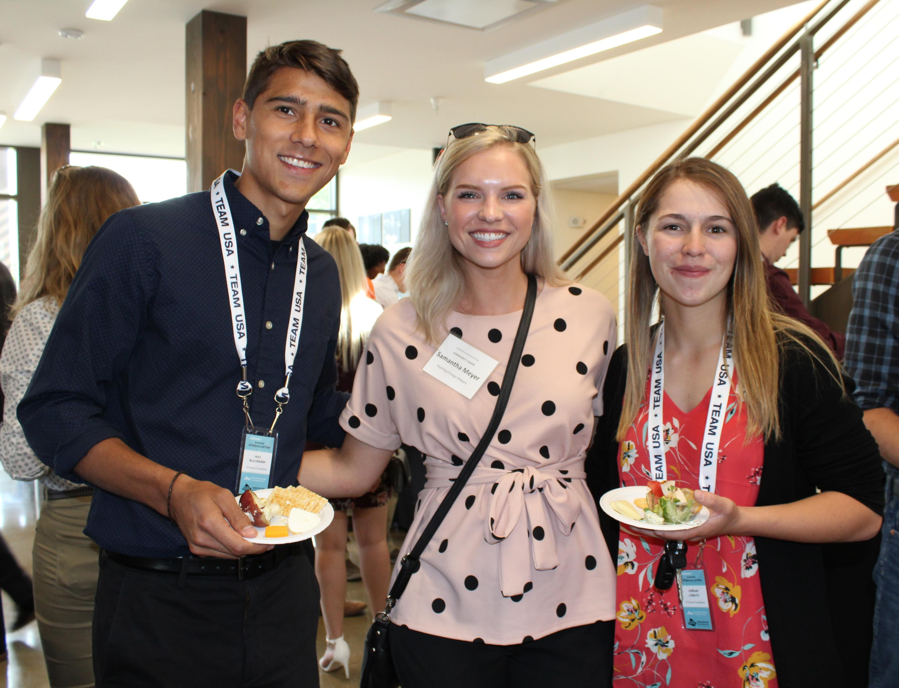
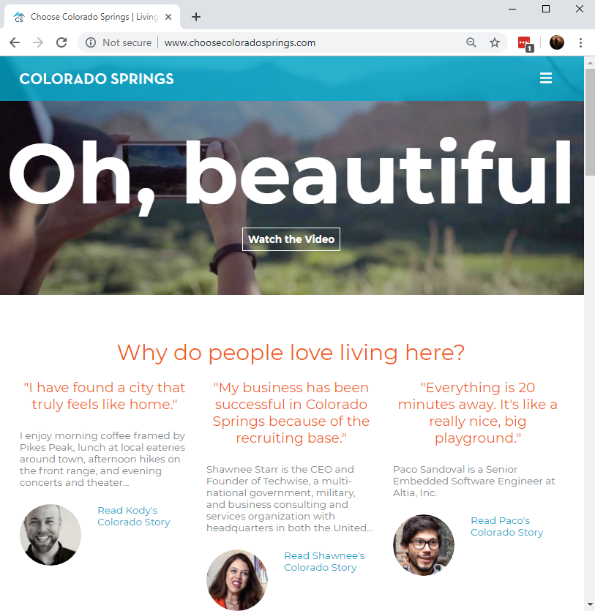
Grow the Talent Pipeline
Intern Welcome Event
  ChooseColoradoSprings.com
Execute Effectively
Tell the Story
Enhance the Product
Notes:
Talent top area of concern for employers
Includes promoting internships and apprenticeships

Slide 13




Support Entrepreneurship in El Paso County
Execute Effectively
Tell the Story
Enhance the Product
Notes:
In supporting entrepreneurship we work with other organizations whose sole focus is this group of businesses in our region.
Funding
Contribute expertise
Promoting programs and events
Identify / nominate businesses’ success

Slide 14
Recommendations to Leverage Success
Execute effectively
  Enhance marketing budget and staff
  Create a workforce alliance leadership group
  Conduct community benchmarking visits
Tell the story
  Implement marketing blueprint
  Enhance additional tools and tactics
Enhance the product
  Sustainably fund catalytic programs for economic development infrastructure
  Establish a deal-closing fund
  Develop a real estate portfolio for manufacturing
  Grow the talent pipeline
  Support entrepreneurship in El Paso County
Execute Effectively
Tell the Story
Enhance the Product

Slide 15
Winning in Colorado Springs & El Paso County:
A transformative strategy for positive change
July 30, 2019

Slide 16
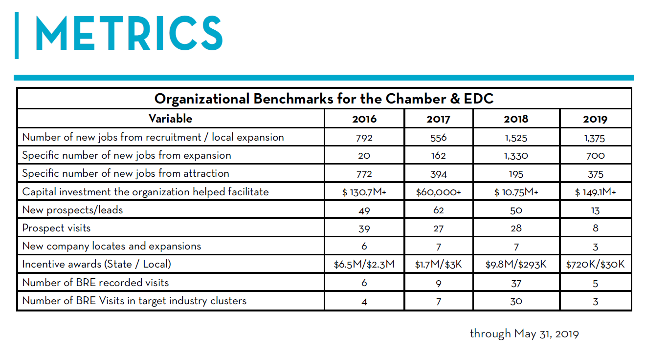
EXECUTE EFFECTIVELY

